Slide 1

Primet Primary School !
For the Easter Challenge could you design a new P.E kit!
Follow the power point to follow mission!

Slide 2


Slide 3
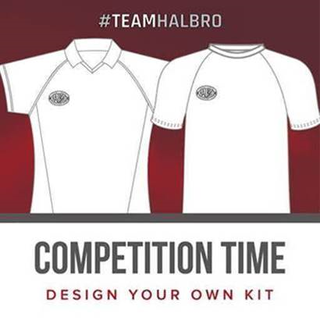
Primet Children!!!!!
Sit back and wait for the result!
Our winner will be selected on 1st May 2020 by Sam Ward, an English international field hockey player for England and the GB Olympic team.
Halbro Sportswear will then make your design a reality and make 20 shirts for your school!
Good luck!

Slide 4
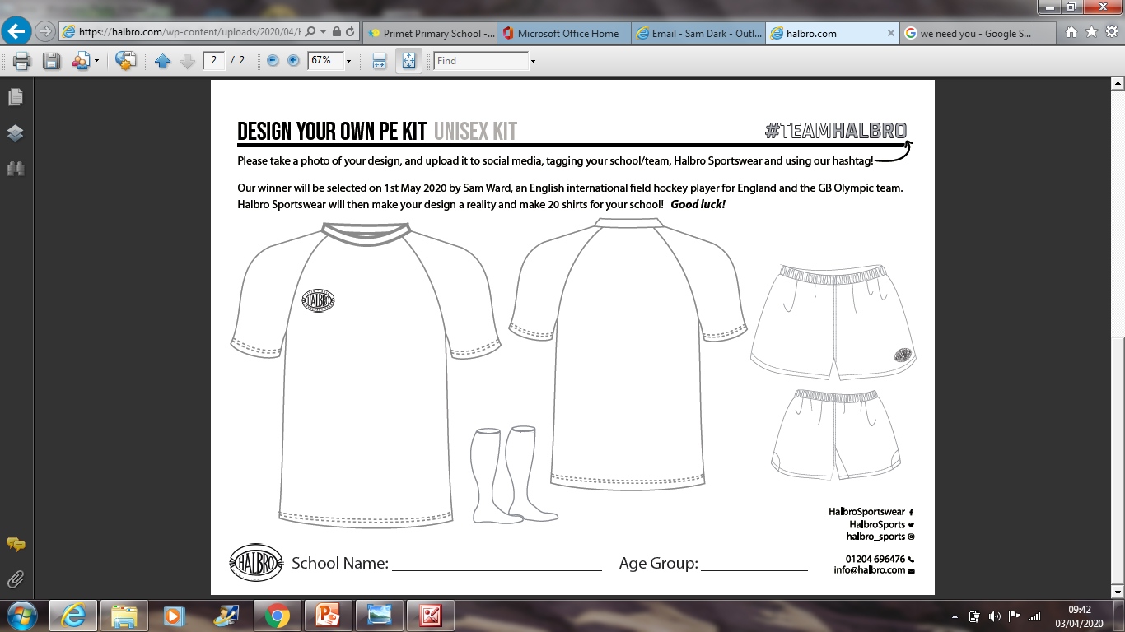
Hey Primet, copy the pictures on to a piece of paper then take a photo and send it to me: missdark@primet.lancs.sch.uk

