Slide 1

Spring
Spring is in the air and the countdown to Easter has begun. This weeks art activity is focusing on the nature of spring. I would like you to create a picture based on flowers, this could be done through observational drawings, collage, flower printing or if you have any other ideas GO FOR IT !! I have added some examples for you and also links to help you with your drawings. Please send in any pictures, I will make sure they go on the school website and if you have any queries feel free to email me, keep up the good work!!

Slide 2
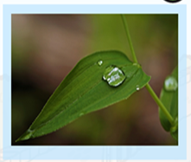
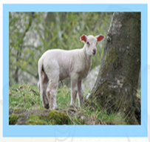


Signs of
Spring

Slide 3
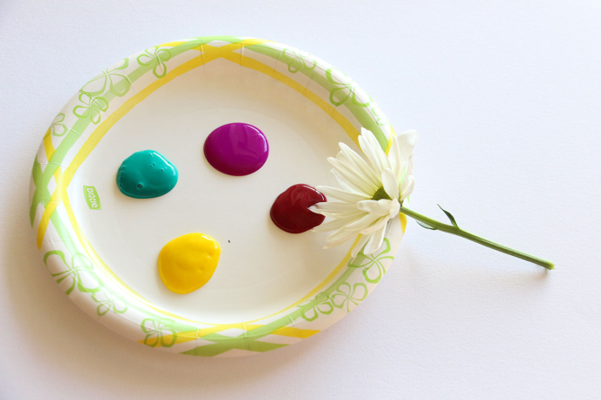
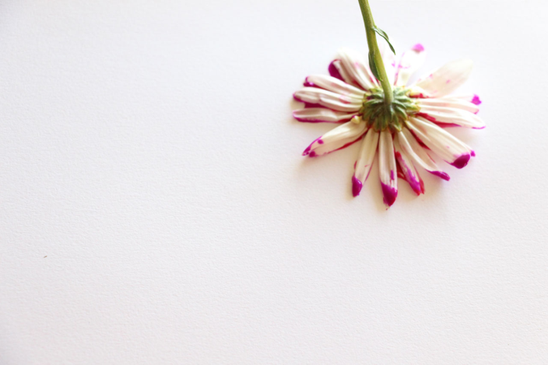
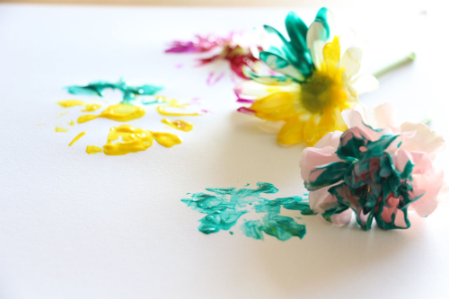
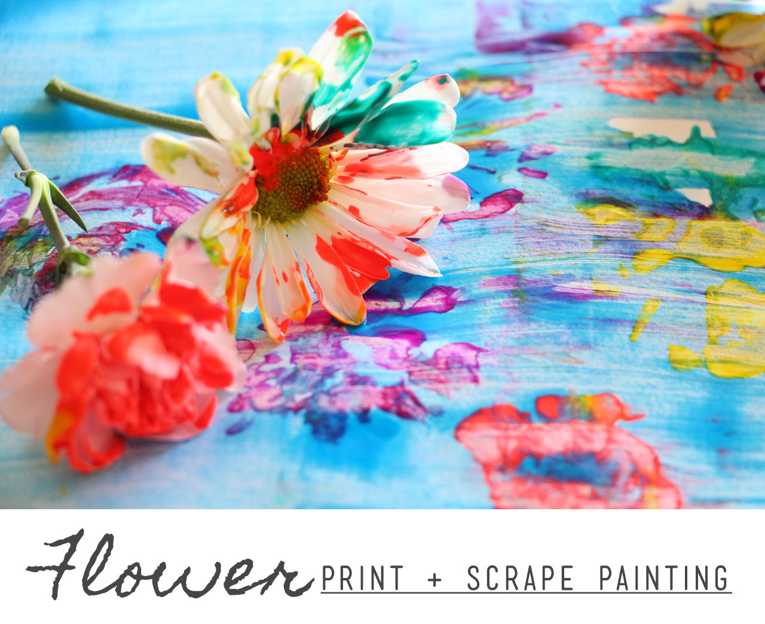
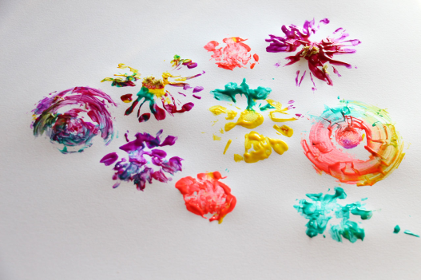
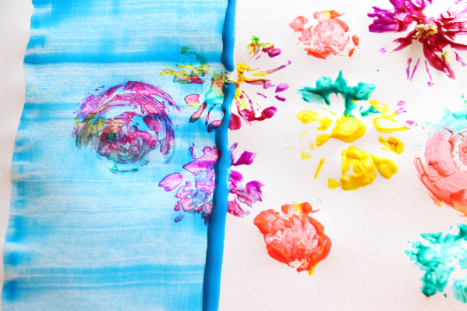
Spring
https://www.playfullearning.net/resource/flower-print-scrape-painting/

Slide 4
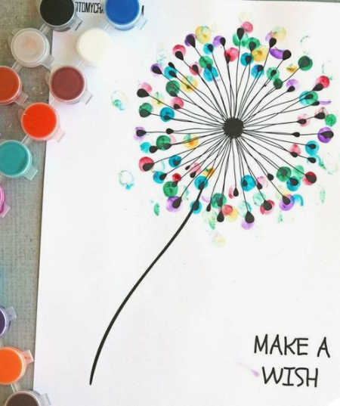
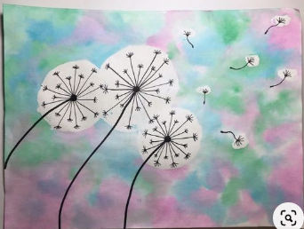
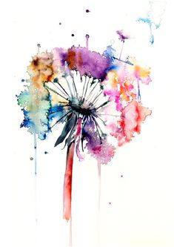
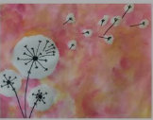
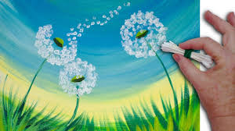
Add a wish to your dandelion
Spring

Slide 5

Add a wish to your dandelion
Spring

Slide 6
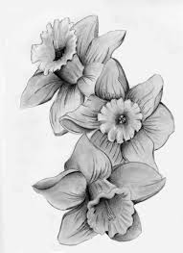
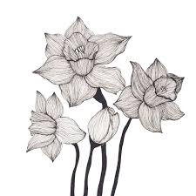
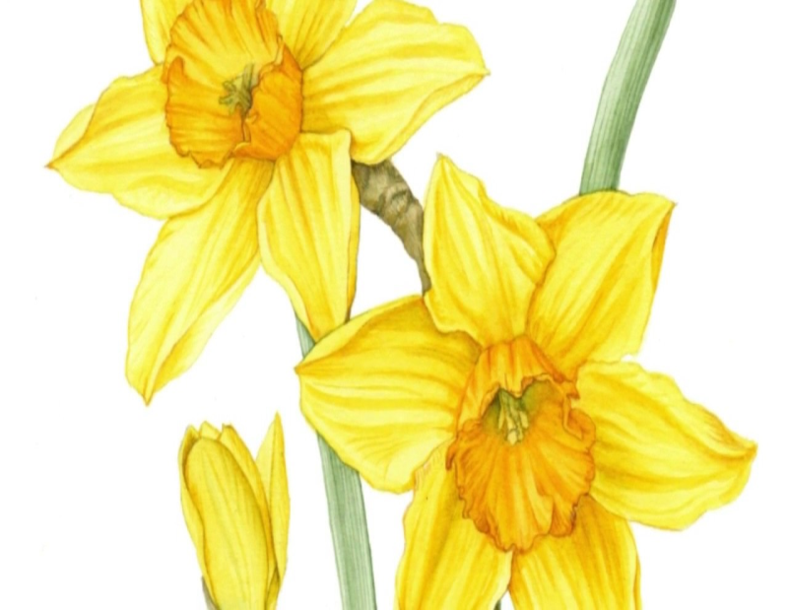
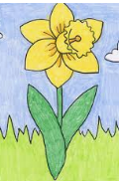
Spring
Make an observational drawing of daffodils.
Sketch, shade with pencils or pencil crayons using different techniques to shade and tone.
How to draw a daffodil
https://www.youtube.com/watch?v=rWTrUwoiJyg

Slide 7
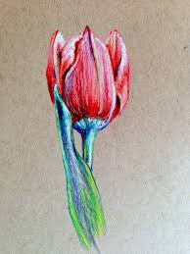
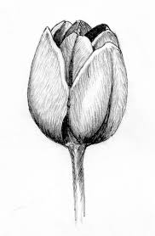
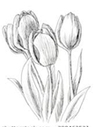
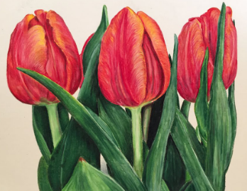
Spring
Make an observational drawing of tulips.
Sketch, shade with pencils or pencil crayons using different techniques to shade and tone.
How to draw a tulip
https://www.youtube.com/watch?v=l7cO4fgq5nU

Slide 8
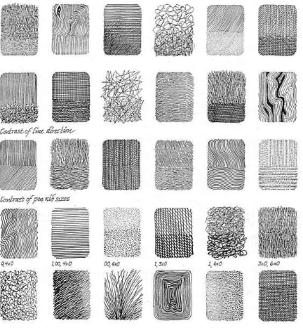
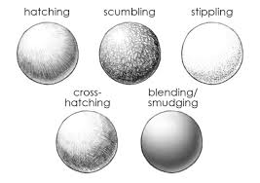
Spring
Shading and toning techniques
How to shade and tone
https://www.youtube.com/watch?v=-DDTrpJ4PXg

Slide 9
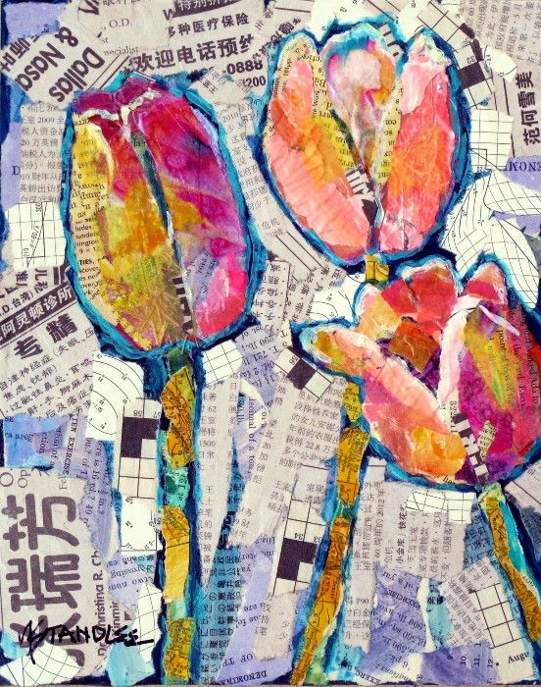
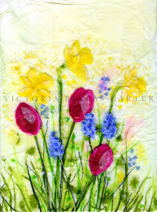
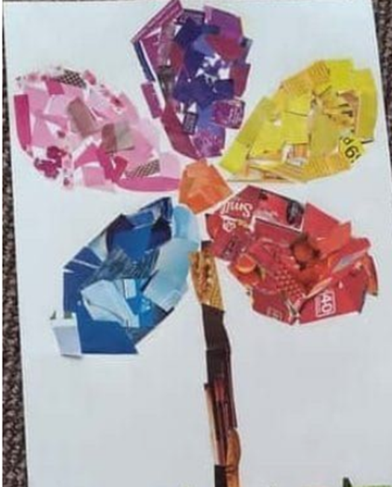
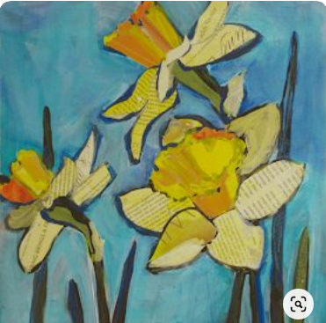
Spring
Collage with,
old newspapers
old letters
Magazines
food menus
old books etc

Slide 10

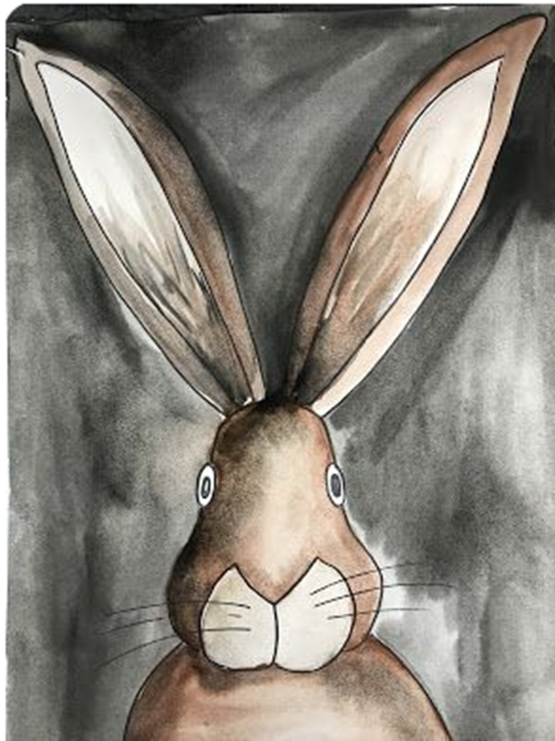

Next week …..
activities

