Slide 1

Hello Primet!
There’s nothing like a good sing song where ever you are!
Copy the link for a sing song!
Todays song:
https://www.youtube.com/watch?v=6I2TTKA8uNk
https://www.youtube.com/watch?v=7edeAetLUj4
https://www.youtube.com/watch?v=H0m3Lfkzcw4
https://www.youtube.com/watch?v=ru0K8uYEZWw

Slide 2
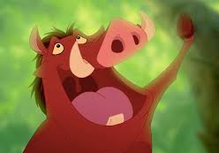
LAAAA LA LAAAA
Have a good sing song!
https://www.youtube.com/watch?v=Z2xooz6844k
https://www.youtube.com/watch?v=QEjgPh4SEmU

Slide 3

Music with Myleen Klass on you tube Twice a week. Next one Friday 27th March 10am can view anytime!
https://www.youtube.com/results?search_query=music+with+myleene+klass

