Slide 1




Slide 2

I’ve added a few websites where you try different styles of art.
Click on the link or copy and paste it into the search bar and it will
lead you to the websites.
I am looking forward to seeing what you create!!!!!!

Slide 3


http://bomomo.com/

Slide 4

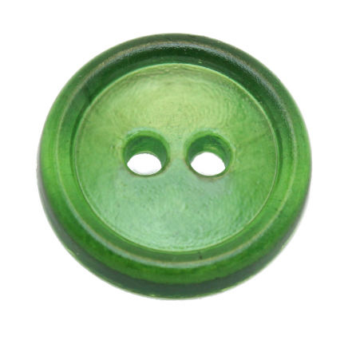

Collage
http://aminahsworld.org/

Slide 5




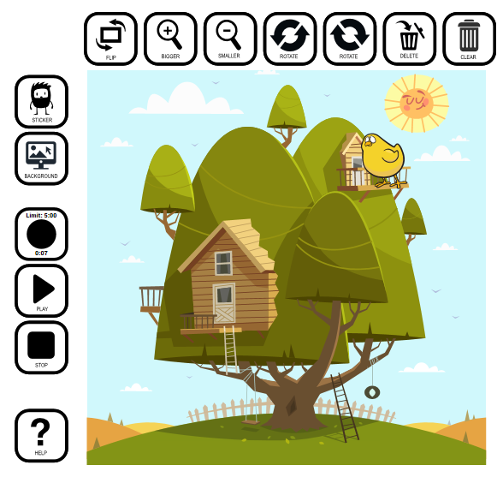

http:///
Create your own animation
@The Animation station
http://toytheater.com/category/art/

Slide 6
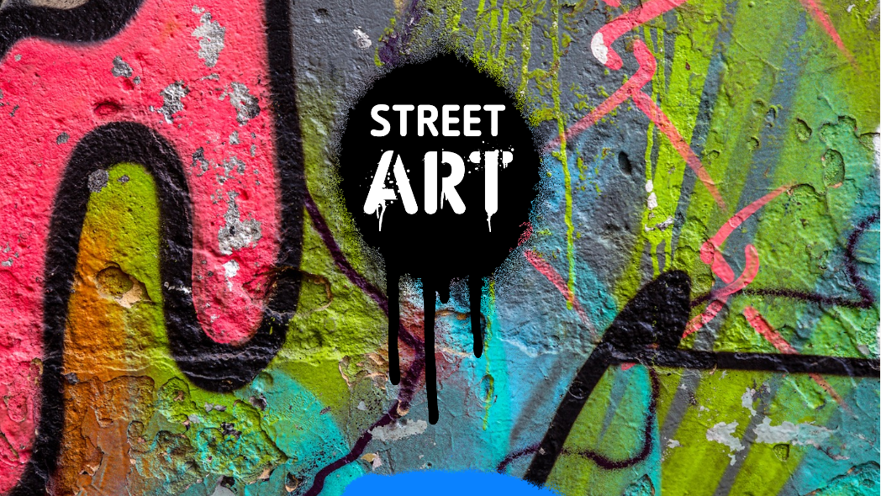


https://www.tate.org.uk/kids/games-quizzes/street-art

