Slide 1



Slide 2

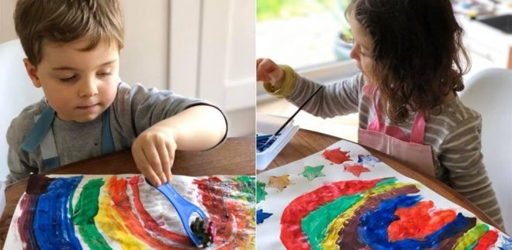
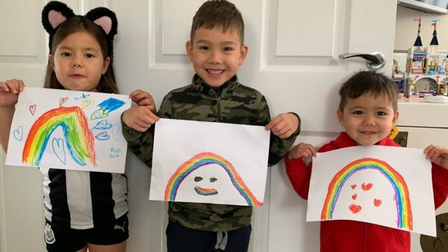
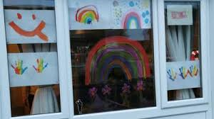
“Spread Hope”
Across the country, hundreds of children are creating rainbow pictures and displaying them in their windows to symbolise “Hope”

Slide 3
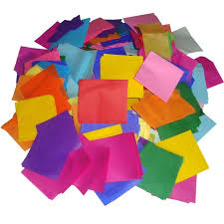
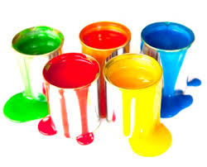

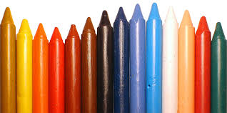
“Spread Hope”
Be as creative as you can and create your own rainbow. You could use…

Slide 4

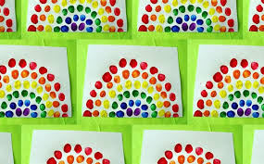
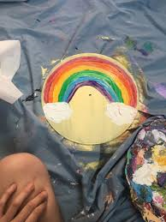

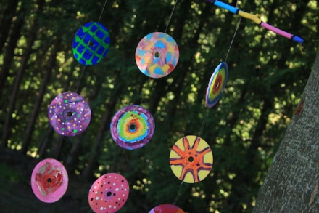
“Spread Hope”
Cut a rainbow outline from paper plates ,card or paper
and add clouds.
Cd mobile
Paint old Cds
(Check with your Parents, don’t be using their favourites )
Attach string /wool
Hang in your windows
Finger paint

Slide 5



“Spread Hope”
“Add a message to your rainbow”

Slide 6

“Spread Hope”
Looking forward to seeing your creations.
Make your sure you take a picture and email them to Miss O’Keefe…
Enjoy

