Slide 1
Monday
16th
March
Year 4 Swimming
Summer Term

Slide 2
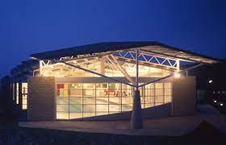
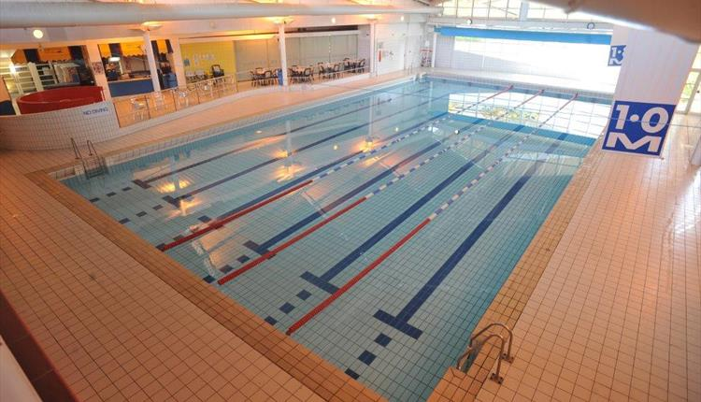
When and Where?
Every Thursday starting from 13th April
Swimming session begins at 1.15pm till 2.00pm
Children to leave school at 12.40pm to get to the swimming pool at 1pm.
We shall be walking – sensible footwear and coats will be needed
Colne Swimming Baths

Slide 3
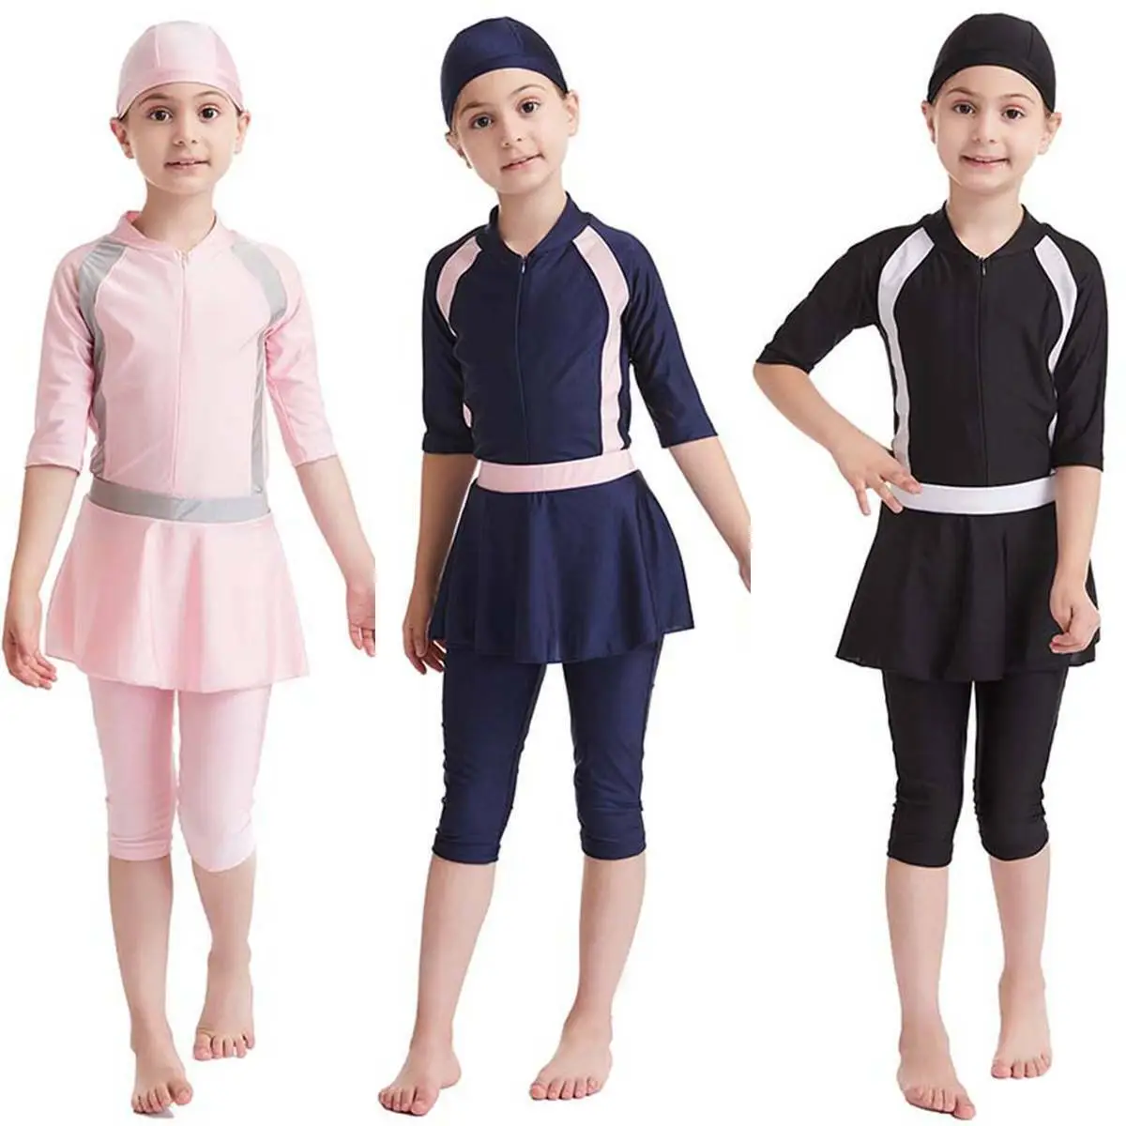
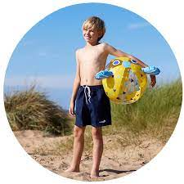
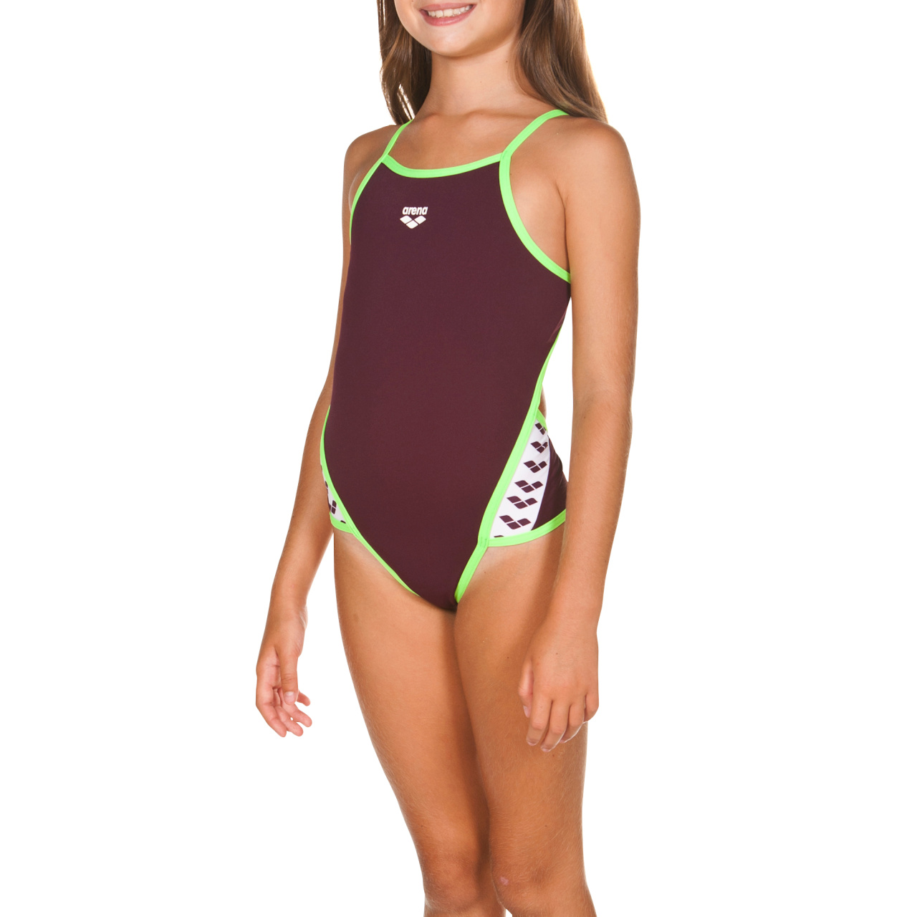
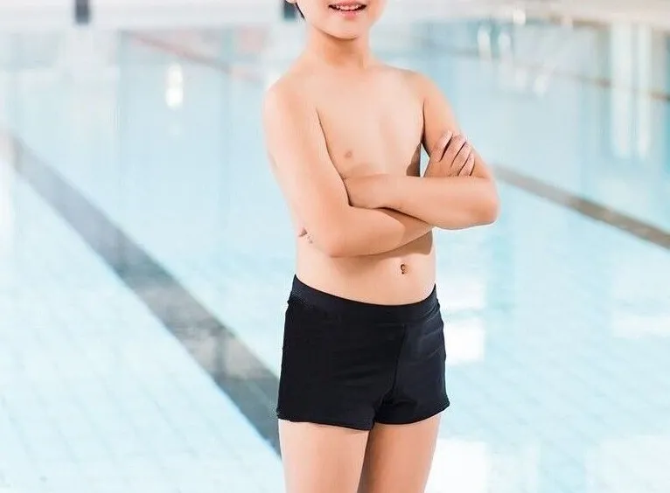
What to wear?
Girls must wear a one piece swimming costume or alternative costume for children who follow Islam.
NO bikinis!
Boys can wear swimming shorts but they must not be baggy and must not go below the knee.

Slide 4
Swimming hats are advisable but not essential however hair MUST be tied back.
Earrings can be worn - studs only – best if they are removed for the lesson. Hoops will not be allowed.
No other jewellery will be allowed – watches, bracelets, chains etc. – LEAVE them at home.
You will need a towel, hair brush and another bag
DO NOT come to school wearing your swimming kit.

Slide 5
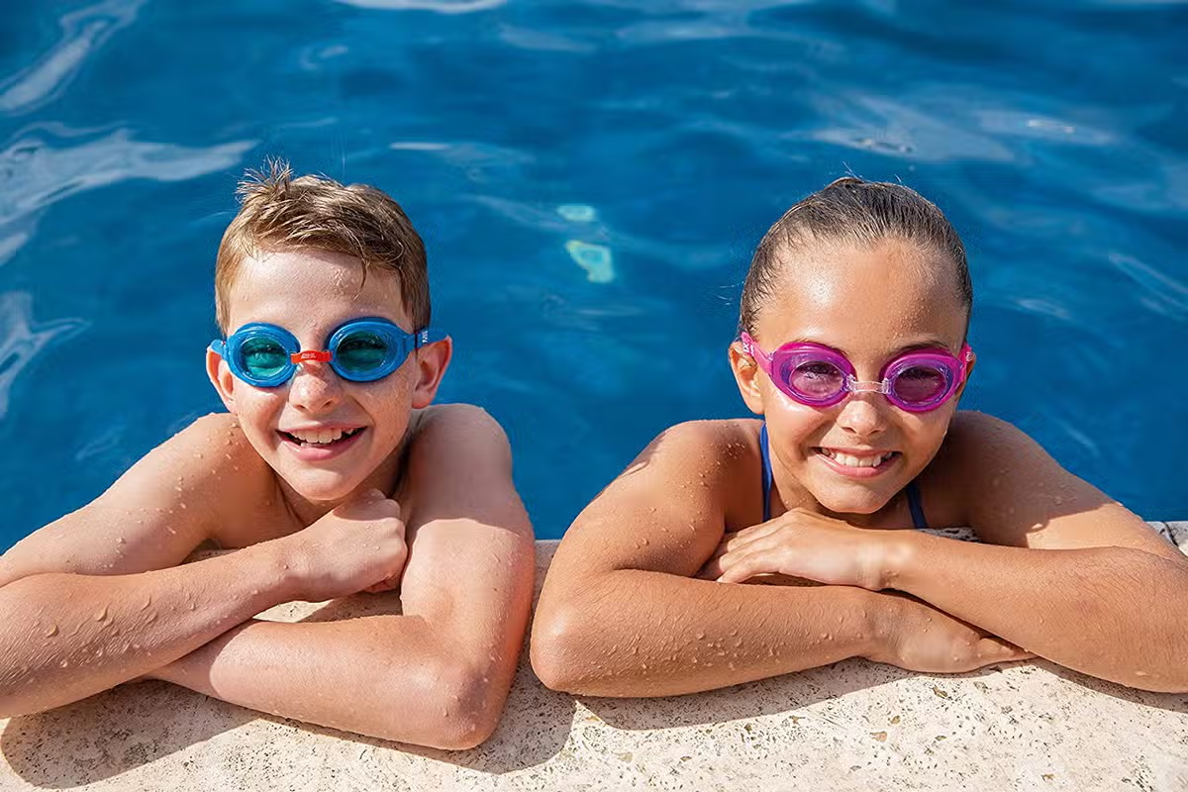
Can I wear goggles?
YES you can
I need a letter signed from parents for this and you must purchase your own goggles.
Goggles will be worn during the swimming elements of the sessions but for water safety sessions they cannot be worn. Swimming staff and school staff will advise you accordingly.
NO goggles is NOT a reason to not go swimming!!

Slide 6
Where will I get changed?
Children to get changed in the cubicles – 2 pupils per cubicle.
Staff to be stood at entrances.
All clothing to be placed in bag and put in a locker – you will not need to pay for the locker.
All children then line up to have a shower before going onto the pool side.

Slide 7
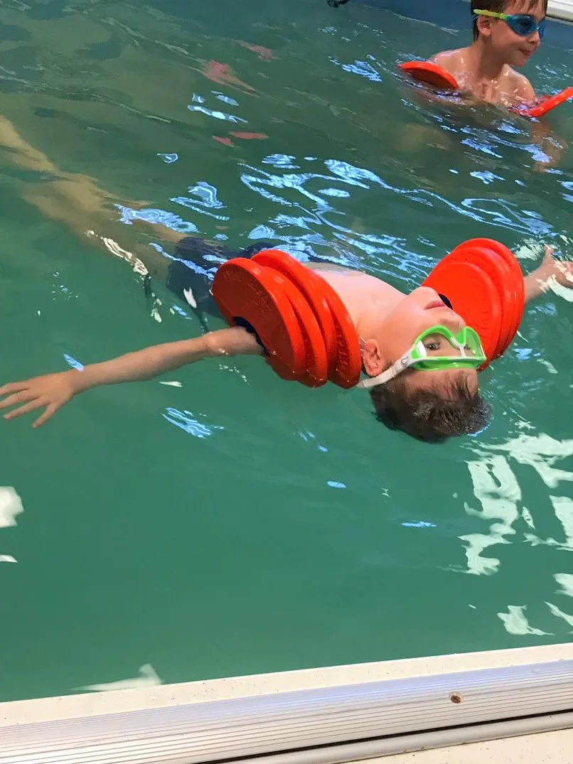
What will I be doing?
Children will be taught how to be safe in and near water – how to enter water safely, float to survive and leave the water safely.
How to swim a distance of 25m in a recognisable stroke
Our staff be on hand helping t teach the sessions

Slide 8
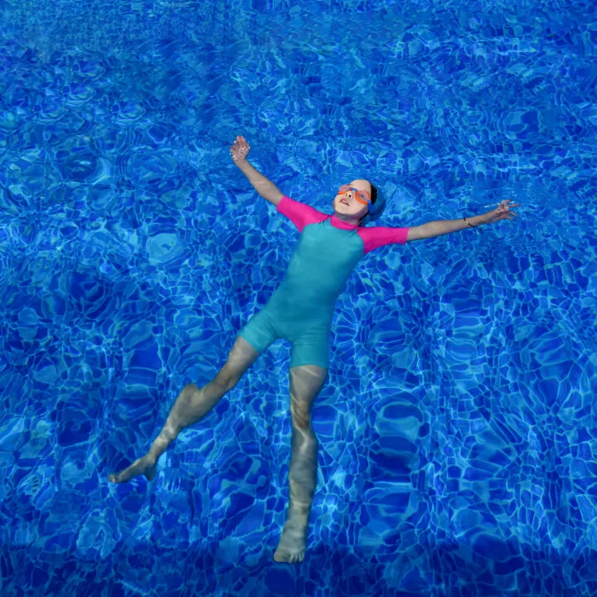
What if I can’t swim?
That is why you are going!
Children will be put into different groups according to ability to swim.
You will play games to build up confidence – by the end of the summer term, you will be swimming.
Floats, woggles and other things will be used to help those who can’t swim – so DON’T PANIC it is going to be fantastic.

