Slide 1

Welcome to Year 3
15.9.25

Slide 2
Who’s who?
Mr Haworth – Class Teacher
Miss O’Keefe– Teaching assistant
Miss Dark –PE specialist
Miss O’Keefe – Art specialist

Slide 3
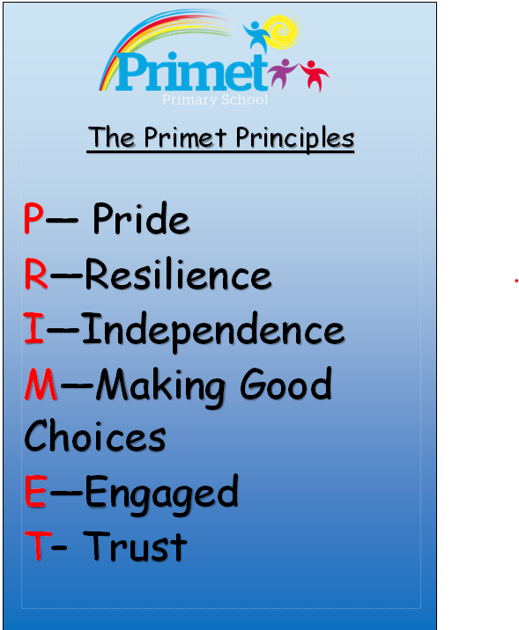
Every aspect of school life is founded on these core principles.
We strive to cultivate learners who are proud, resilient, and independent. Our goal is for pupils to make positive choices both within school and beyond. We encourage active engagement in their learning and participation in school life. Our students will be trusted by the adults around them, and in turn, they can have full confidence in our support.

Slide 4

To achieve the Primet Principles, we follow these behavioral expectations.
Be Ready. Be Respectful. Be Safe.
When asked, children can explain what ‘Ready’ behaviours are. They can explain what it means to be Respectful and how they personally show this to all members of our school community.
Similarly, they know how to stay safe in our school: inside and outside and can give examples of safe choices.

Slide 5
Y3 English
Aut 1 – Stone Age boy -
Aut 2 – Iron man
Spr 1 –Fables – Tortoise an the Hare
Spr 2 – The enchanted forest
Sum 1 – Peter Rabbit
Sum 2 – Boudicca

Slide 6
Y3 Science
Aut 1 – Light and Dark
Aut 2 – Magnets and forces
Spr 1 – Animals inc Humans
Spr 2 – Plants
Sum 1 – Roarsome rocks
Sum 2 – End of Year round up

Slide 7
Y3 Topics
Aut – Stone Age to Iron Age
Spr - Lancashire Cotton mills
Sum - Romans

Slide 8
Reading in Year 3
Reading is a key priority at Primet. While children will encounter a wide range of texts, certain books will be explored in greater depth. These carefully chosen texts will support pupils in developing a deeper understanding of language and structure, enabling them to write with the skill and creativity of real authors.
Reading at home is vital for children to be able to access the full depth of the curriculum, not just English lessons. This allows them to become more creative and rounded learners.

Slide 9
Times tables in Year 3
Many of the harder operations and calculations in Year 3 rely on accurate, rapid recall of multiplication tables from 1-12.
It is vitally important that children practise these if there is a gap in their recall. Being able to quickly and confidently enables them to not only succeed in Maths but actively enjoy it when they are able to engage with harder problems.

Slide 10
Homework expectations in Year 3:
Times tables
Reading
Spellings
Useful websites to support your child’s education:

Slide 11
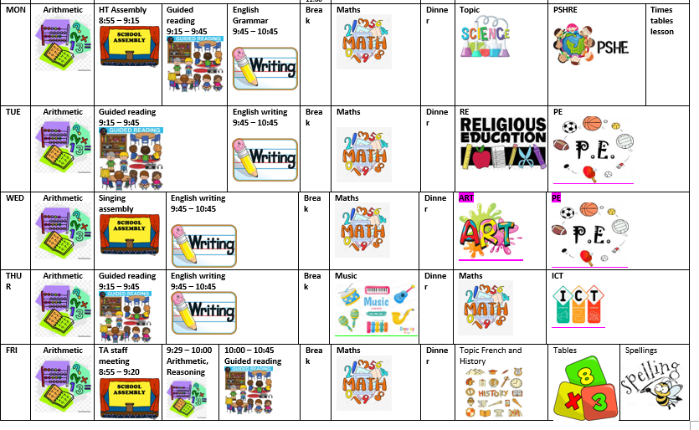
Here is the weekly timetable:

Slide 12
Enrichment in Y3:
More information to be communicated closer to the time.
Library visits
Walk in the local area
Visit to the cenotaph

Slide 13
Thank you for listening.
Please take your time to look at the environment and workbooks
Do you have any questions?

