Slide 1
Welcome to Year 5
15.9.25

Slide 2

Who’s who?
Ms Bashir: Year 5 class teacher
Ms Mills: Year 5 TA
Mrs Haydock: SSA 1:1
Miss O’Keefe: Art Specialist
Miss Dark: PE Coach

Slide 3
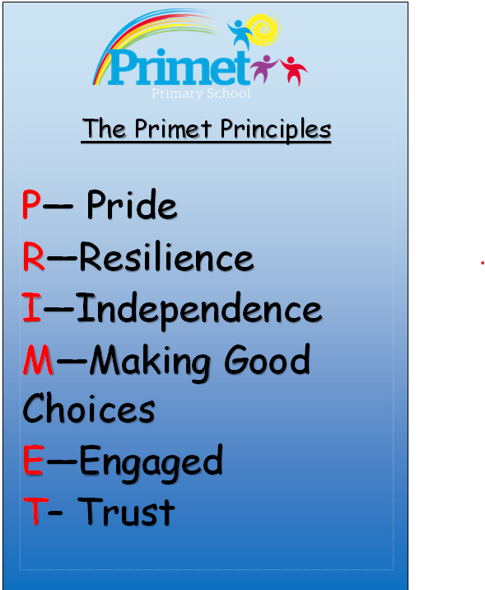
Every aspect of school life is founded on these core principles.
We strive to cultivate learners who are proud, resilient, and independent. Our goal is for pupils to make positive choices both within school and beyond. We encourage active engagement in their learning and participation in school life. Our students will be trusted by the adults around them, and in turn, they can have full confidence in our support.

Slide 4

To achieve the Primet Principles, we follow these behavioral expectations. Be Ready. Be Respectful. Be Safe.
When asked, children can explain what ‘Ready’ behaviours are. They can explain what it means to be Respectful and how they personally show this to all members of our school community. Similarly, they know how to stay safe in our school: inside and outside and can give examples of safe choices.

Slide 5
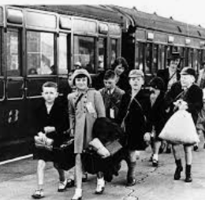
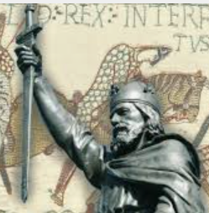
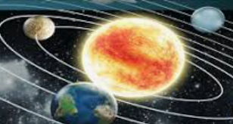
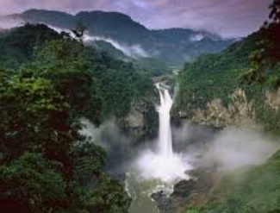
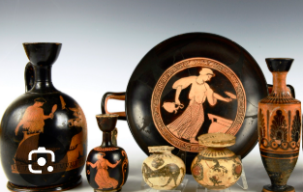
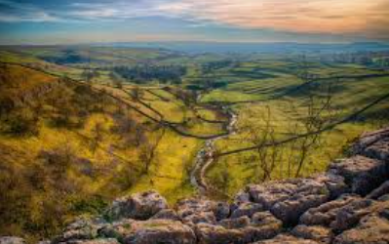
Y5 Topics
World War 2 - Evacuees
Invaders and Settlers – Anglo Saxons
Earthlings – Earth and Space
Amazon Adventure - Deforestation
Faster, Higher, Stronger – Ancient Greeks
Wonderful Britain – National Parks

Slide 6
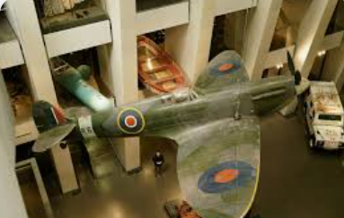

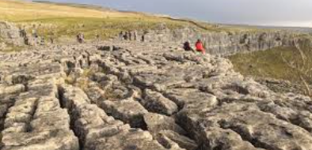
Enrichment in Y5:
More information to be communicated closer to the time.
Imperial War Museum
Space Day
Malham Cove

Slide 7

Reading in Year 5 – Key texts
Notes:
Reading is a key priority at Primet. While children will encounter a wide range of texts, certain books will be explored in greater depth. These carefully chosen texts will support pupils in developing a deeper understanding of language and structure, enabling them to write with the skill and creativity of real authors.

Slide 8
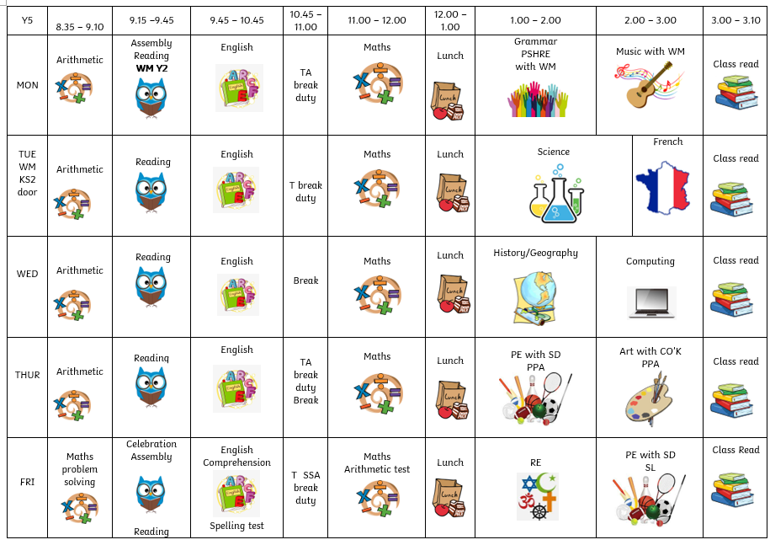
Class timetable

Slide 9
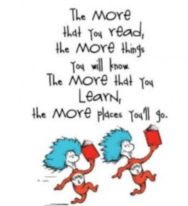
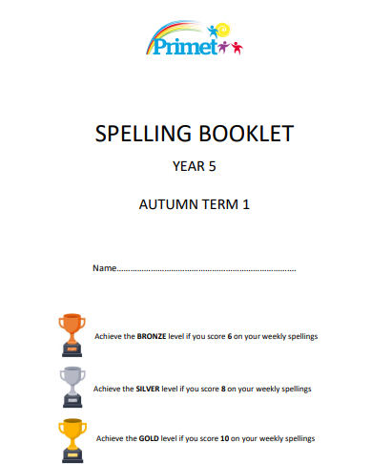

Homework Expectations in Year 5
Reading
Spelling
Timetables
Links on school website

Slide 10
Thank you for listening
Please take your time to look at the environment and workbooks which will show the expectations of Y5
Do you have any questions?

