Slide 1
Welcome to Year 6
15.9.25

Slide 2
Who’s who?
Mr Higgins – Class Teacher
Miss Iram – Teaching assistant
Miss Dark – Teaching assistant (am) and PE specialist
Miss O’Keefe – Art specialist

Slide 3

Every aspect of school life is founded on these core principles.
We strive to cultivate learners who are proud, resilient, and independent. Our goal is for pupils to make positive choices both within school and beyond. We encourage active engagement in their learning and participation in school life. Our students will be trusted by the adults around them, and in turn, they can have full confidence in our support.

Slide 4

To achieve the Primet Principles, we follow these behavioral expectations. Be Ready. Be Respectful. Be Safe.
When asked, children can explain what ‘Ready’ behaviours are. They can explain what it means to be Respectful and how they personally show this to all members of our school community. Similarly, they know how to stay safe in our school: inside and outside and can give examples of safe choices.

Slide 5
Y6 English
Aut 1 – Hugo Cabret
Aut 2 – Biographies
Spr 1 –Classic stories (The Hobbit)
Spr 2 – Macbeth
Sum 1 (SATs) – Strange Things
Sum 2 – Strange Things (cont)

Slide 6
Y6 Science
Aut 1 – Light
Aut 2 – Animals inc Humans – Circulatory system
Spr 1 – Living Things - Classifying
Spr 2 – Evolution and Inheritance
Sum 1 (SATs) – Electricity
Sum 2 – End of Year round up

Slide 7
Y6 Topics
Aut 1 – Meet the Mayans
Aut 2 – Volcanoes in Mexico
Spr 1 – Fair Trade
Spr 2 – Vikings and Anglo-Saxons
Sum 1 (SATs) – How Colne has changed
Sum 2 – How Colne has changed (cont)

Slide 8
Reading in Year 6
Reading is a key priority at Primet. While children will encounter a wide range of texts, certain books will be explored in greater depth. These carefully chosen texts will support pupils in developing a deeper understanding of language and structure, enabling them to write with the skill and creativity of real authors.
Reading at home is vital for children to be able to access the full depth of the curriculum, not just English lessons and allows them to become more creative and rounded learners.

Slide 9
Times tables in Year 6
Many of the harder operations and calculations in Year 6 rely on accurate, rapid recall of multiplication tables from 1-12.
It is vitally important that children practise these if there is a gap in their recall. Being able to quickly and confidently enables them to not only succeed in Maths but actively enjoy it when they are able to engage with harder problems.

Slide 10
Homework expectations in Year 6:
Times tables
Reading
Spellings
Useful websites to support your child’s education:

Slide 11
End of KS2 SATs
Tests will be sat during May 2026
Maths – 3 tests
  Arithmetic – 30mins
  Reasoning 2 – 40mins
  Reasoning 3 – 40mins
Reading – 1 test
  60mins – 3 different texts
Spelling, Punctuation and Grammar – 2 tests
  Punctation and grammar – 45mins
  Spelling – roughly 20mins

Slide 12
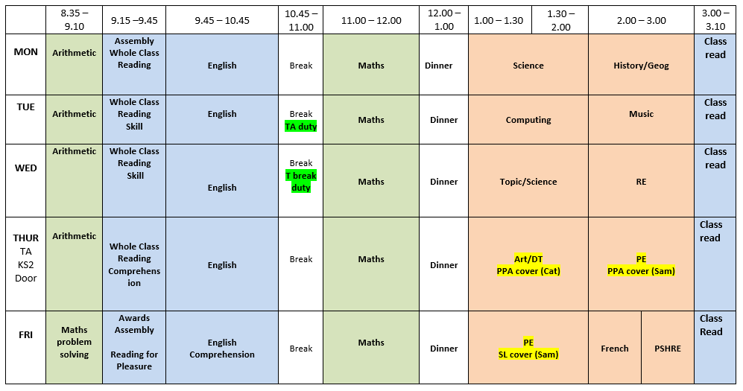
Here is the weekly timetable:

Slide 13
Enrichment in Y6:
More information to be communicated closer to the time.
Library visits
Y6 residential – Gulliver’s World
Topic related local area visits

Slide 14
Mobile phones and electronic devices
School understands the value these can have socially and educationally but they need to be very, very carefully monitored.

Slide 15
Thank you for listening.
Please take your time to look at the environment and workbooks which will show the expectations of Y6.
Do you have any questions?

