Slide 1
Welcome to Year 4
15.9.25

Slide 2
Who’s who?
Mrs Cunningham – Class Teacher
Mrs Dawson – Class Teacher
Mrs Haworth – Teaching Assistant
Miss Harris – SSA
Miss O’Keefe – Art Teacher
Miss Dark – PE Teacher

Slide 3

Every aspect of school life is founded on these core principles.
We strive to cultivate learners who are proud, resilient, and independent. Our goal is for pupils to make positive choices both within school and beyond. We encourage active engagement in their learning and participation in school life. Our students will be trusted by the adults around them, and in turn, they can have full confidence in our support.

Slide 4

To achieve the Primet Principles, we follow these behavioral expectations. Be Ready. Be Respectful. Be Safe.
When asked, children can explain what ‘Ready’ behaviours are. They can explain what it means to be Respectful and how they personally show this to all members of our school community. Similarly, they know how to stay safe in our school: inside and outside and can give examples of safe choices.

Slide 5
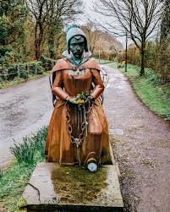
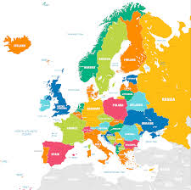
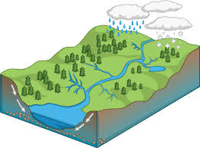

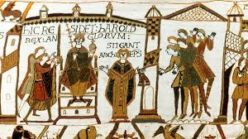
Curriculum in Y4: History and Geography
Sustainable living
Rivers
Europe
Pendle Witches
1066

Slide 6
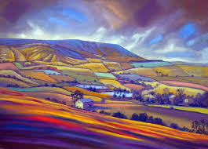
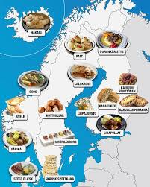
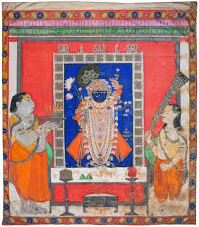
Curriculum in Y4: Art and DT
History of Gods - Textiles
Keith Melling
Scandinavian Food

Slide 7
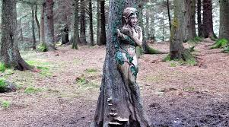
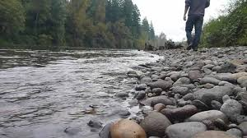
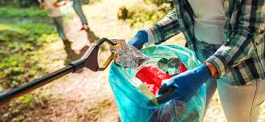
Enrichment in Y4:
More information to be communicated closer to the time.
Top secret: Witch visit!
River Walk
Litter Pick

Slide 8





Reading in Year 4
Reading is a key priority at Primet. While children will encounter a wide range of texts, certain books will be explored in greater depth. These carefully chosen texts will support pupils in developing a deeper understanding of language and structure, enabling them to write with the skill and creativity of real authors.

Slide 9
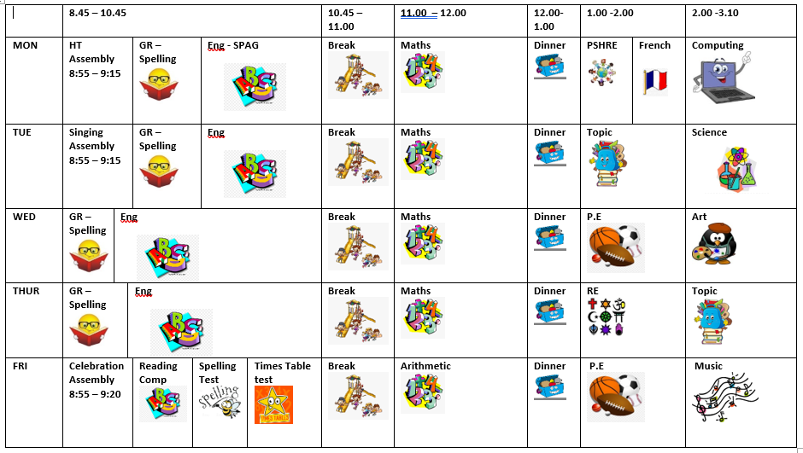
Here is the weekly timetable:

Slide 10
Homework expectations in Year 4:
Times tables;
Reading;
Spellings.

Slide 11
Thank you for listening.
Please take your time to look at the environment and workbooks which will show the expectations of Y4.
Do you have any questions?

