Slide 1
Welcome to Year 1
15.9.25

Slide 2
Who’s who?
Mrs Kausar – Class Teacher
Miss Shaughnessy – Teaching Assistant
      Miss O’Keefe – Art Teacher
      Miss Dark – PE Teacher

Slide 3

Every aspect of school life is founded on these core principles.
We strive to cultivate learners who are proud, resilient, and independent. Our goal is for pupils to make positive choices both within school and beyond. We encourage active engagement in their learning and participation in school life. Our students will be trusted by the adults around them, and in turn, they can have full confidence in our support.

Slide 4

To achieve the Primet Principles, we follow these behavioral expectations.
  Be Ready. Be Respectful. Be Safe.
When asked, children can explain what ‘Ready’ behaviours are. They can explain what it means to be Respectful and how they personally show this to all members of our school community. Similarly, they know how to stay safe in our school: inside and outside and can give examples of safe choices.

Slide 5
Curriculum in Y1: History and Geography
Autumn 1
What can we see around our school?
Summer 1
How can we use maps to find out about our world? ?
Spring 1
What do we know about our island home?
Autumn 2
Changes within living memory.
Spring 2
Kings Queens and Castles
The lives of significant individuals.
Summer 2
Events beyond living memory - The Great fire of London

Slide 6

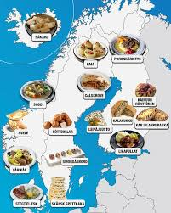
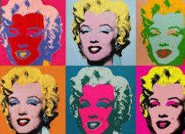



Curriculum in Y1: Art and DT
DT Preparing food and combining
ART Self-portraits - drawing and painting in charcoal, chalk, pastels and watercolours developed into digital art
ART Picasso Drawing in pastel developed into 3D using clay
DT -Mechanisms pop ups and simple card levers
ART - Andy Warhol Observational drawings and paintings developed into printmaking.
DT-Structures, stability and strength- Making a lighthouse (Lighthouse keeper’s lunch)

Slide 7
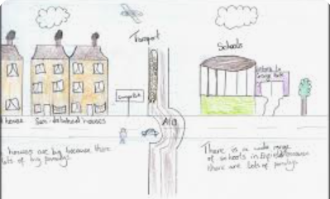
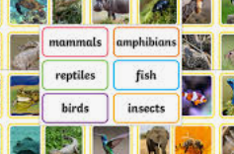
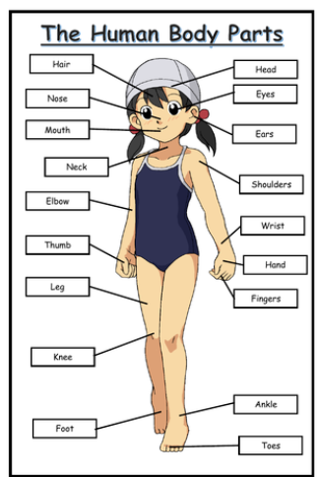
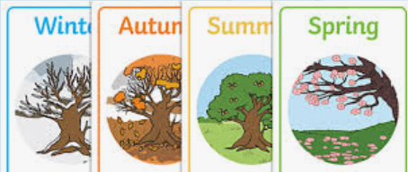

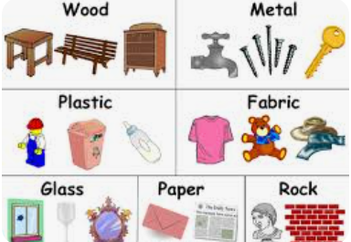
Curriculum in Y1: Science
Spring 1-Animals
Spring 2 - Plants
Autumn 1 -Observations of the local area
Autumn 2 Everyday Materials
Summer 1- The Human Body
Summer 2- Seasons

Slide 8



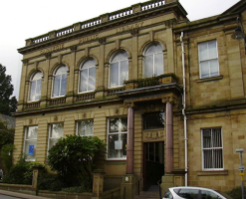
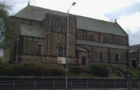
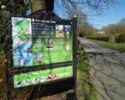
Enrichment in Y1:
More information to be communicated closer to the time.
KS1Nativity
Pantomime
Mother toungue week
Church Visit
Alkincoates Park
Library visit

Slide 9








Reading in Year 1
Reading is a key priority at Primet. While children will encounter a wide range of texts, certain books will be explored in greater depth. These carefully chosen texts will support pupils in developing a deeper understanding of language and structure, enabling them to write with the skill and creativity of real authors.

Slide 10

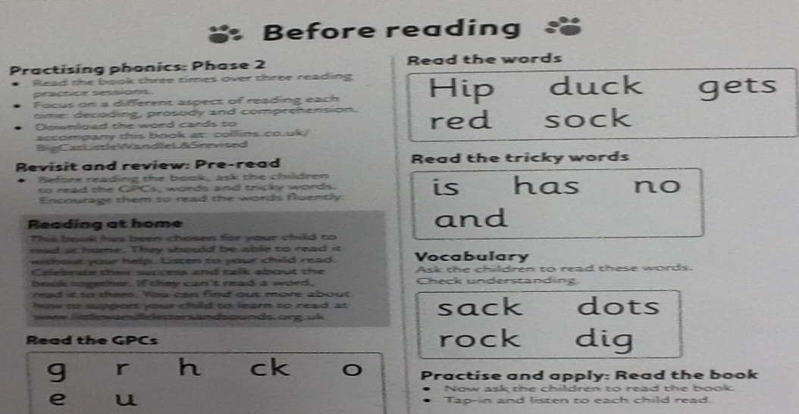
Phonics Little wandle linked to reading books

Slide 11
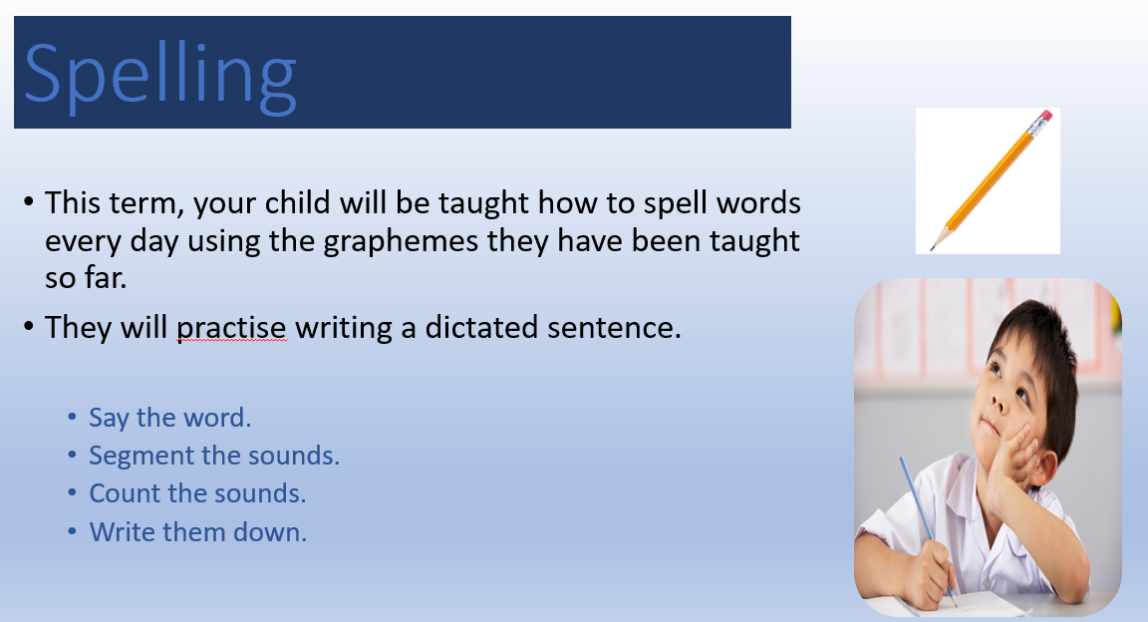

Slide 12
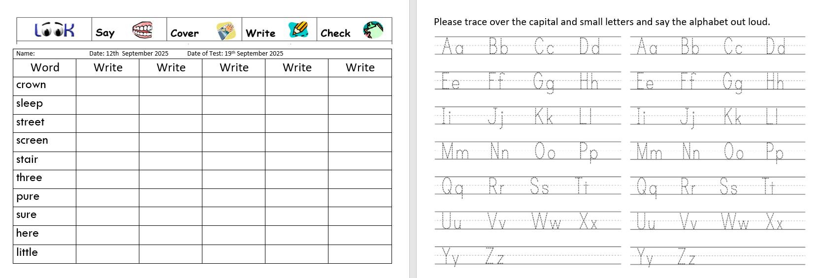
Phonics Daily phonics lessons linked to the weekly spelling

Slide 13
Homework expectations in Year 1:
Reading;
Spellings.
Useful websites to support your child’s education: https://www.littlewandle.org.uk/

Slide 14
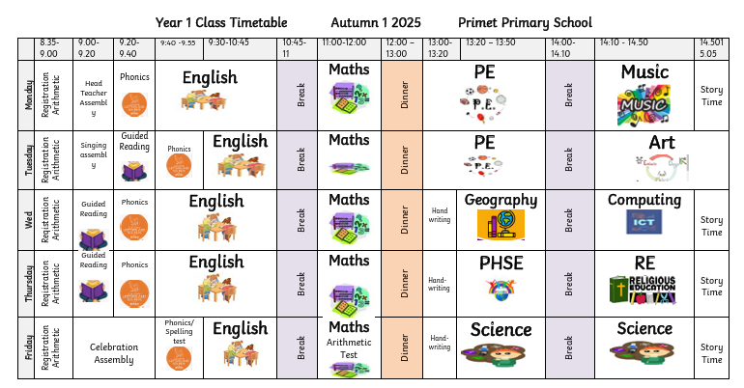
Here is the weekly timetable:

Slide 15
Thank you for listening.
Please take your time to look at the environment and workbooks which will show the expectations of Y1.
Do you have any questions?

