Slide 1

World Book Day at Primet
Thursday 4th March 2021

Slide 2


World Book Day
The first World Book Day was in 1995.
World Book Day is a celebration of:
  authors – people who write books;
  illustrators – artists who draw pictures for books;
  books – funny, scary and true stories, poetry, jokes and
  much more.
Most importantly, it’s a celebration of readers – that’s you!

Slide 3





World of stories
World Book Day
Enjoy listening to free audiobooks. Click on the link and select the story you would like to listen to:
https://www.worldbookday.com/world-of-stories/

Slide 4


Author
Tom Fletcher
Get all sorts of ideas about interactive storytelling from Tom Fletcher
https://youtu.be/15c6fW8-3MY

Slide 5

Get a Free Book with a
£1 Book Token!
Use your £1 Book Token - you can take it to a bookshop and swap it for one of the 15 World Book Day books!
That’s right – you can choose a book for free with your token!

Slide 6


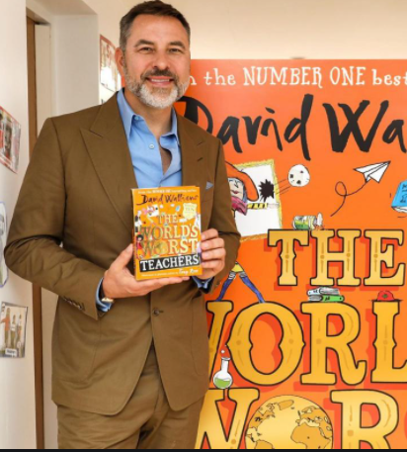

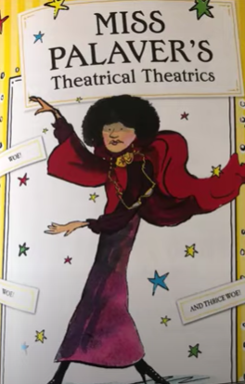
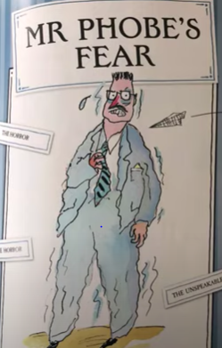
BOOK DAY COMPETITION
Listen to a section of David Walliams book The World’s Worst Teacher
https://www.youtube.com/watch?v=--rV2qYWytc&list=PLk7uugqntSd2iuNRBXvJ34KiMD4mAVLRm&index=3
Can you add a section to David Walliams book. Write a description of The World’s Worst Teacher:
What makes them the World’s
Worst Teacher?
What does he/she look like?
What is he/she like – behaviours?

