Slide 1

World Book Day at Primet
Thursday 4th March 2021

Slide 2




World Book Day
The first World Book Day was in 1995.
World Book Day is a celebration of:
  authors – people who write books;
  illustrators – artists who draw pictures for books;
  books – funny, scary and true stories, poetry, jokes and
  much more.
Most importantly, it’s a celebration of readers – that’s you!
Log into Rising Stars https://my.risingstars-uk.com/Default.aspx?cid=DL351830
and read the book ‘World Book Day’
You can also press the play button to listen to the book been read.

Slide 3





World of stories
World Book Day
Enjoy listening to free audiobooks. Click on the link and select the story you would like to listen to:
https://www.worldbookday.com/world-of-stories/

Slide 4


Author
Tom Fletcher
Listen to the author Tom Fletcher
https://youtu.be/15c6fW8-3MY
Write a letter to your
favourite author explaining why
you like their books. Can you
think of a question to ask them?

Slide 5
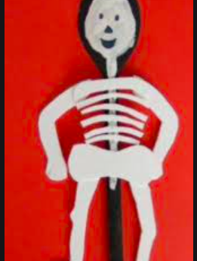
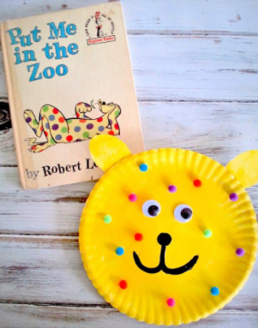
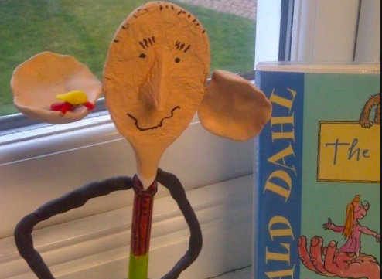

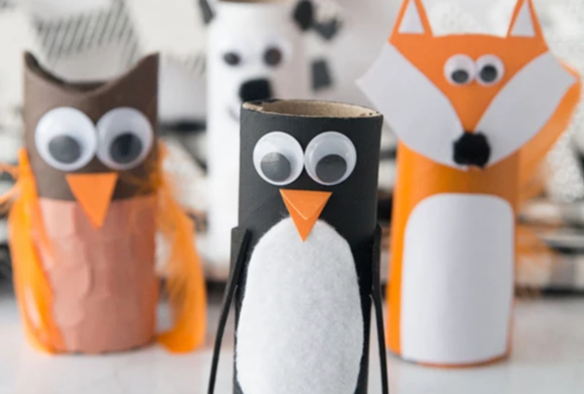
This year’s creative challenge that children will be able to complete at home and bring into school when they return on 8th March to display in class.
Your task is to create a story or poem character from a household item. You could decorate a spoon, spatula, empty bottle, small box, anything at all, the house is your oyster! If you are feeling particularly creative, you could create a set of characters.

Slide 6

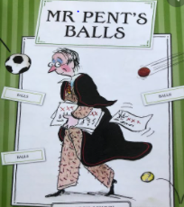
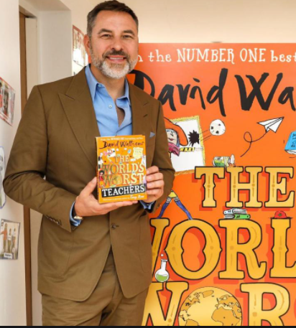
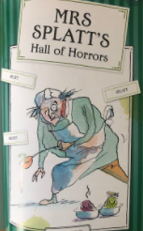
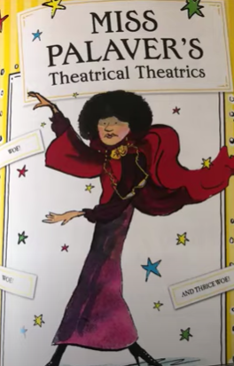
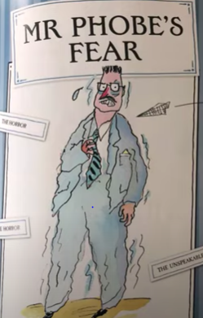
BOOK DAY COMPETITION
Listen to a section of David Walliams book The World’s Worst Teacher
https://www.youtube.com/watch?v=--rV2qYWytc&list=PLk7uugqntSd2iuNRBXvJ34KiMD4mAVLRm&index=3
Can you add a section to David Walliams book. Write a description of The World’s Worst Teacher:
What makes them the World’s
Worst Teacher?
What does he/she look like?
What is he/she like – behaviours?

Slide 7

Get a Free Book with a
£1 Book Token!
Use your £1 Book Token - you can take it to a bookshop and swap it for one of the 15 World Book Day books!
That’s right – you can choose a book for free with your token!

