Slide 1


Maths
Multiplication and Division
Year One
Maths | Year 4 | Multiplication and Division | Written Methods of Multiplication | Lesson 2 of 2: Short Multiplication with Three-Digit Numbers

Slide 2
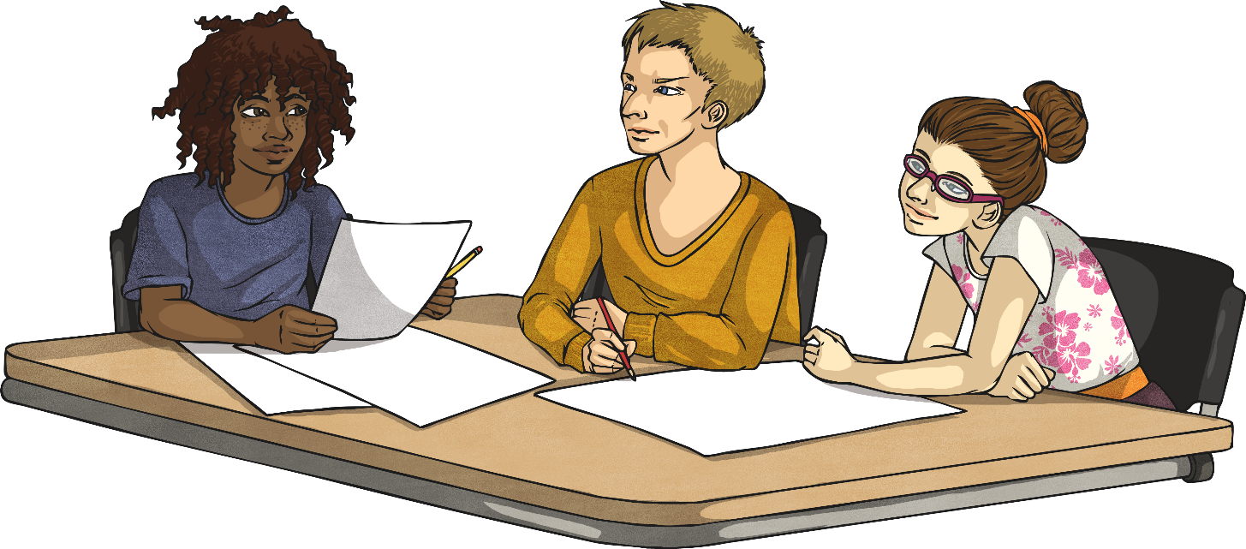

Short Multiplication with Three-Digit Numbers

Slide 3
Aim
I can use the short method of multiplication to multiply three-digit numbers by one-digit numbers.
Success Criteria
I can set my calculation out correctly.
I can start at the right-hand side when calculating.
I can regroup tens, hundreds and thousands, recording this in the next column.
I can use a calculator to check my own work and fix my mistakes.

Slide 4

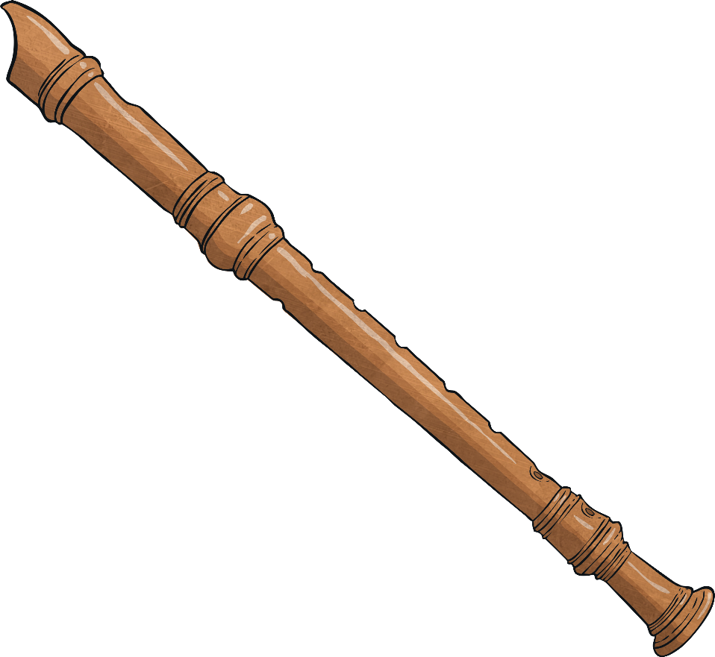
Change Direction
Stand in a circle.
I will choose a multiplication table.
You must say the multiplication table out loud, moving round the circle.
When you hear the sound, you must start saying the table backwards.
If you hear the sound again, start counting forwards again!

Slide 5
Short Multiplication
H
T
O
First set your calculation out correctly with one number in each square. Use a ruler to draw your lines.
 | 4 | 9
× |  | 7
Calculate the ones digit.
9 × 7 = 63.
We can only put ones in the ones column. Write the 3 here.
We need to regroup the 60 ones into 6 tens. These go into the tens column. Write 6 under the line.
3
4
3
Now calculate the tens digit. Multiply 4 by 7. 4 tens × 7 = 28 tens = 280.
We need to add on the 6 tens that we wrote under the line.
28 tens + 6 tens = 34 tens.
6
Write the 4 in the tens column, and the 3 in the hundreds column.

Slide 6


Missing Numbers
Can you work out the missing digits in these calculations?
Click on a paint splat to reveal the answers.
 | 3 | 6
× |  | 4
 | 8 | 7
× |  | 7
1
4
4
6
0
9
2
4

Slide 7

Multiply Three-Digit Numbers
by One-Digit Numbers
H
T
O
First set your calculation out correctly, with one number in each square. Use a ruler to draw your lines.
 | 2 | 3 | 1
× |  |  | 2
Multiply the ones.
Now calculate the tens.
4
6
2
Now calculate the hundreds.

Slide 8
Multiply Three-Digit Numbers
by One-Digit Numbers
H
T
O
First set your calculation out correctly, with one number in each square. Use a ruler to draw your lines.
 | 2 | 0 | 1
× |  |  | 4
Multiply the ones.
Now calculate the tens.
8
0
4
Now calculate the hundreds.

Slide 9
Regrouping into the Thousands
H
T
O
First set your calculation out correctly, with one number in each square. Use a ruler to draw your lines.
 | 4 | 6 | 8
× |  |  | 7
Multiply the ones.
Now calculate the tens.
Now calculate the hundreds.
3
2
7
6
Each time, remember to add on the digits you wrote underneath the line when you regrouped.
4
5

Slide 10
Regrouping into the Thousands
H
T
O
First set your calculation out correctly, with one number in each square. Use a ruler to draw your lines.
 | 5 | 9 | 3
× |  |  | 6
Multiply the ones.
Now calculate the tens.
Now calculate the hundreds.
3
5
5
8
Each time, remember to add on the digits you wrote underneath the line when you regrouped.
5
1

Slide 11

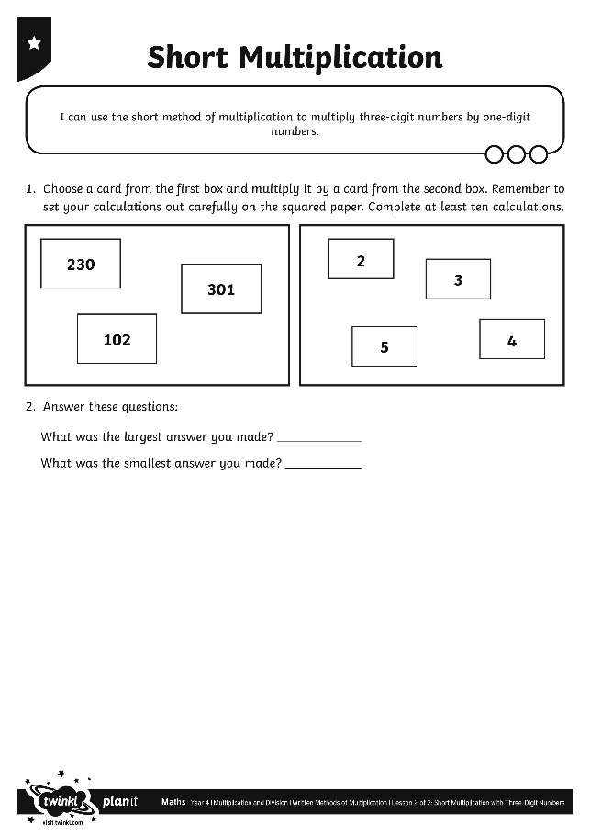
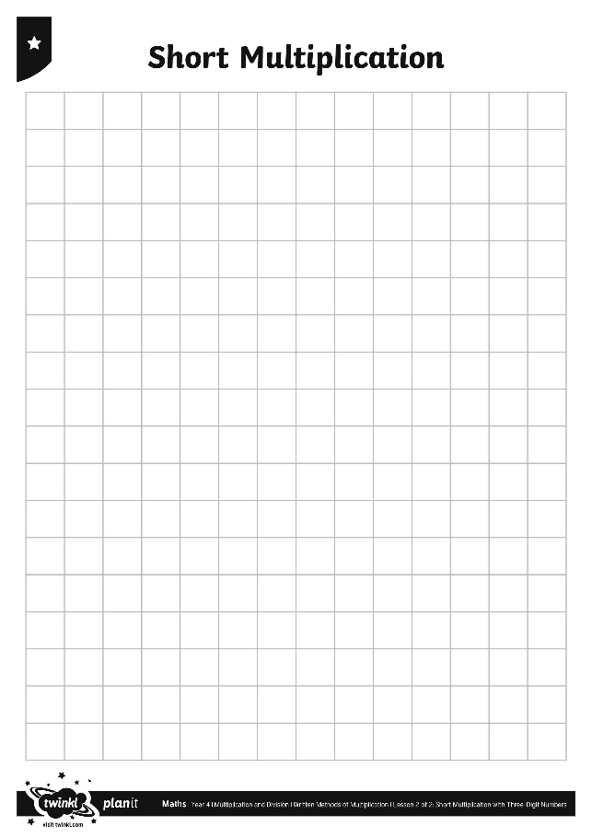
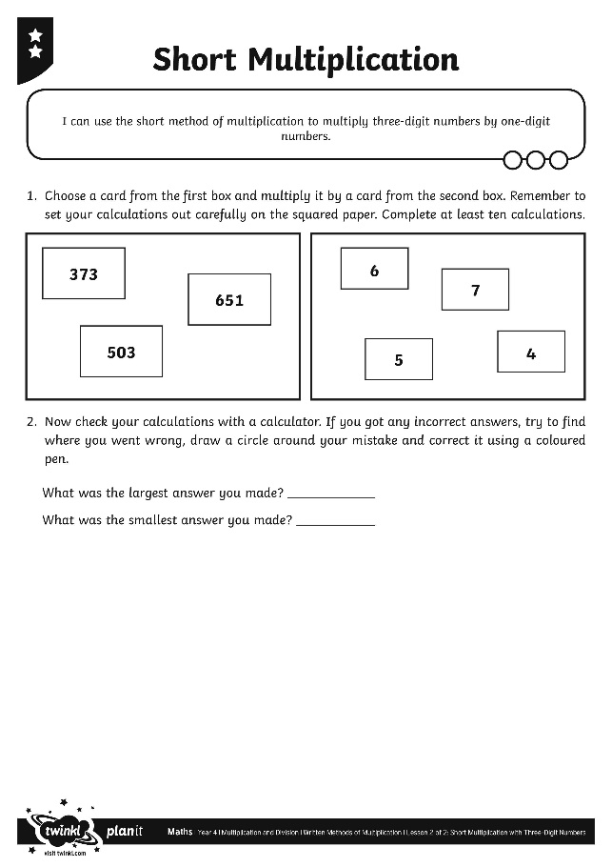

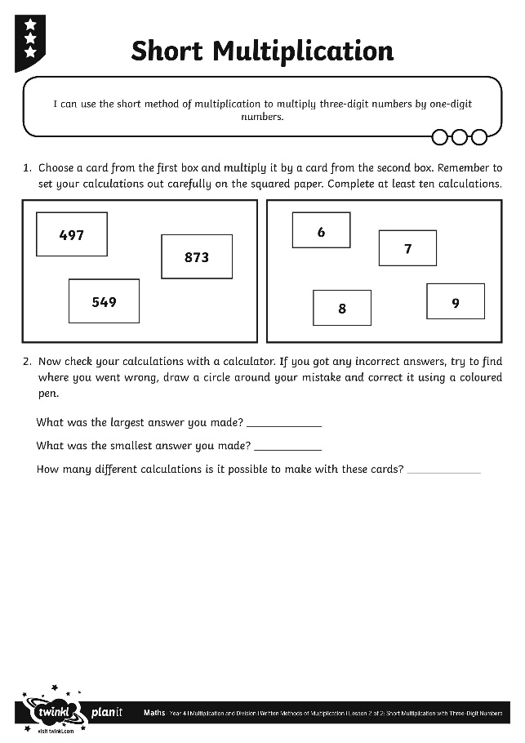

Short Multiplication
Activities

Slide 12


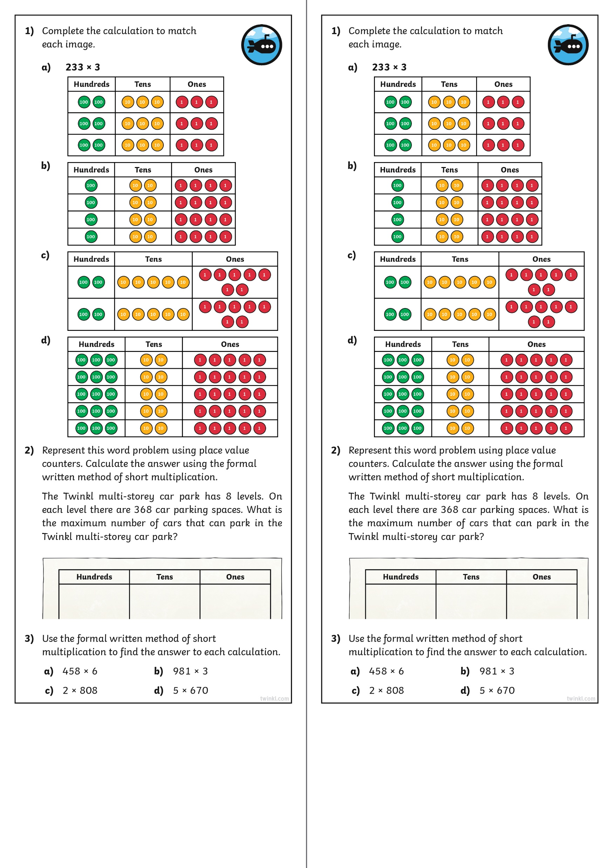
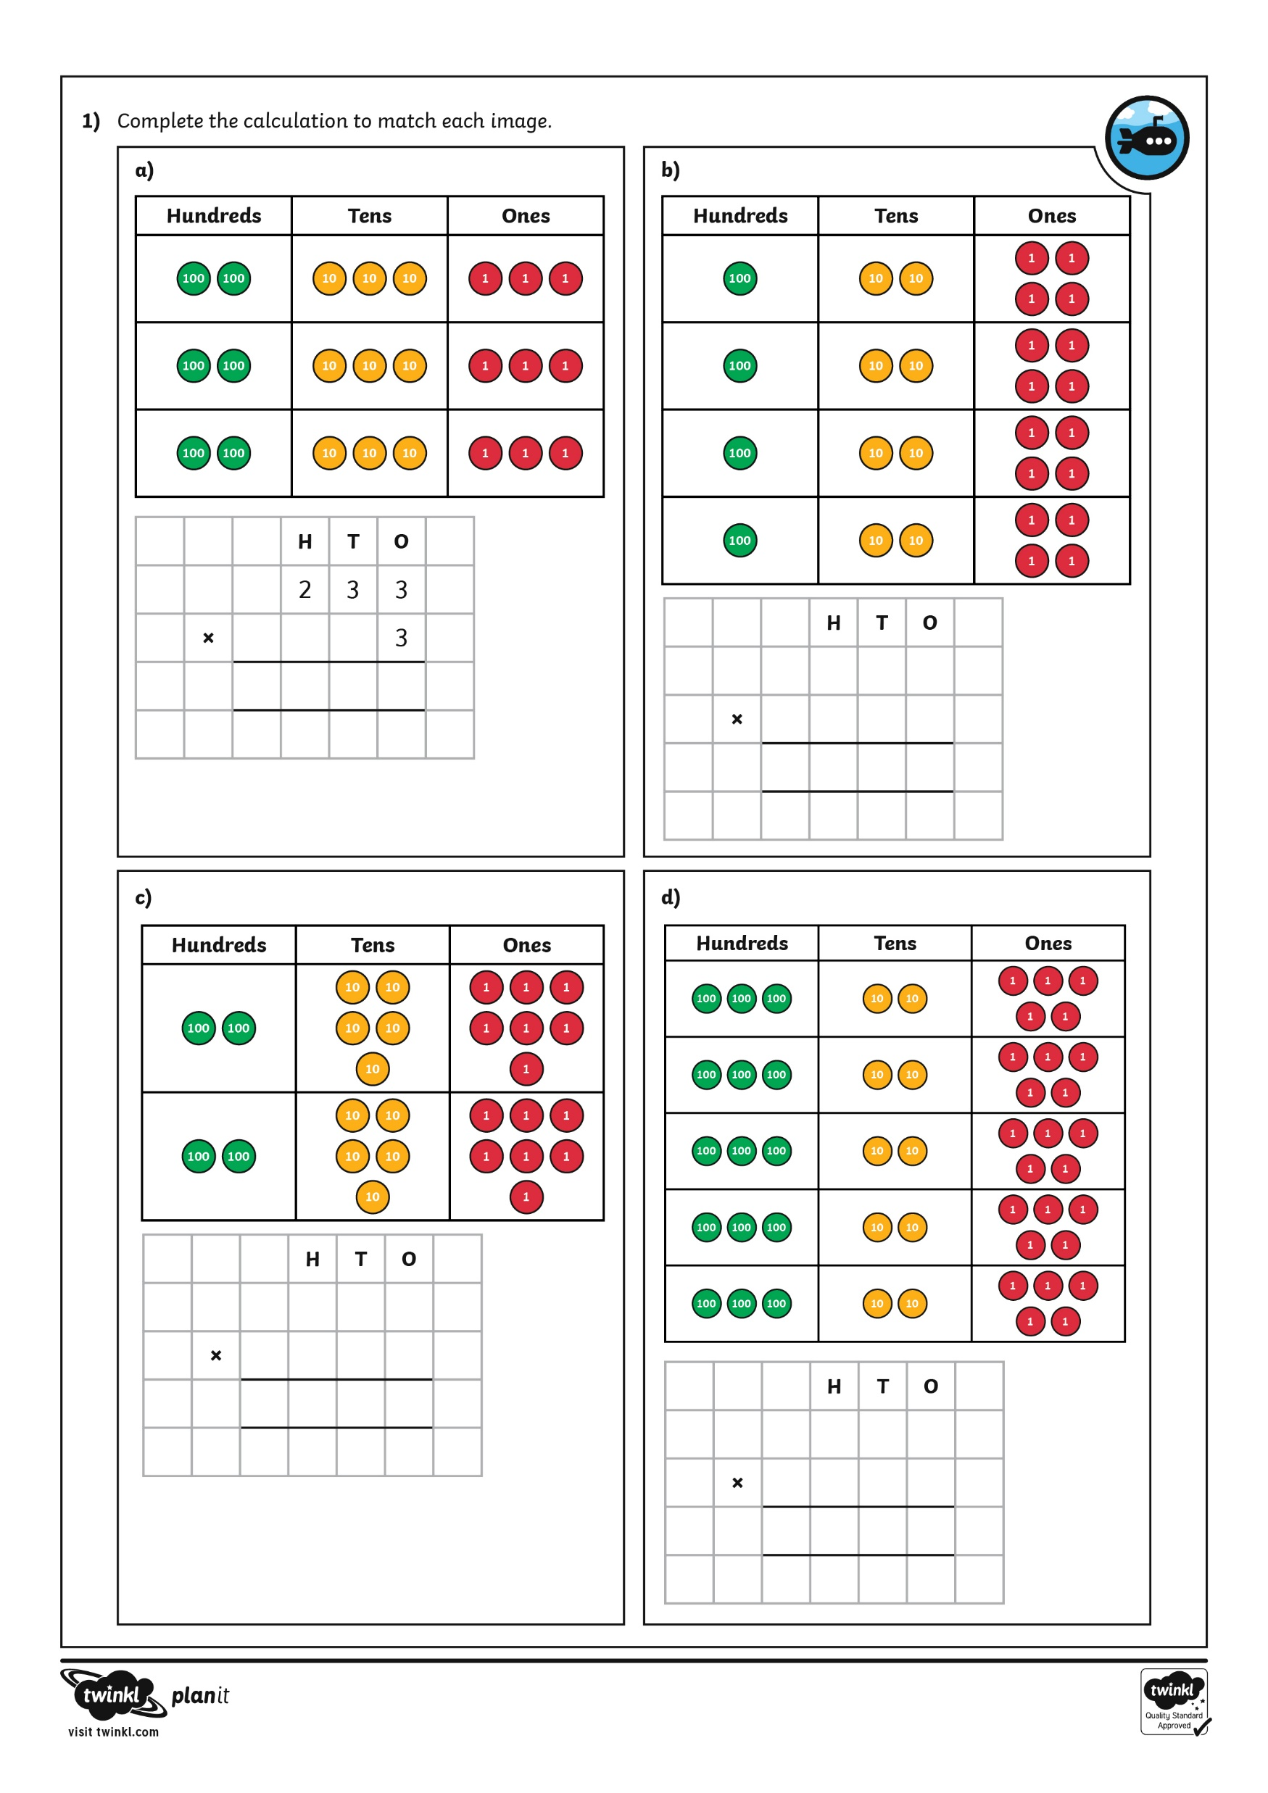
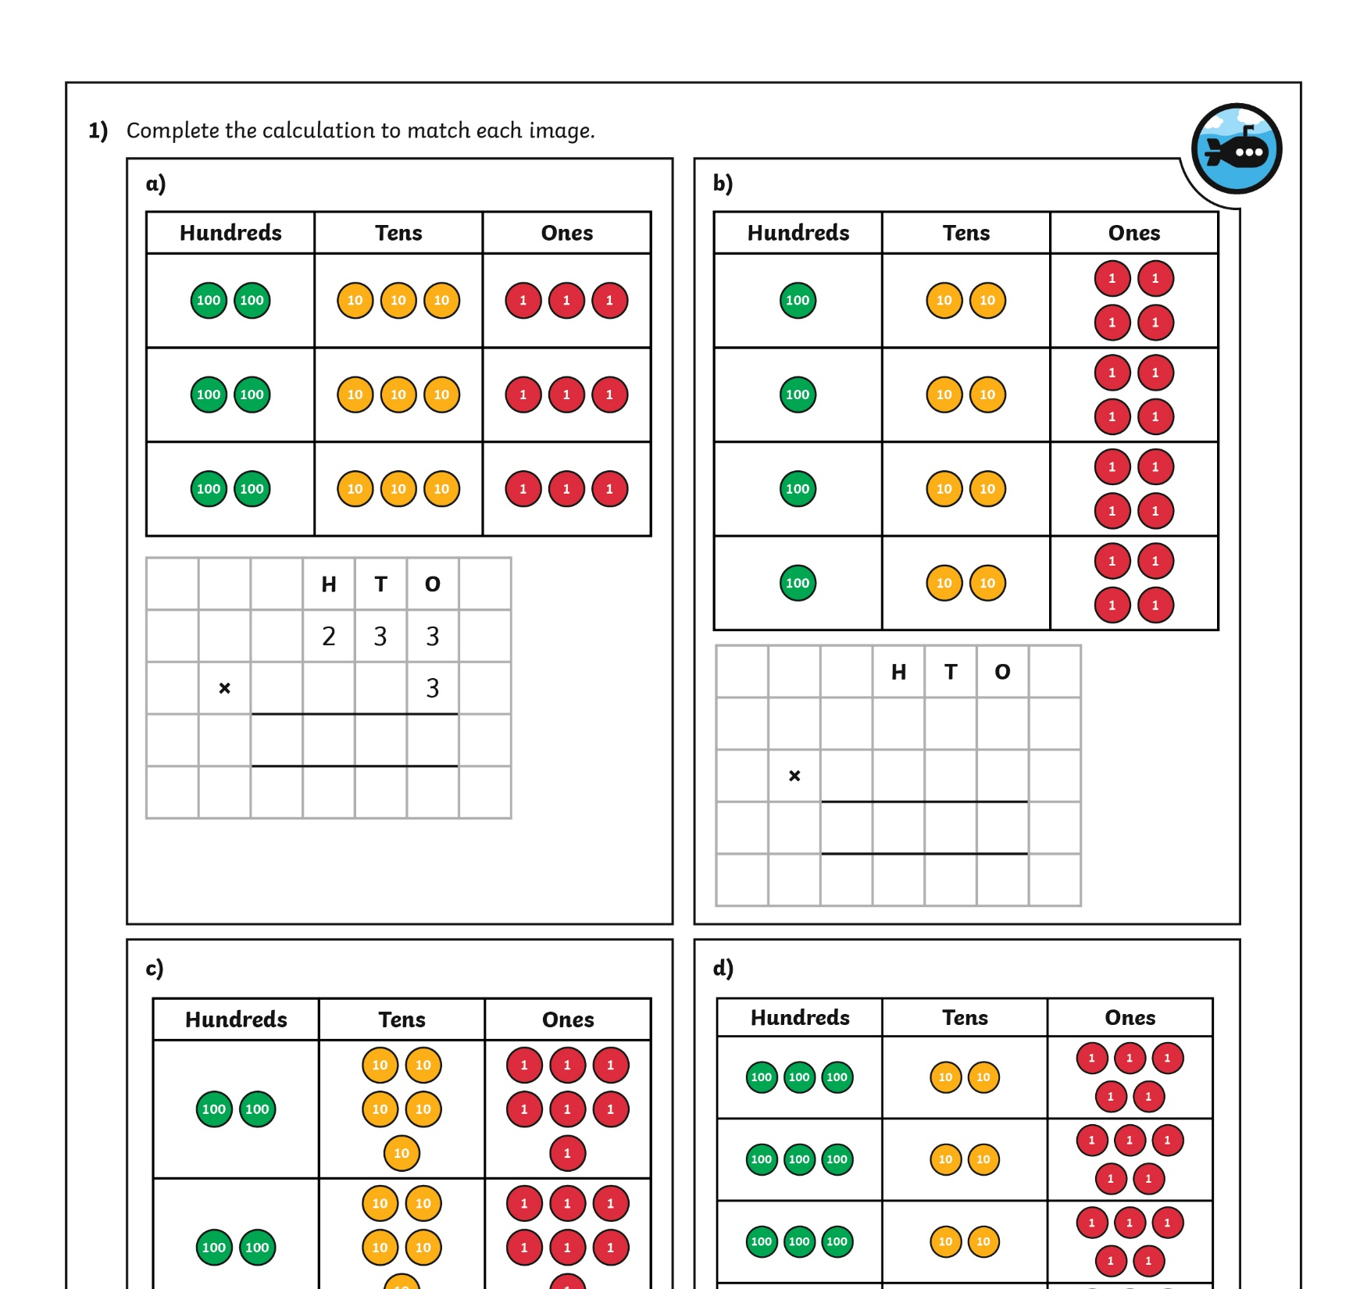
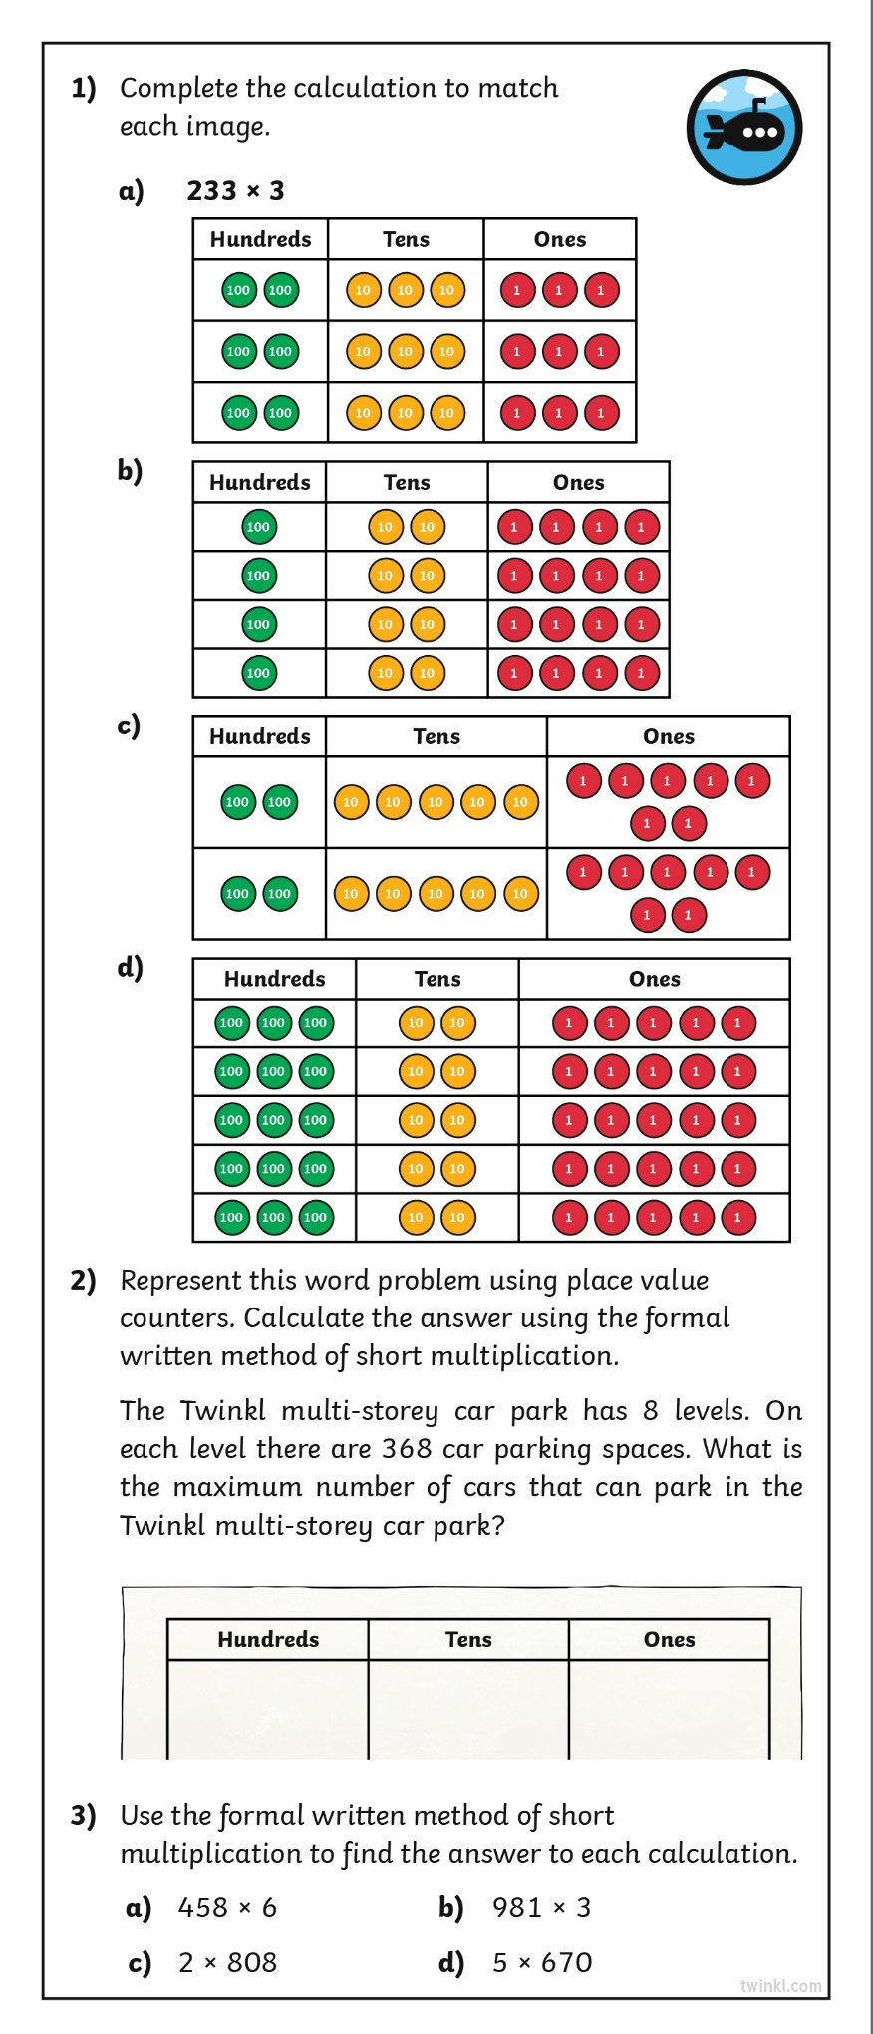
Diving into Mastery
Dive in by completing your own activity!

Slide 13

Work Backwards
Can you replace the paint splat in this calculation with a digit from the cards to make the calculation correct? Click a digit card to see if you were correct.
×
 | 8 | 4 | 0
2
0
1
4
How did you solve this problem?

Slide 14
Work Backwards
Can you replace the paint splat in this calculation with a digit from the cards to make the calculation correct? Click a digit card to see if you were correct.
 | 4
× |  |  | 8
3 | 8 | 0 | 0
4
7
5
6
How did you solve this problem?

Slide 15

Aim
I can use the short method of multiplication to multiply three-digit numbers by one-digit numbers.
Success Criteria
I can set my calculation out correctly.
I can start at the right-hand side when calculating.
I can regroup tens, hundreds and thousands, recording this in the next column.
I can use a calculator to check my own work and fix my mistakes.

