Slide 1
L.O: To understand what personal space and boundaries.

Slide 2
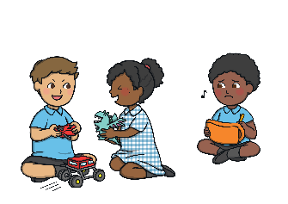
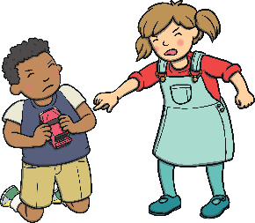
Keeping My Hands to Myself
Sometimes at school, I might sit too close to my friends.
This might be uncomfortable for my friends.
Being too close to someone is called being in their
personal space.

Slide 3
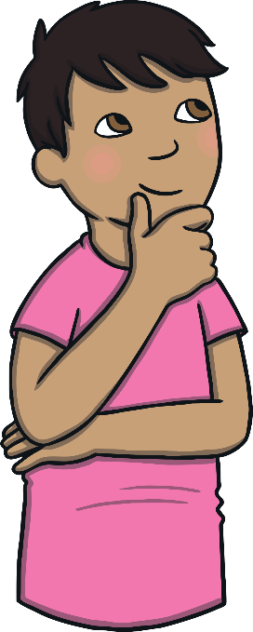
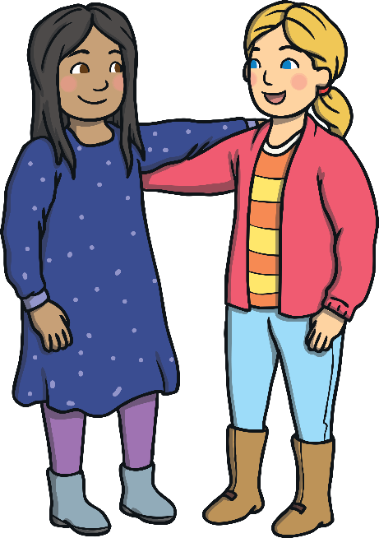
What Should I Do?
I can check to see if I am too close to someone.
I can get really close to my friends if I like.

Slide 4
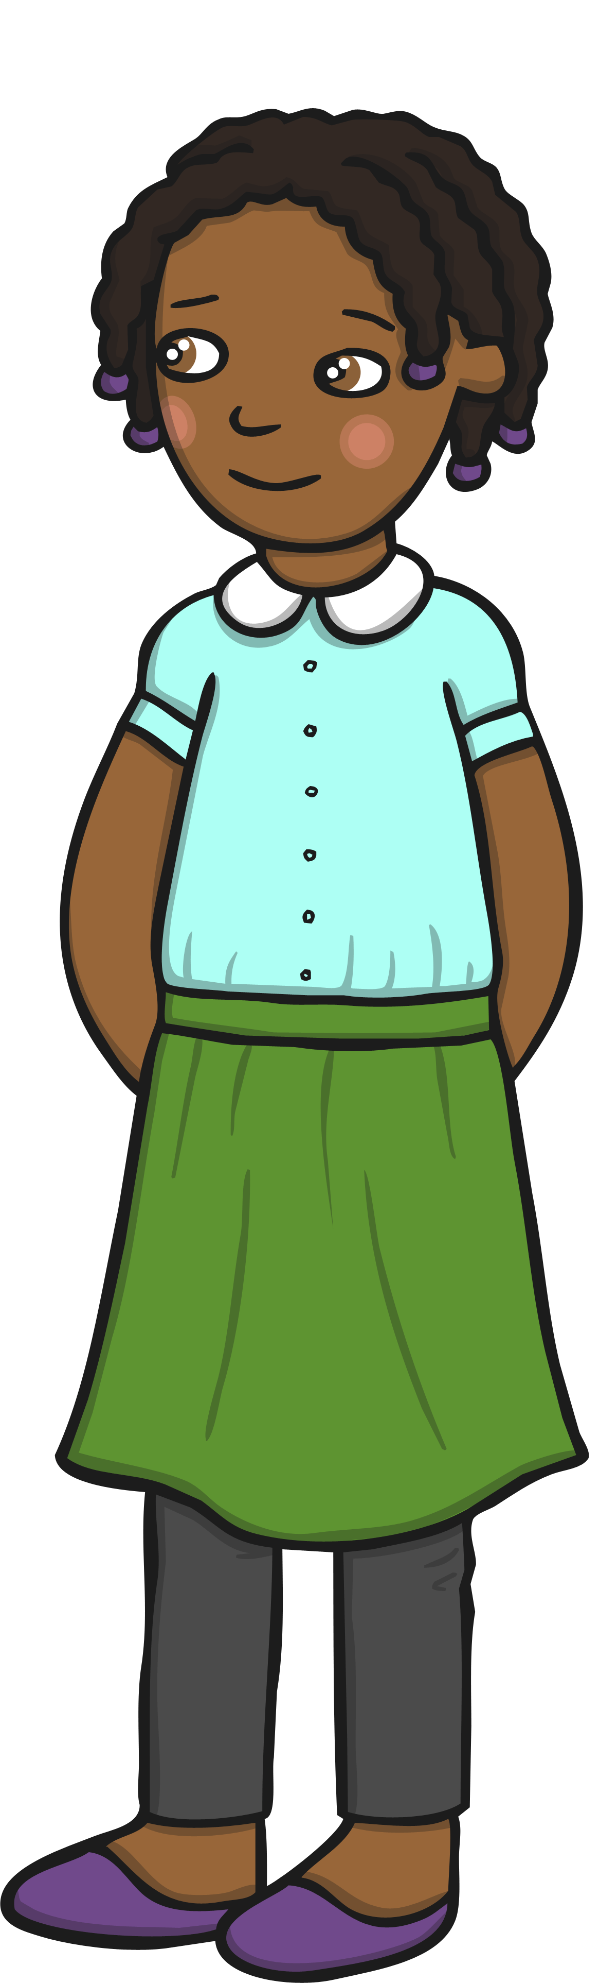
Well Done! Great Choice!
I can check if I am in someone’s personal space by using my arms.
This might be uncomfortable for my friends.
Being too close to someone is called being in their personal space.

Slide 5

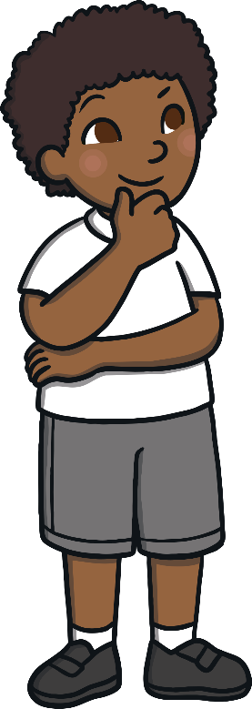
Hmmm… Let’s Think
If we are too close to other people, we can
annoy and upset them.
We can make them feel a bit uncomfortable.
This might make our teachers or friends feel sad.
How would you feel if your friend got too close
to you?

Slide 6


Personal Space Is Important
My friends will be happy when I remember their
personal space.
My teachers will be happy when I remember
their personal space.
I will try to remember other people’s personal space.

