Slide 1
If pictures could speak
National Story Telling Week

Slide 2
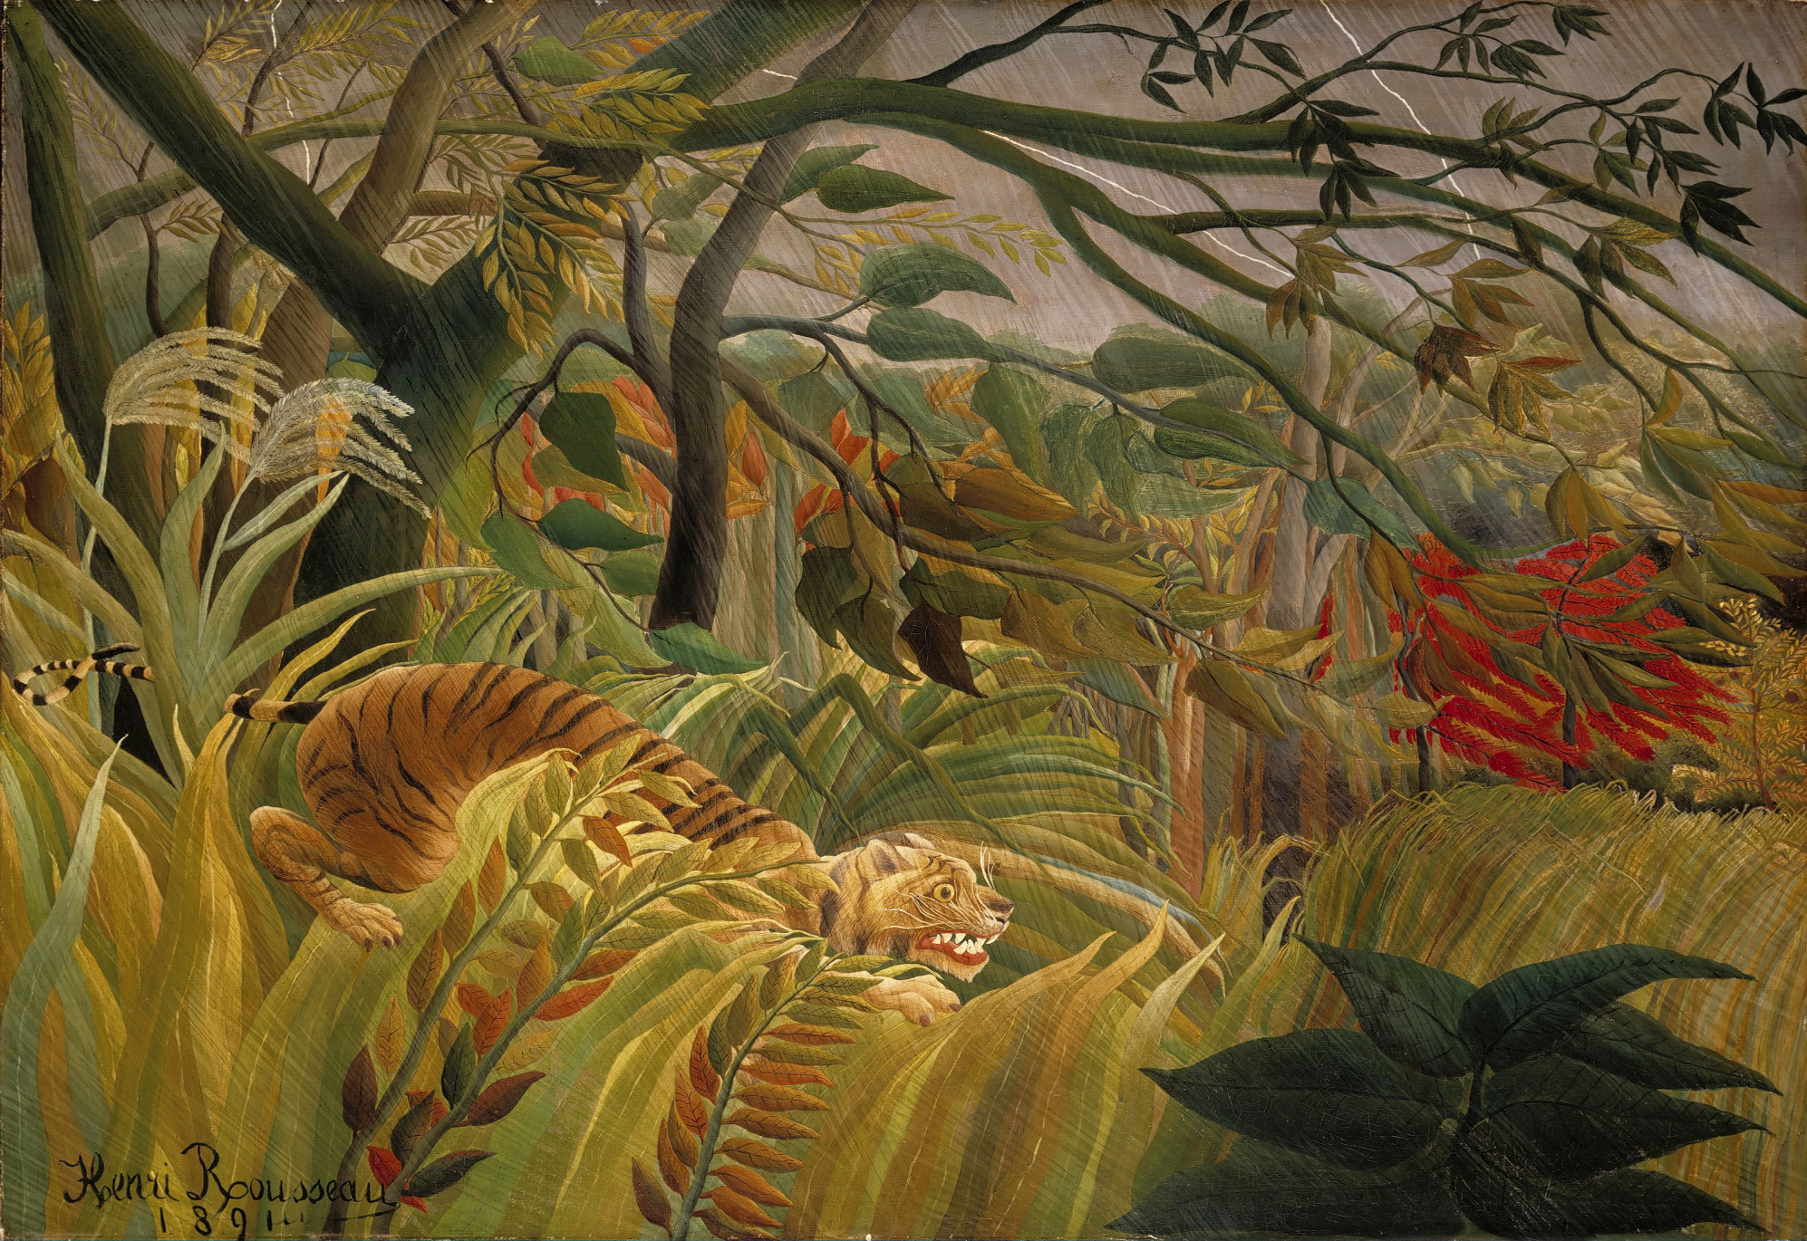

Slide 3


Slide 4
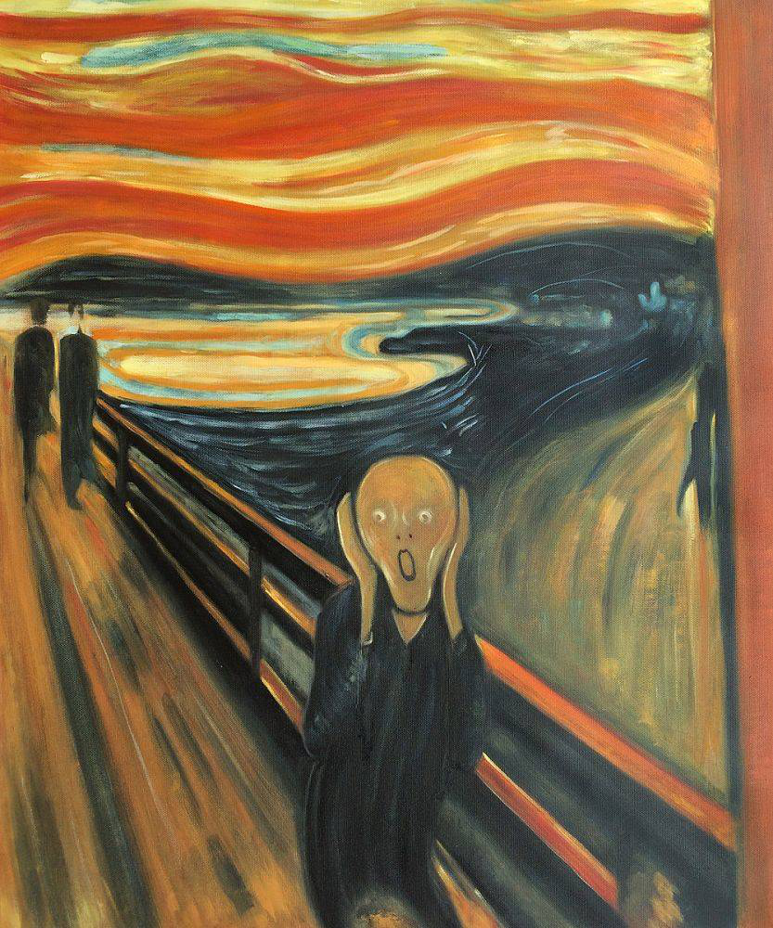

Slide 5
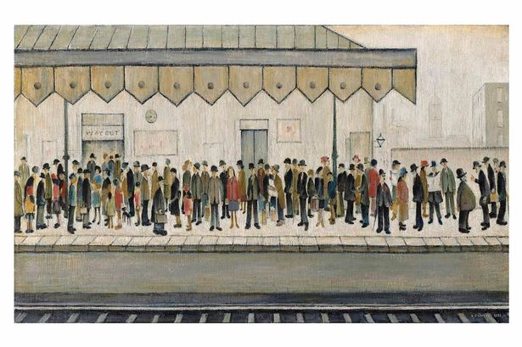

Slide 6
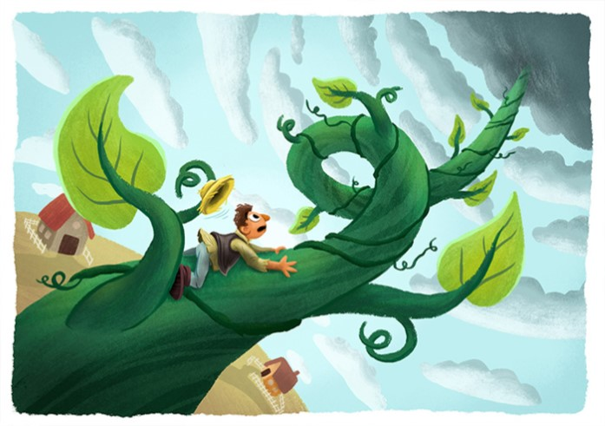

Slide 7


