Slide 2

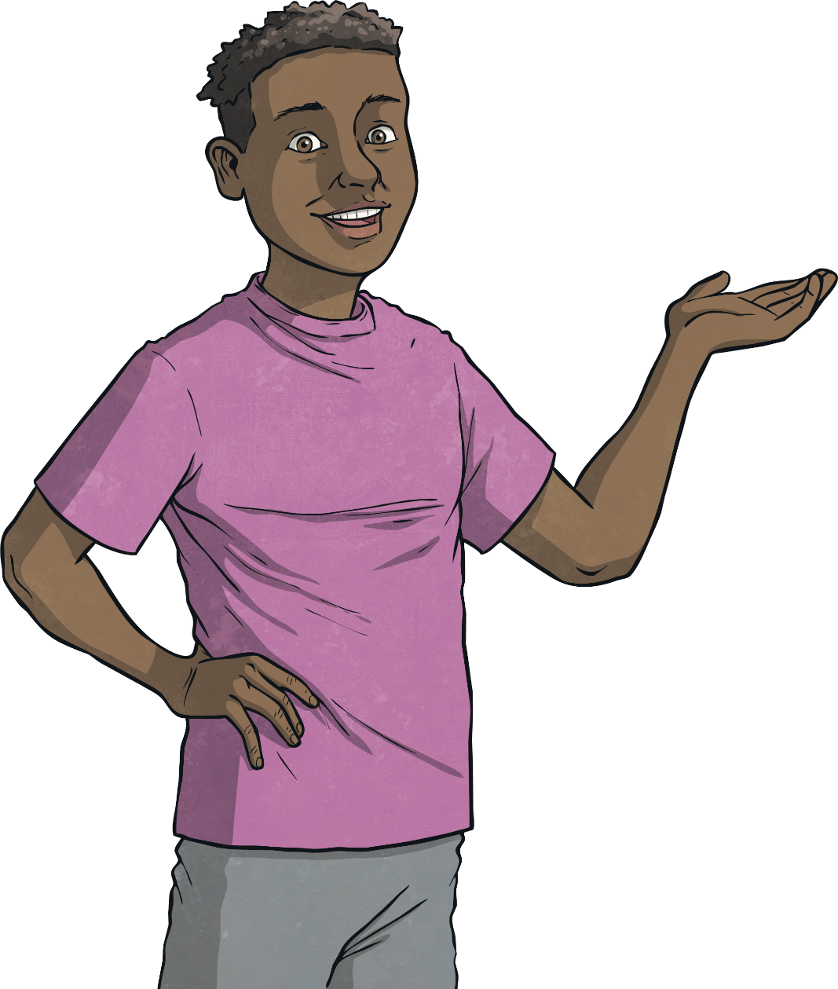
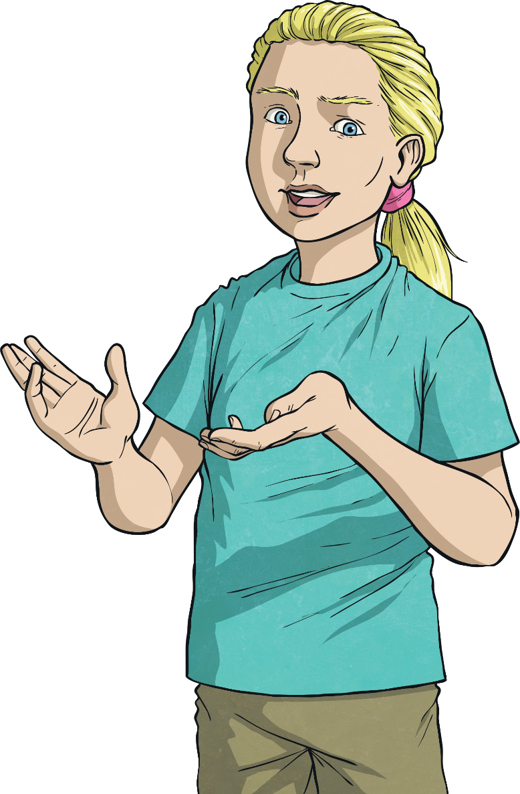
How does it feel when big changes happen in our lives?
How can we cope with these feelings?

Slide 3





Spot the Link
Decide with your partner what all these pictures have in common.

Slide 4

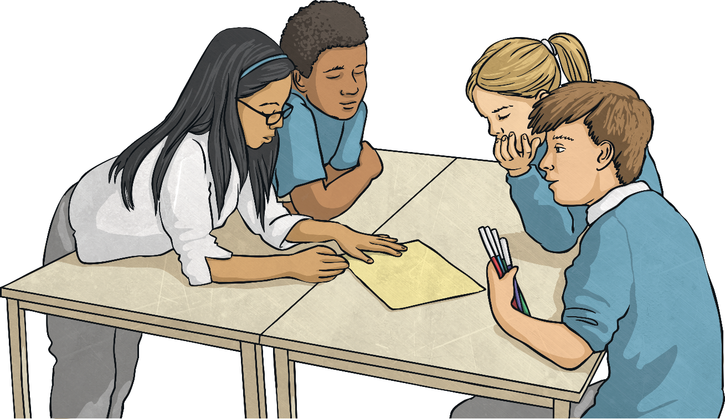
Changes
In your groups, think of changes that a child your age might
have experienced.
You might base this on personal experience, but we are not going to share personal information about ourselves or each other today.

Slide 5
Types of Change
Look at all the changes you thought of in your groups. Did you get any of these?
moving house
moving bedroom
bedroom getting redecorated
changing school
changing class
starting
school dinners
getting a new baby brother or sister
an older sibling leaving home
a friend moving away
making new friends
getting a new pet
parents splitting up
getting a new step-parent
a family member or friend dying
getting new neighbours
getting a new car
selling or giving away all your old toys
joining a club
getting ill or injured
getting a new haircut or glasses
changing groups
a parent starting a new job
a pet dying
a family member getting ill or injured
a parent losing their job

Slide 6


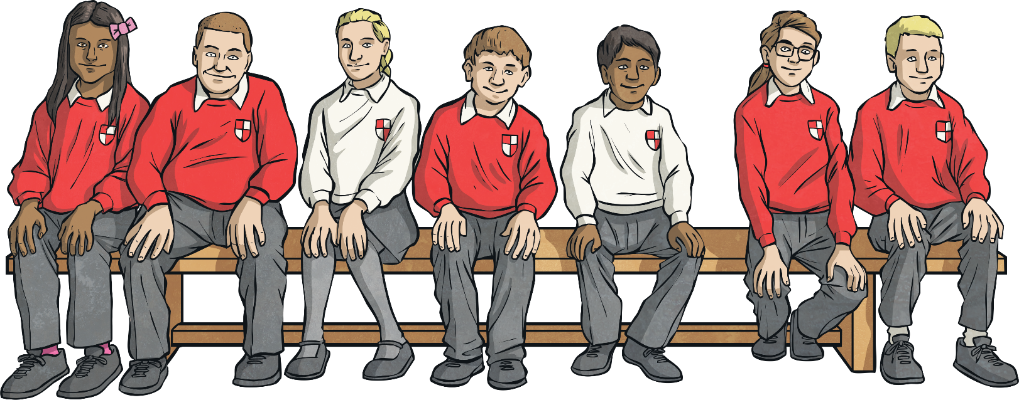
Types of Change
Changes happen all the time and happen to everyone. It’s part of life.
Some changes happen really suddenly, but sometimes we know a change is going to happen and we can prepare for it.
Different types of change can make you feel different emotions.
Some changes are small and others are pretty big.
Different people might see changes differently, so what one person thinks is a small change that’s easy to cope with, another person might see as a problem.
Some changes are exciting and fun, while others are really difficult to cope with and cause us to feel uncomfortable emotions. Some changes cause us to feel a mixture of comfortable and uncomfortable emotions.

Slide 7


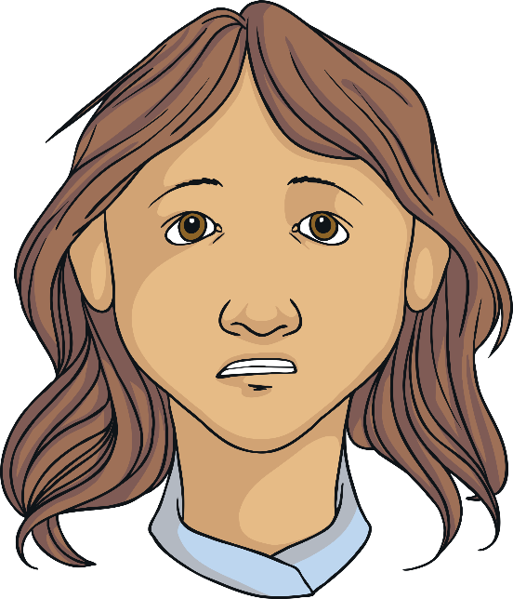
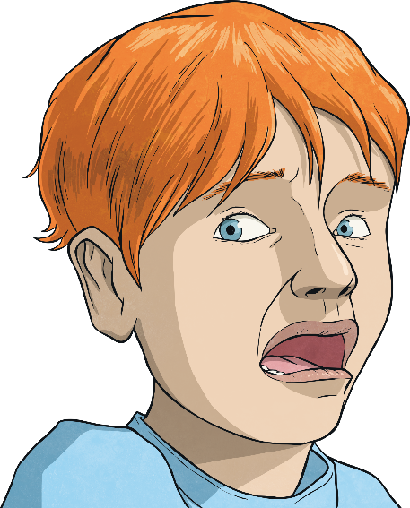
Coping with Change
What emotions did you note down that might be linked to these different changes?
Let’s go round the class and when it’s your turn, suggest an emotion or feeling that people might experience due to a change in their life.
It could be a pleasant or an uncomfortable emotion.

Slide 8
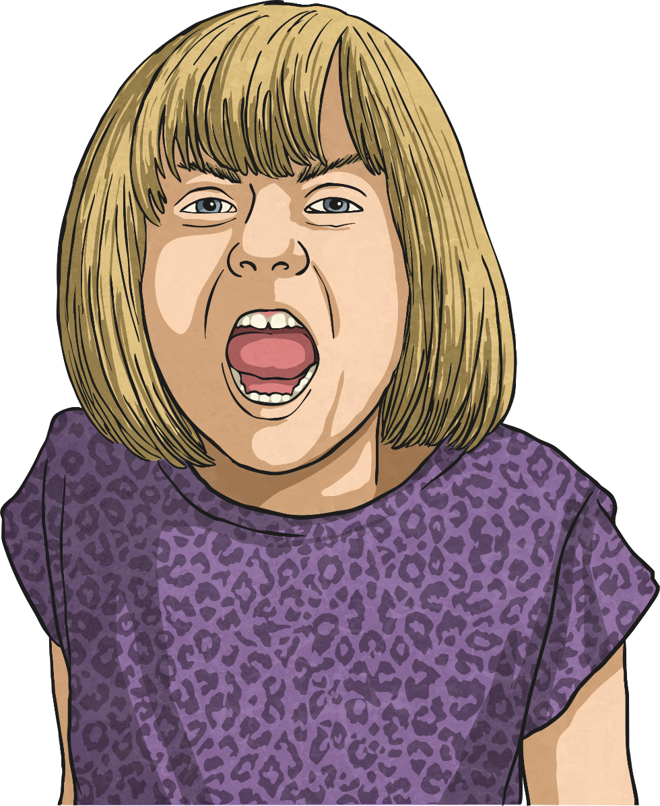
Coping with Change
Now, let’s think about those emotions that are not so nice to feel…
Sadness, anger, worry, fear, loneliness, jealousy. Some changes can make us feel these emotions and that can be really hard to deal with.
It’s very normal to feel these sorts of emotions and it’s OK to feel this way.
But you wouldn’t want to feel like this for long, so it’s good to have some strategies for coping with these sorts of emotions.
Let’s see what you can do to help with difficult emotions.

Slide 9

Coping with Change
The first thing to remember is that whatever is changing now, won’t go on forever and you will get used to the change over time.
People say time is a great healer and it’s true – things tend to get better as time goes on.
Which sorts of change could time help with?

Slide 10
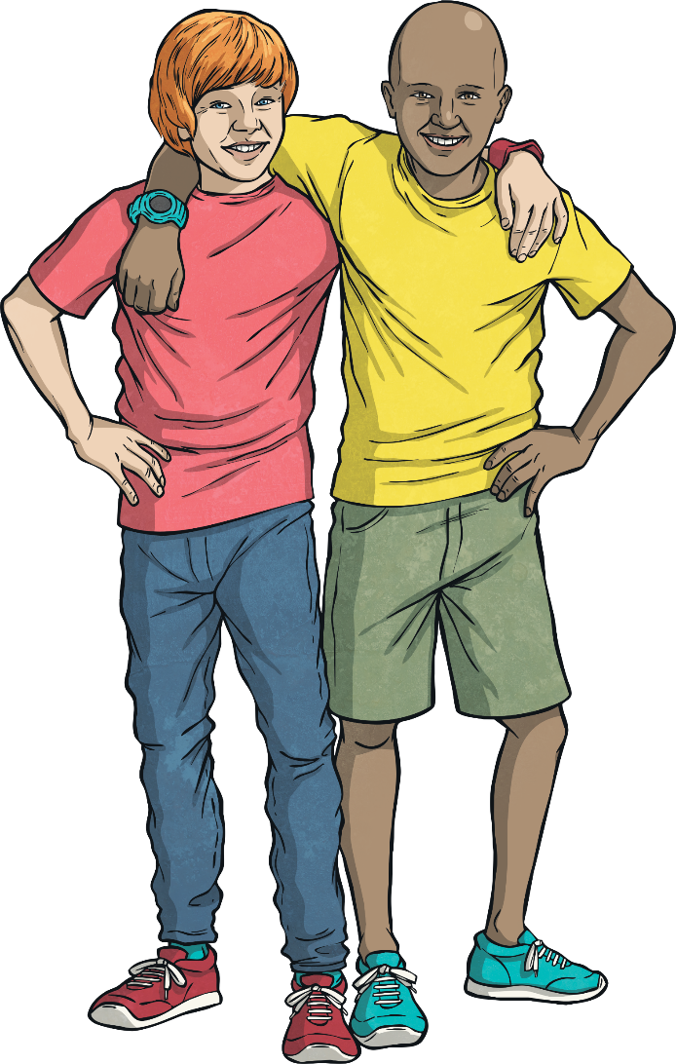
Coping with Change
Friends can often help us out when we’re having a tough time. Our friends care about us and are often good listeners.
It could even be that a friend has been through the same kind of change and understands how you’re feeling.
Which sorts of change
could friends help with?

Slide 11
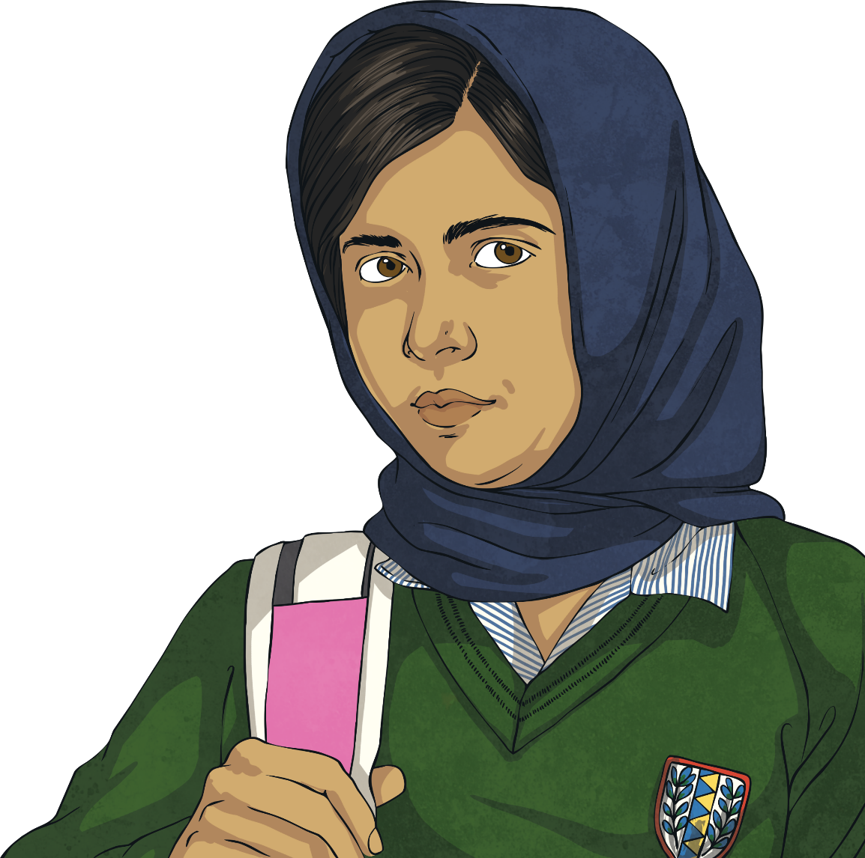
Coping with Change
Thinking about the change that is going to happen and preparing for it can really help. This might mean planning what you are going to do or say in a certain situation or talking to others to get advice about something.
Which sorts of change
could being prepared
help with?

Slide 12

Coping with Change
Sometimes writing your feelings down can help
get them out and stop them from getting
bottled up inside.
You could write them down in a notebook,
a diary or in a letter to someone.
Which sorts of change
could writing your
feelings down help with?

Slide 13
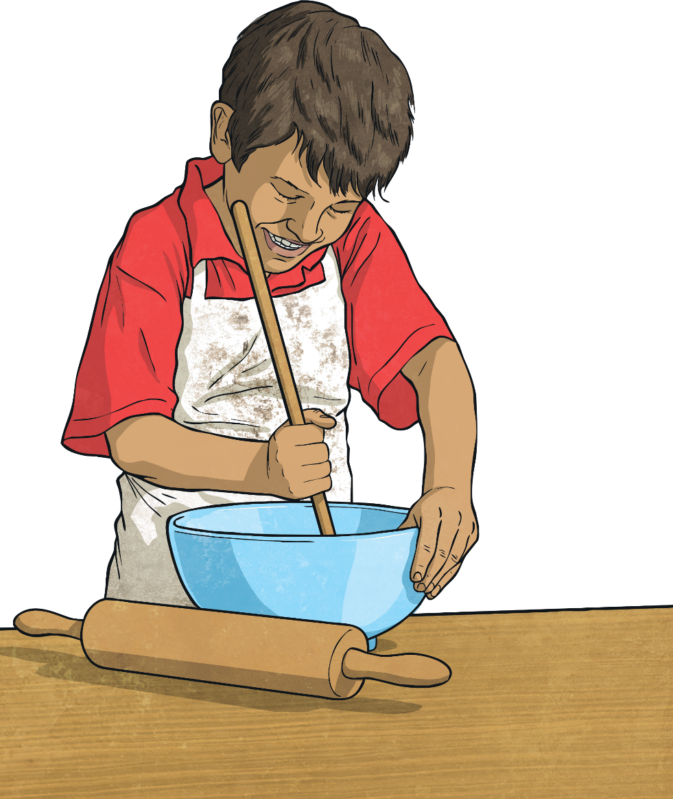
Coping with Change
When your head feels too full of thoughts and feelings that are getting you down, you can focus on something you really enjoy – perhaps on your own or perhaps with others – to distract you from your difficult feelings and keep you busy.
Which sorts of change could keeping busy
help with?

Slide 14
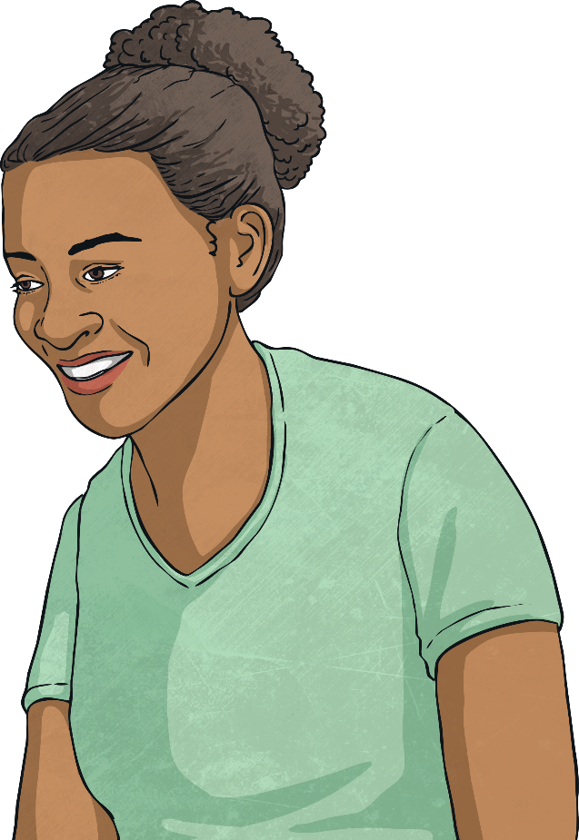
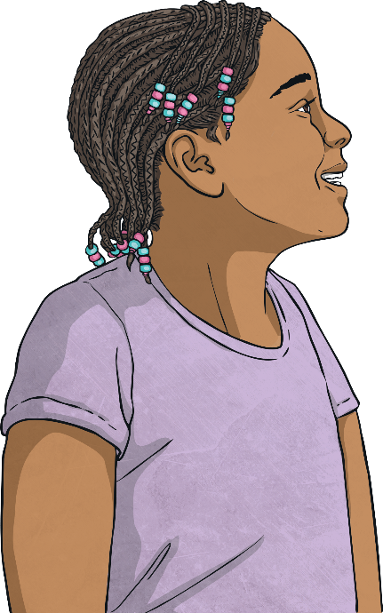
Coping with Change
People say:
Talking to a trusted adult about the change you are worried about or about the emotions you are experiencing due to a change in your life can be a really good way to get help.
“A problem shared is a problem halved”
Consolidating
“It’s good to get things off your chest”
It could be a family member, a teacher or a counsellor.
Reflecting
Some changes can make us feel lonely, as if we are the only one who feels a certain way about the change. If you feel at all lonely it is really helpful to talk to a trusted adult.

Slide 15
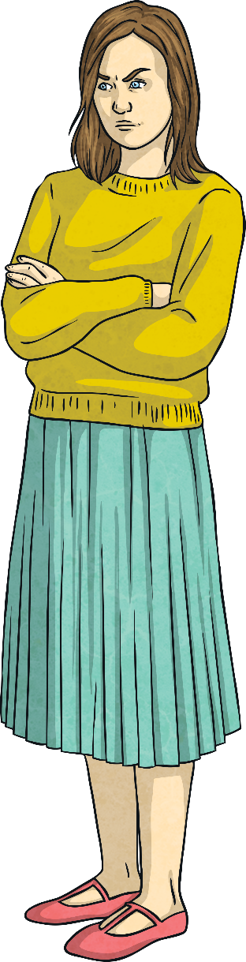
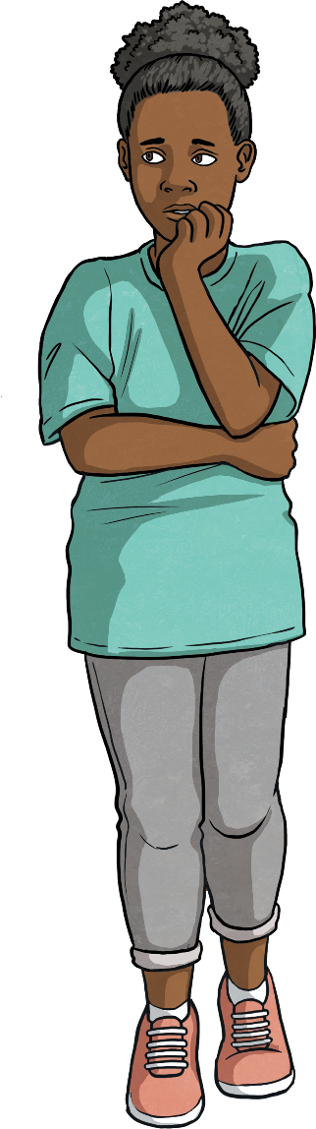
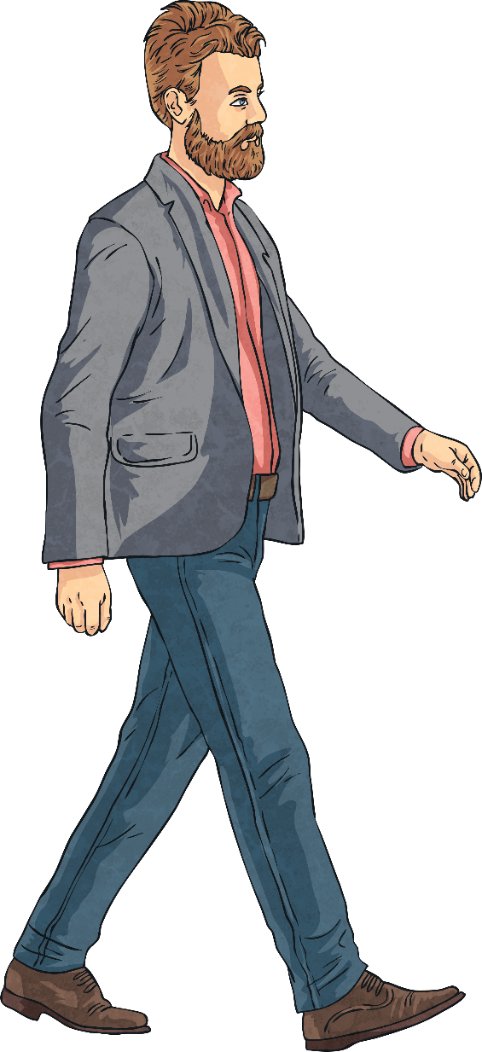
Help Lacey Out
After lots of talking and arguing, Lacey’s parents have decided to separate and her dad is going to move out, into a flat on the other side of town. It’s going to be a big change.
Lacey feels worried too. She worries that she will miss her dad when he is not there and that he might not bother
to see her as often.
All this change is a lot to deal with and Lacey is struggling to manage all these uncomfortable emotions.
Lacey is feeling angry. She is angry at both her parents for not staying together and not working things out.
She worries about her mum having to look after her and her brother all by herself and she is worried about them not having enough money.
What could she do?
She is also feeling confused. Why does her dad have to move out? Why can’t things just get better?

