Slide 1
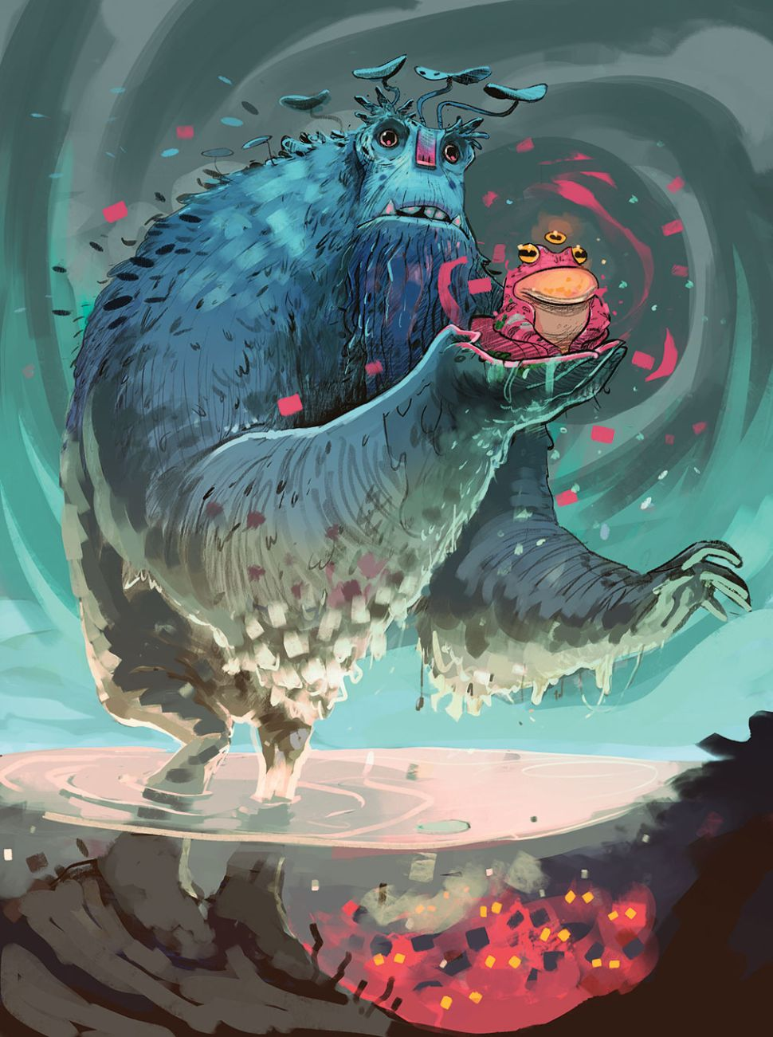
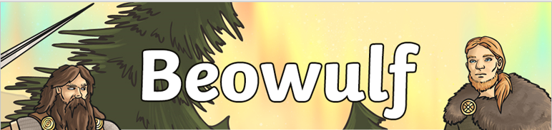
Create your own Monster

Slide 2
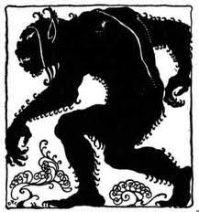
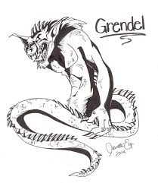
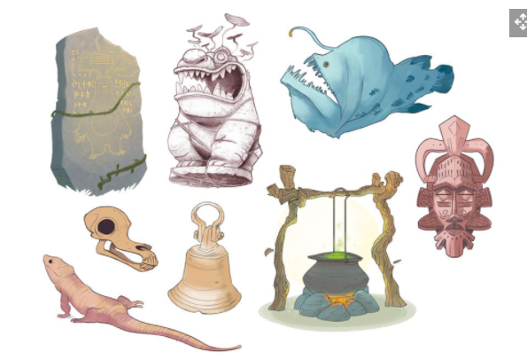
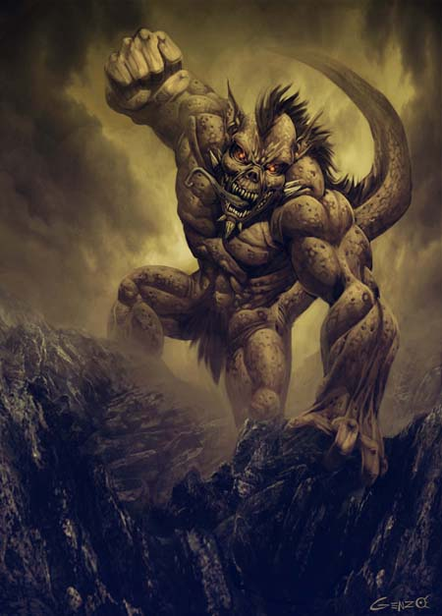
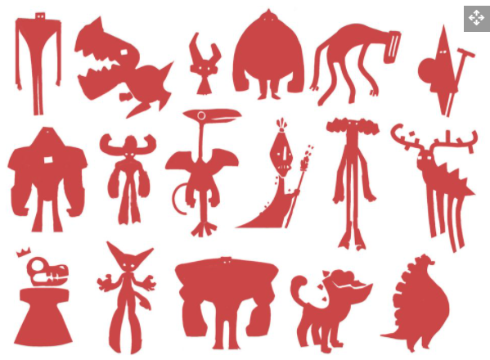
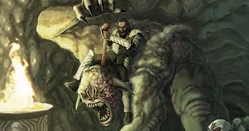

This week we will be creating our very own monsters.
Everybody, will have different ideas and thoughts of how they will want their monster to look.
I would really like you have fun with this and to be as imaginative as you can be.
If you are struggling for ideas or where to start use the images and tips over the next few slides for inspiration.
These images are all illustrations and drawings of the same monster Grendel from Beowulf. Each on each one has been drawn by a different artist and how they imagine the monster will look like.

Slide 3
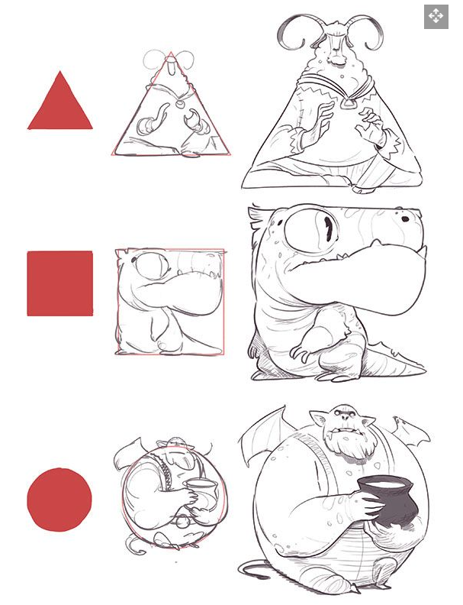
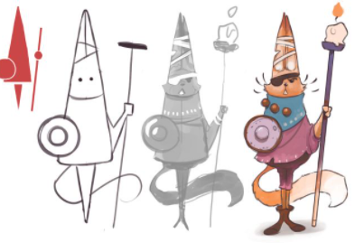
Drawings are made up of all different shapes. Start off with basic shapes, then combine shapes together to form the outline of your monster from this you can start to add different features.

Slide 4
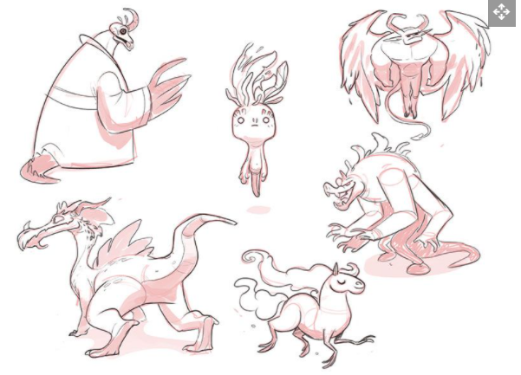
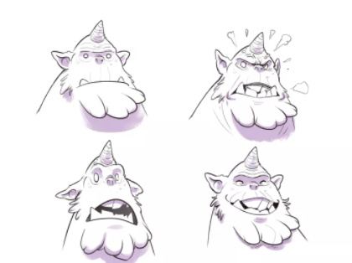
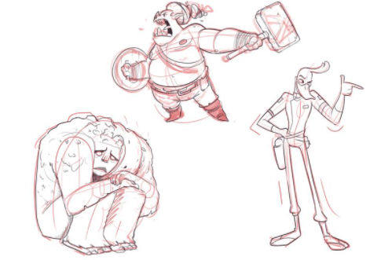
Sketch your monster try not to rub out pencil marks every time you think you have made a mistake, this could add to your image and give you a new idea or you can rub them out at the end.
Think about the body language and facial expressions of your monster, do you want your monster to look kind and friendly or can you make your monster look scary and evil.

Slide 5
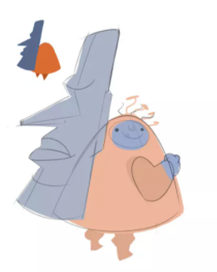
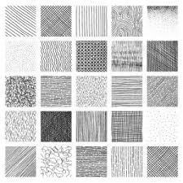
.
Using the skills you already know, add shading and tone to your drawings. You can apply this by using a pencil, or pencil crayons. This will be more effective and add more character to your monster.
Remember for lighter areas leave a gap between the pencil marks and have them spaced apart.
For darker areas make your pencil marks closer together.

Slide 6
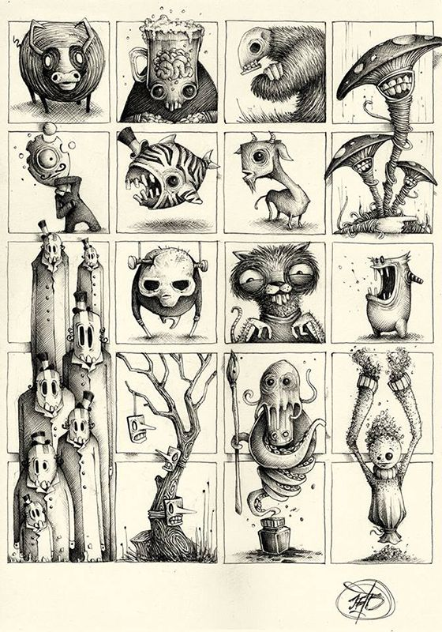
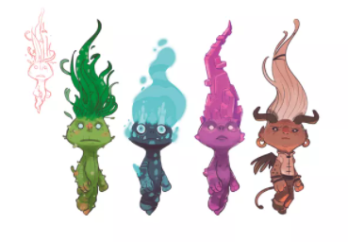
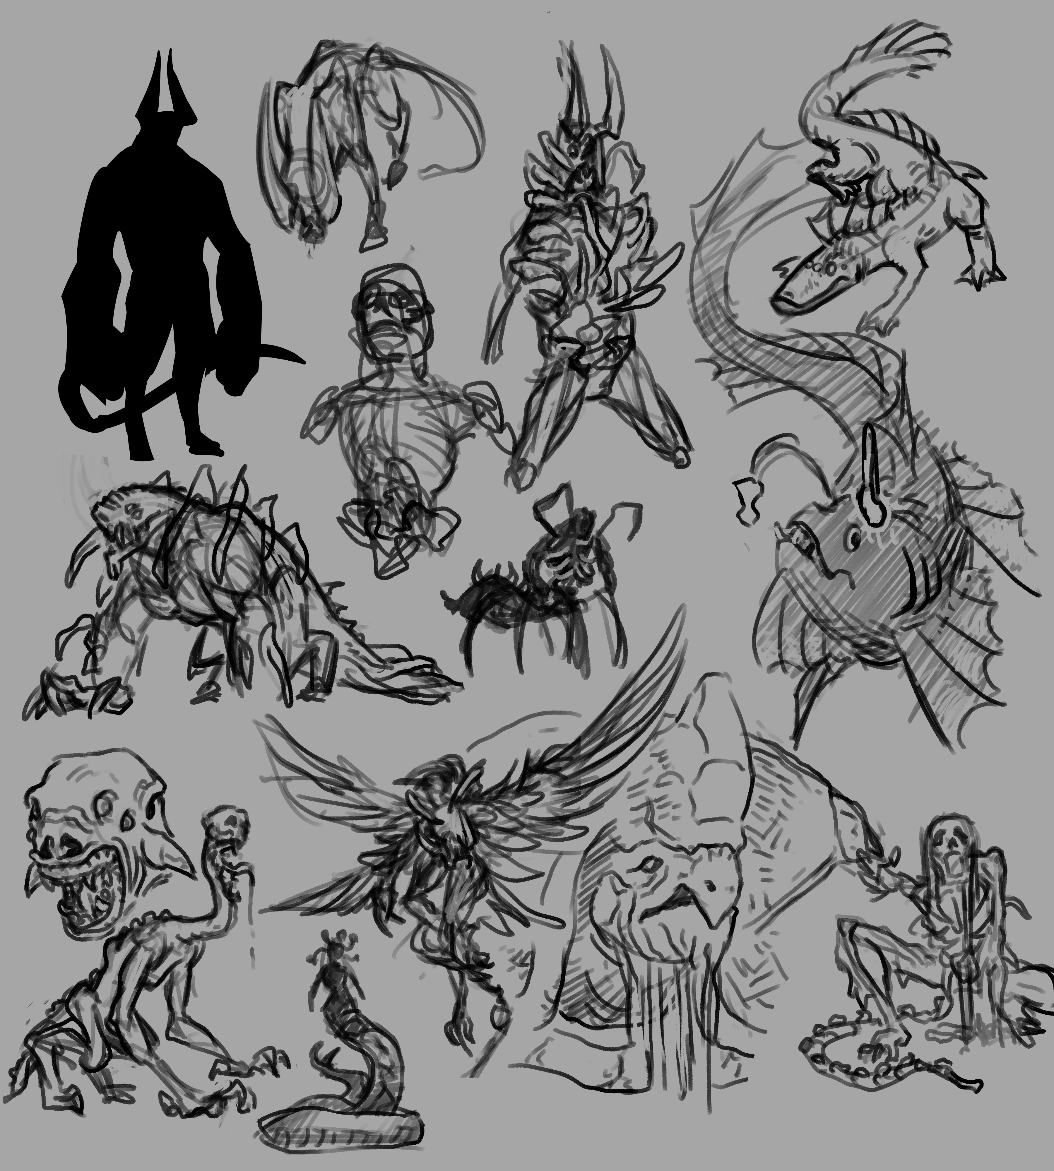
Try a few different ideas, you can keep parts you like from one of the monsters you have drawn, add new features or draw a completely different monster.

Slide 7

Use images from books, google and you can also follow videos on YouTube.
https://www.youtube.com/watch?v=2PI7eZ8zQG0 –Grendel
https://www.youtube.com/watch?v=mM71LoetVQ4- Peak Monster
https://my-how-to-draw.com/how-to-draw-monsters.html- Monster
I would like you to sketch a few different ideas for your monster and choose which one you would like to use for your final piece next week.

