Slide 2
Keywords
We are going to be thinking about some of these words. Do you know what any of them mean? What do you think of when you hear these words?
apartheid
racism
campaign
segregation
reconciliation

Slide 3
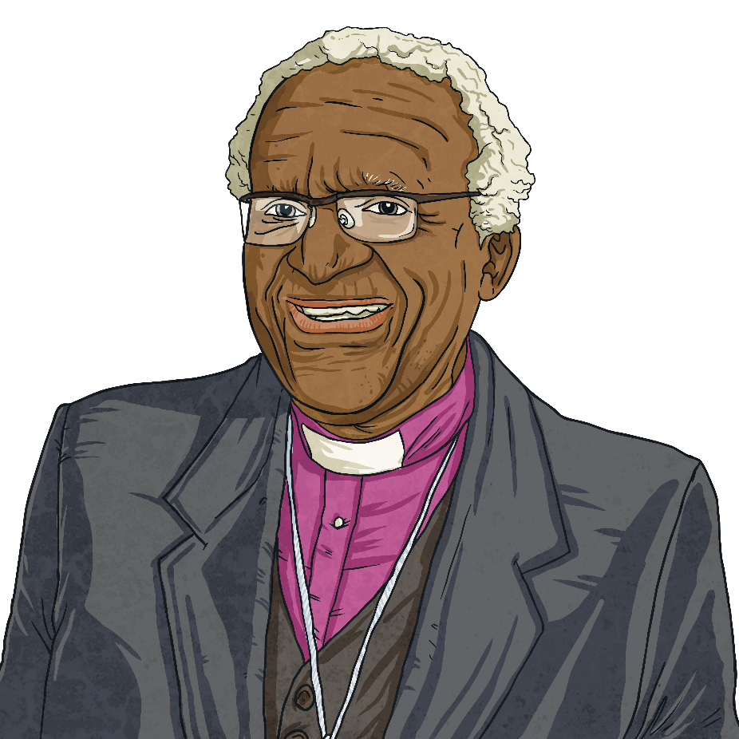
Desmond Tutu
Desmond Tutu is a South African cleric and civil rights campaigner. He is known for his work in bringing an end to apartheid in South Africa and has also campaigned to bring an end to world poverty.

Slide 4
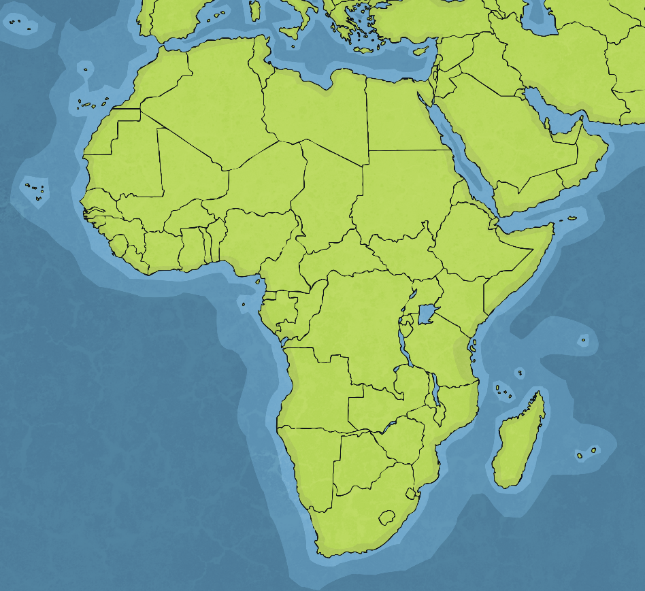
Early Life
Desmond was born on 7th October 1931 in Klerksdorp, South Africa.
The city where he grew up was known for its gold mining. It had been founded by White settlers originally from the Netherlands. These settlers were known as Voortrekkers and later, Afrikaners.
Like all Black people in the area, Desmond and his family were forced to live in a certain part of the town, known as the ‘native location’. Desmond’s family were poor, as were most Black families in Klerksdorp.
South Africa

Slide 5
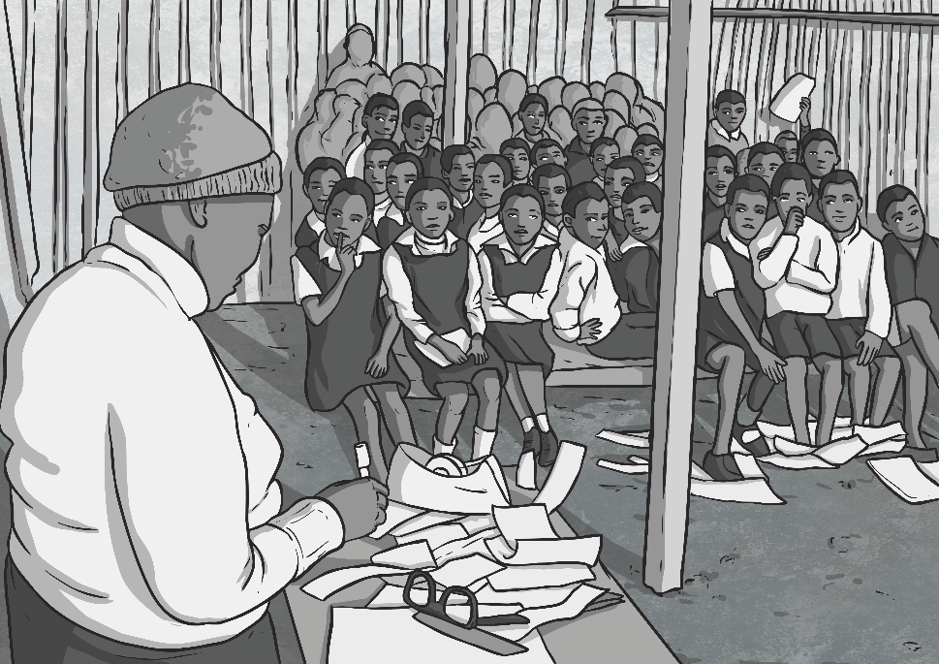
Education
Desmond’s father, Zachariah, was a primary school teacher. Desmond attended his father’s school, where he discovered a love of reading and football. Desmond did well at secondary school and enjoyed playing rugby while there.
Originally, Desmond wanted to become a doctor but his parents couldn’t afford the tuition fees. Instead, Desmond trained as a teacher.
In 1953, the South African government introduced a law called the Bantu Education Act. This law made all education completely separate for Black and White children. Facilities provided for Black children were nowhere near the standard provided for White students. After the introduction of the law, Desmond felt he could no longer be a teacher.

Slide 6
Apartheid
The Bantu Education Act was part of a system in South Africa known as apartheid.
The word ‘apartheid’ comes from the Afrikaans language and means ‘separateness’ or ‘distantiation’. It was a system designed to keep Black and White people completely apart in all aspects of life. The system officially started in 1948 although oppression of Black people had been happening for many years before that.
Apartheid served to oppress Black people in all areas of their lives. They were forced to live in certain areas. If they had to travel, they were forced to carry travel papers. Marriage between Black and White people was outlawed.
As time went on, more apartheid laws were passed. If Black people disobeyed the laws, they were imprisoned.

Slide 7

Becoming a Priest
In his childhood, Desmond had become a Christian. After feeling he could not longer continue as a teacher, Desmond decided to become a priest instead. After studying religion at college, Desmond was ordained as a priest in 1960.
In 1962, Desmond was given funding to travel to England to do further studies in religion. Desmond’s wife, Nomalizo, and their children travelled with him. As Black people, the Tutu family had to get permission from the South African government to travel. It is thought that they were given permission because at the time, Desmond wasn’t involved in the anti-apartheid movement. While living in England, the Tutu family saw what freedom they had away from apartheid.

Slide 8

Return to South Africa
In 1966, Desmond and his family returned to South Africa. The family found it difficult to readjust to living life under apartheid.
Desmond began to speak out against apartheid. In 1968, a group of students at Fort Hare held a peaceful sit-in protest against apartheid. The police threatened to disperse the protesters through the use of dogs. Desmond walked into the group and began to pray with the students.

Slide 9
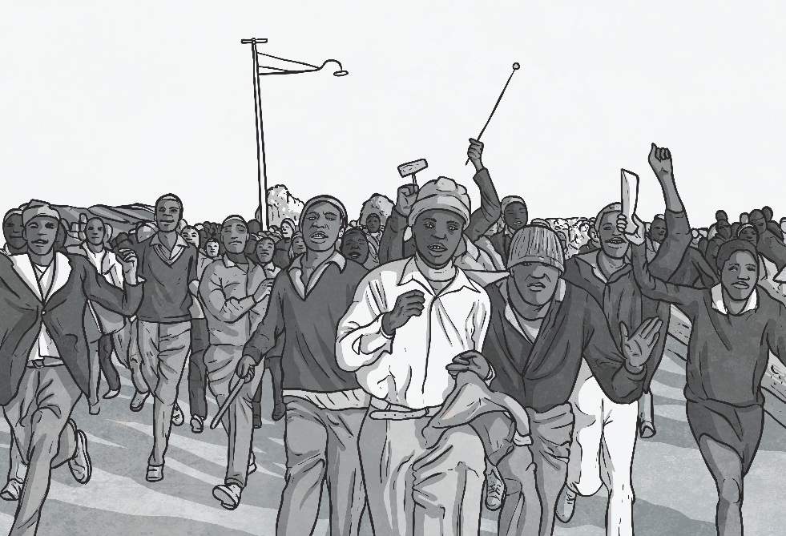
The Soweto Uprising
On 16th June 1976, more than 10,000 Black students started a peaceful march to protest against apartheid education policies. Police set their trained dog on the protestors before firing tear gas and bullets into the crowd of marching children. Exact figures are unknown but it is thought that between 176 and 700 children lost their lives.
This event, as well as others, made Desmond become more involved in the anti-apartheid movement. In a sermon, he described the silence of the White members of his church as ‘deafening’ and asked whether they would have been so quiet if the school children who were killed had been White.

Slide 10

Campaigning
Across the world, some countries were beginning to boycott South African goods in protest against apartheid. Desmond spoke out in favour of this boycott.
He held a 24-hour prayer vigil at St Mary’s Cathedral in support of anti-apartheid campaigners who had been imprisoned.
In 1980, Desmond led a protest march against apartheid and was arrested. The authorities confiscated his passport.

Slide 11
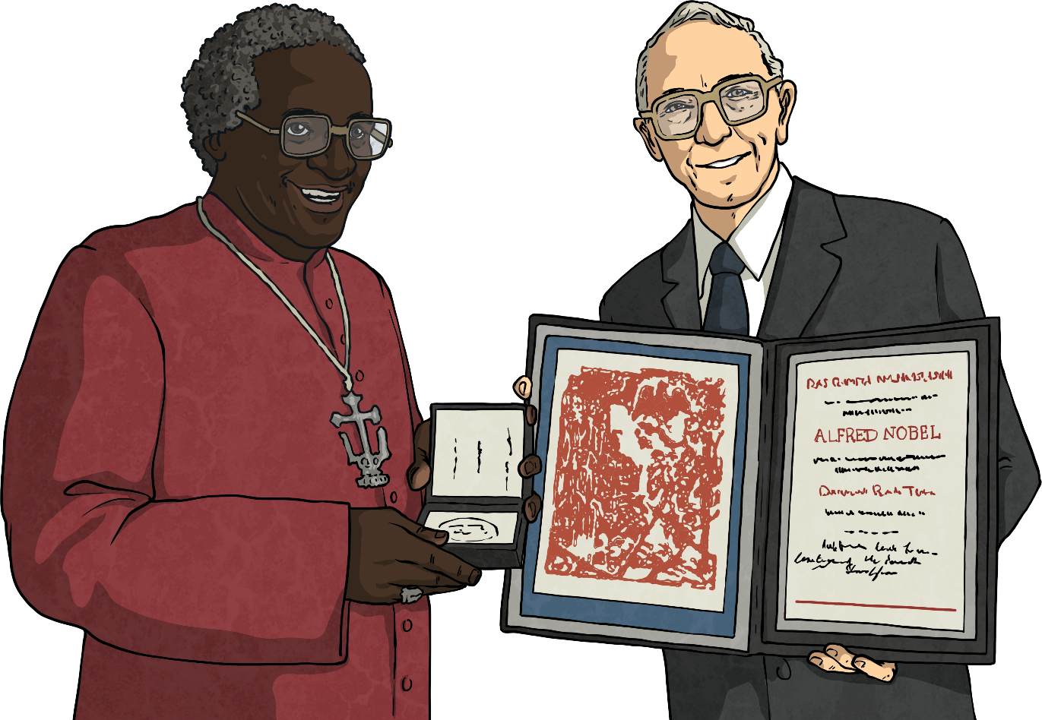
Achievements
Desmond used his position in the church to continue to speak out against apartheid. In 1984, he was awarded the Nobel Peace Prize for his work on the campaign.
Desmond’s career in the church continued to develop. He was given the position of bishop of Johannesburg in 1985, becoming the first Black person to take on the role.
In 1986, Desmond became the archbishop of Cape Town, which is the most senior position in the South African church. Again, he was the first Black person to hold this position.

Slide 12
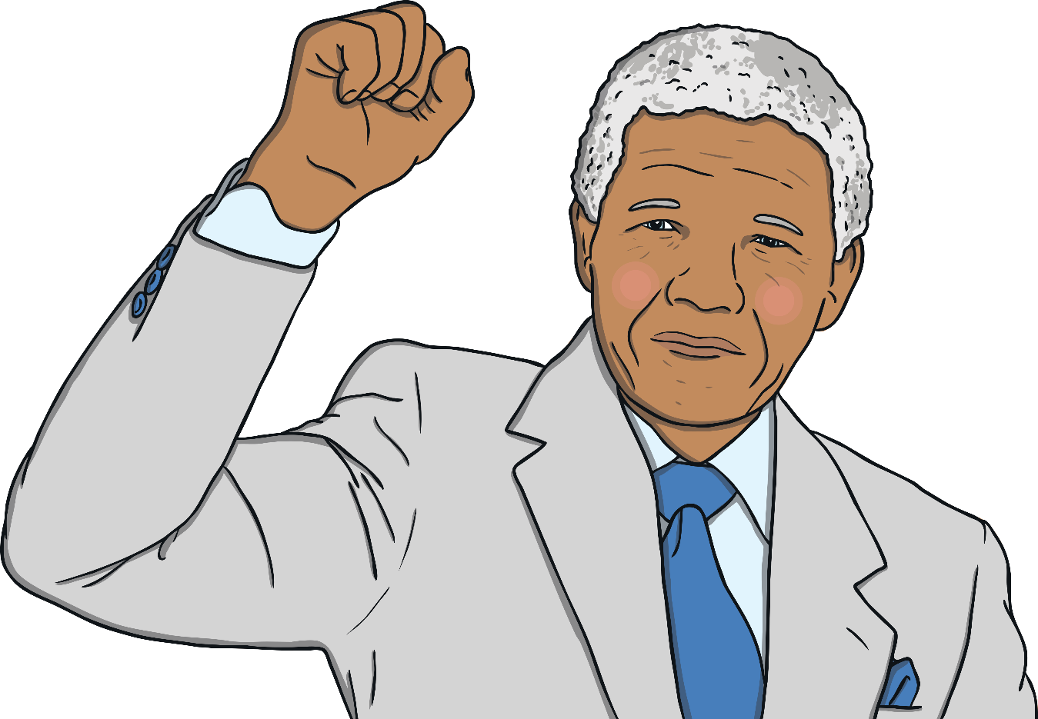
The End of Apartheid
At the start of the 1990s, apartheid began to end. This culminated in the elections of 1994, when Nelson Mandela became the first Black president of South Africa. Archbishop Tutu declared himself to be on ‘cloud nine’.

Slide 13
Truth and Reconciliation Commission
In 1995, President Mandela asked Archbishop Tutu to lead a campaign called the Truth and Reconciliation Commission. This aim of the organisation was to uncover the full truth about the human right abuses that had happened during apartheid.
Over the next three years, the organisation received over 20,000 statements from victims and many people appeared before the commission, telling stories of the dreadful suffering they experienced during apartheid. It was not uncommon for members of the commission, including Archbishop Tutu, to sit crying as they listened to the stories.
At the end of the proceedings, the Commission condemned many apartheid leaders for the atrocities committed.

Slide 14

Other Work
He campaigned for many years for the rights of women to become priests.
He is a supporter of LGBTQ+ rights and has called for the church to accept equal marriage.
He has travelled to countries in the Middle East to support peace talks between different countries.
As well as speaking against racial injustice, Desmond has campaigned on many other issues:

Slide 15
Quotations
“If you are neutral in situations of injustice, you have chosen the side of the oppressor.”
“Do your little bit of good where you are; it’s those little bits of good put together that overwhelm the world.”
“Without forgiveness, there’s no future.”
“God’s dream is that you and I and all of us will realise that we are family, that we are made for togetherness, for goodness and for compassion.”

