Slide 1
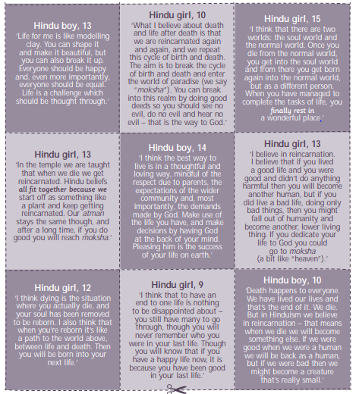
Tasks
1. Pick out 5 key words in the comments that young Hindu people made and write what each of these words means.
2. Write a card like this about your own views to answer the question "What do you think about the afterlife?"

