Slide 1
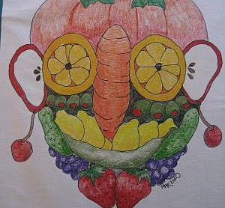
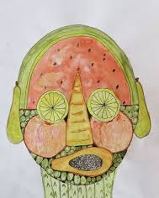
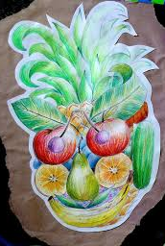
Year 3

Slide 2
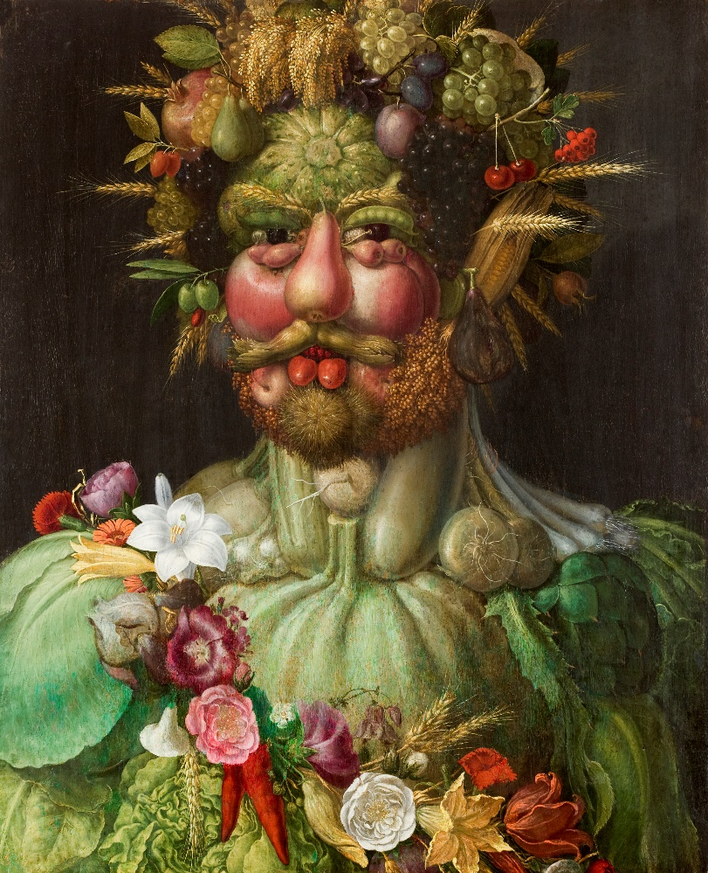
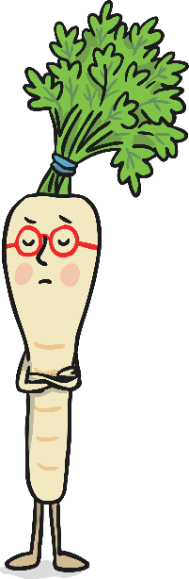
Portraits
This week you are going to begin your portrait in the style of Giuseppe Arcimboldo.
I have gathered some images of Arcimboldo's work and some portraits that have been inspired by the artist. You can use these along side your own drawings for ideas when creating your final piece.
I have also included a video which shows step by step of how to build your face up, using fruit and vegetables.
https://www.youtube.com/watch?v=7TVsSjv9zEY

Slide 3
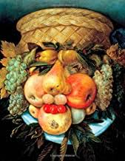
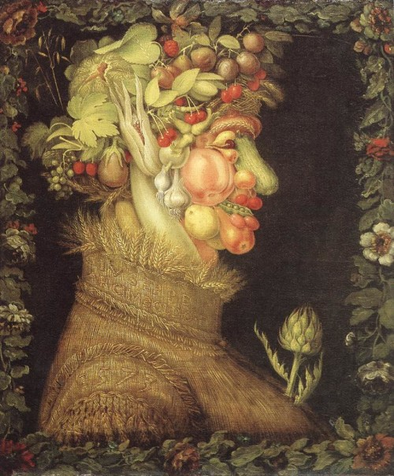
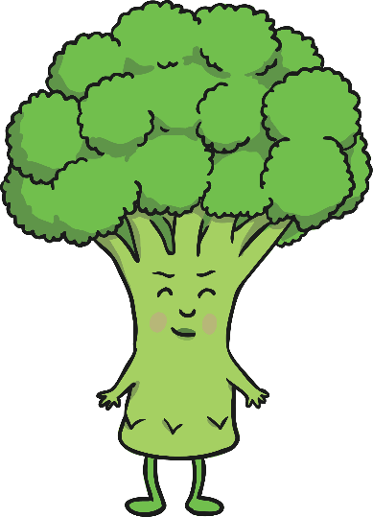
Gallery

Slide 4
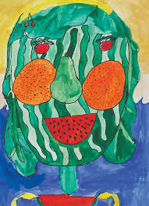
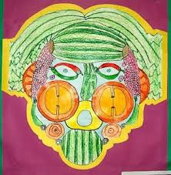
Inspiration

Slide 5
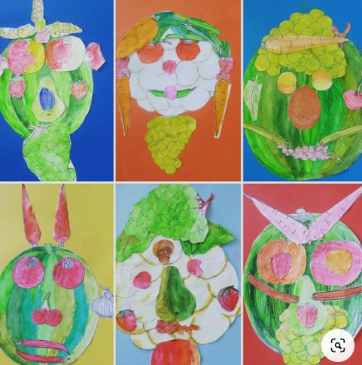
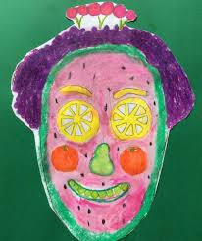
Inspiration

Slide 6
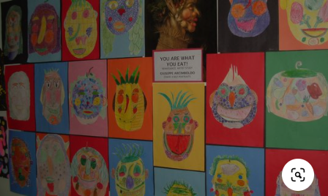
Inspiration
This week, I want you to take your time and focus on drawing the outline of our face and the features, we will add colour next week.
Remember to …..
Sketch
Choose the most appropriate fruit and vegetable to represent the different features of the face.
Draw to the scale of your page.(Don’t draw small as this will make it a lot more complicated for you.)
When you are happy with your drawing, draw over lines your want to keep.
Have fun with this activity and be as creative as you can!
Draw like Arcimboldo
https://www.youtube.com/watch?v=5YsMCDpaUkE

