Slide 1
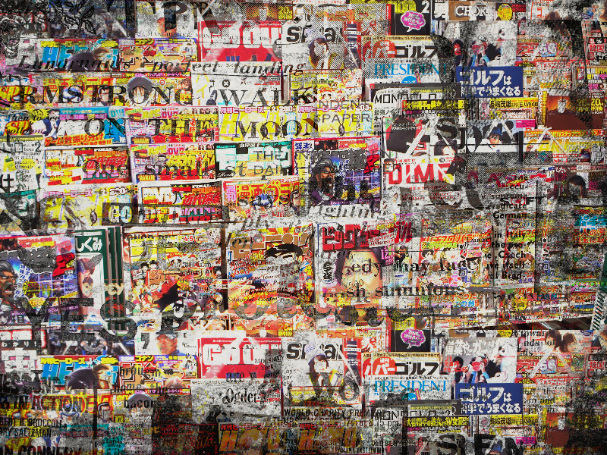
Collage

Slide 2
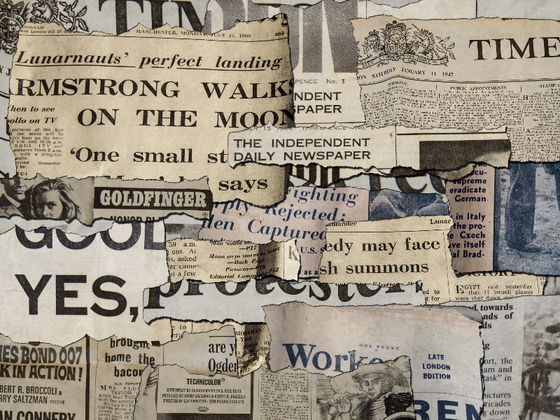
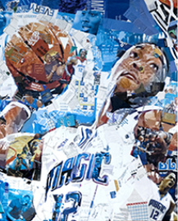
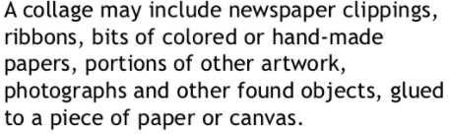
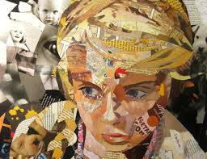
Collage
Collage art can be created in many was, this could include, fabric collages, digital, natural, paint and magazine collages.
Follow the link
https://www.youtube.com/watch?v=ppBdIj2pEUc

Slide 3
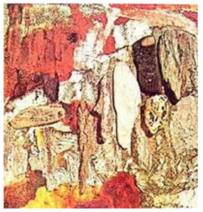
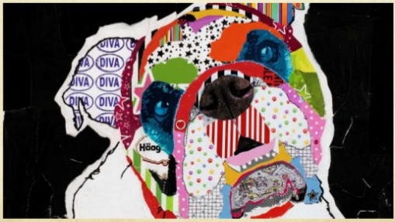
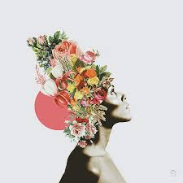
Collage
Natural Collage
Created by using, natural wood, driftwood and leaves…
Follow the link
Fabric Collage
Fabric collages uses different materials, such as fabric, ribbon etc.. Layerd up to create images.
Digital Collage
Digital collage is a technique of using computer tools cut out and layer parts from different images to create a new image.
Magazine Collage
Created by cut out from magazines, newspaper, leaflets and letters.

Slide 4
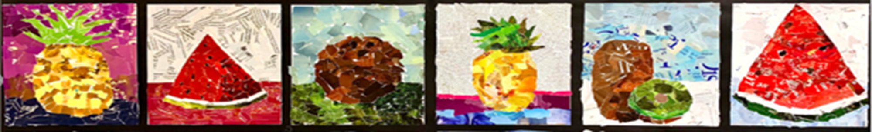
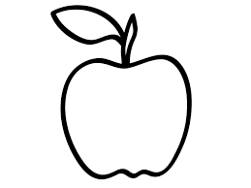
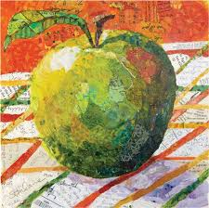
We will be focusing on magazine collage.
You had a practice last week so you are now ready for your final piece.
As we focusing more on collage you can start by drawing a simple shape or just the outline of a piece of fruit(this doesn’t have to be a large drawing) and use different types of paper, layer them up and completely fill the shape.
Tear small pieces, this will look more effective in your work.
Please start to save any, magazines, newspapers, menus, catalogues as these will be useful over the next couple of week.
https://www.youtube.com/watch?v=M4aygj8g6Xs

