Slide 1
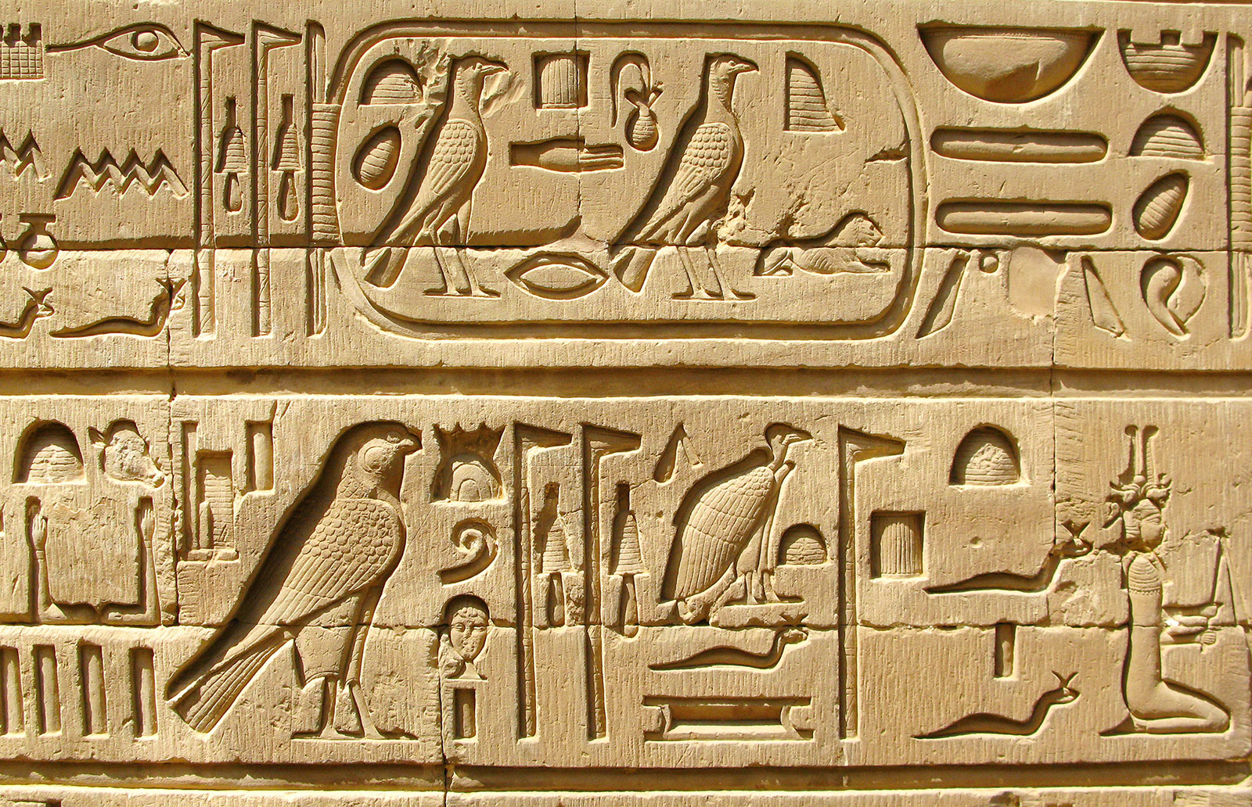
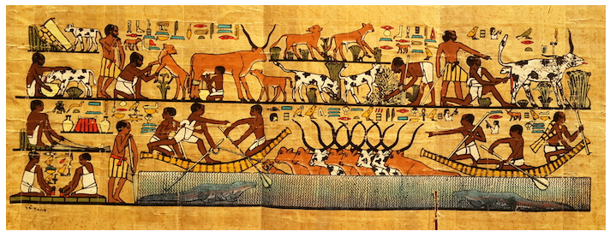
Papyrus Paper

Slide 2
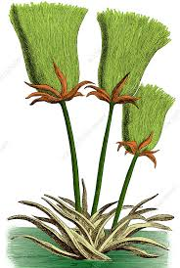
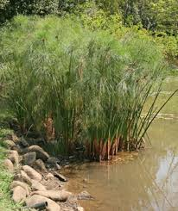
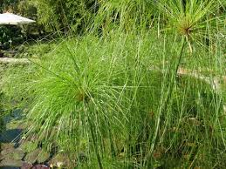
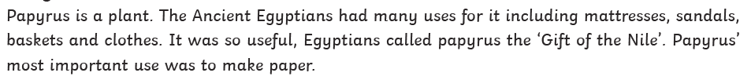
Papyrus plant
Story of Papyrus
https://www.youtube.com/watch?v=VIb02hE-dCA

Slide 3
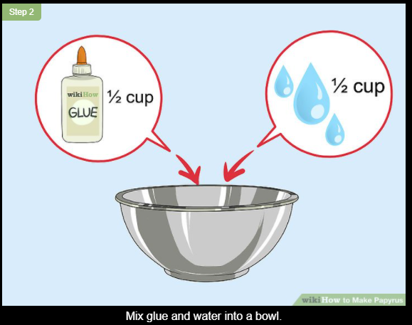
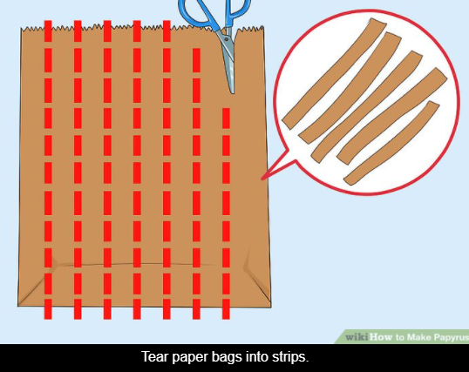
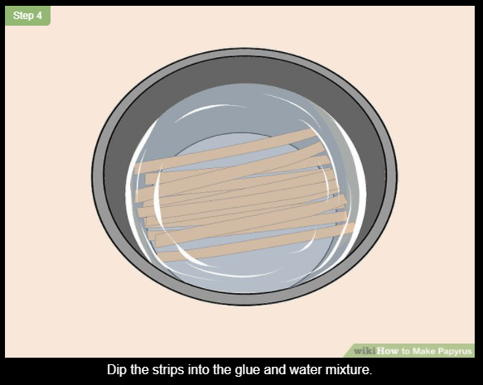
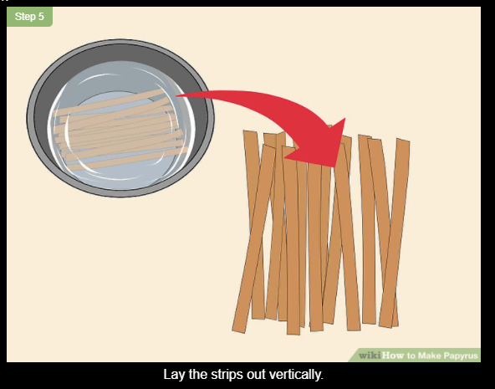
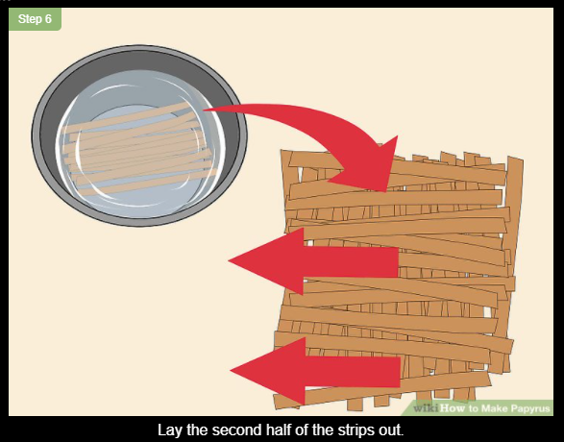
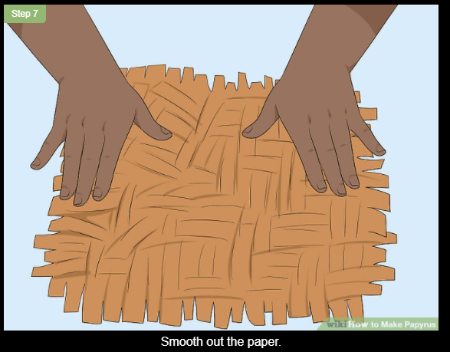
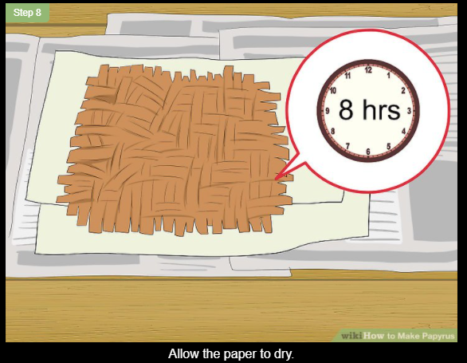
Papyrus Paper
You are going to make your own papyrus paper. We will be using paper, PVA glue and water.
Any old newspapers, brown paper, brown paper bags would be useful, if not paper will work the same.
Over the next couple of slides, you will see the steps you need to take and there is also a link which leads you to a website for more information.
When making your paper it might be best to place a carry bag down which you can layer your paper on. This will make it easier to move when your paper is wet, and you can peel it away when your paper is dry.
If you have not got any PVA glue or unable to get hold of any
I have added an alternative.
.

Slide 4
Papyrus Paper
.

Slide 5
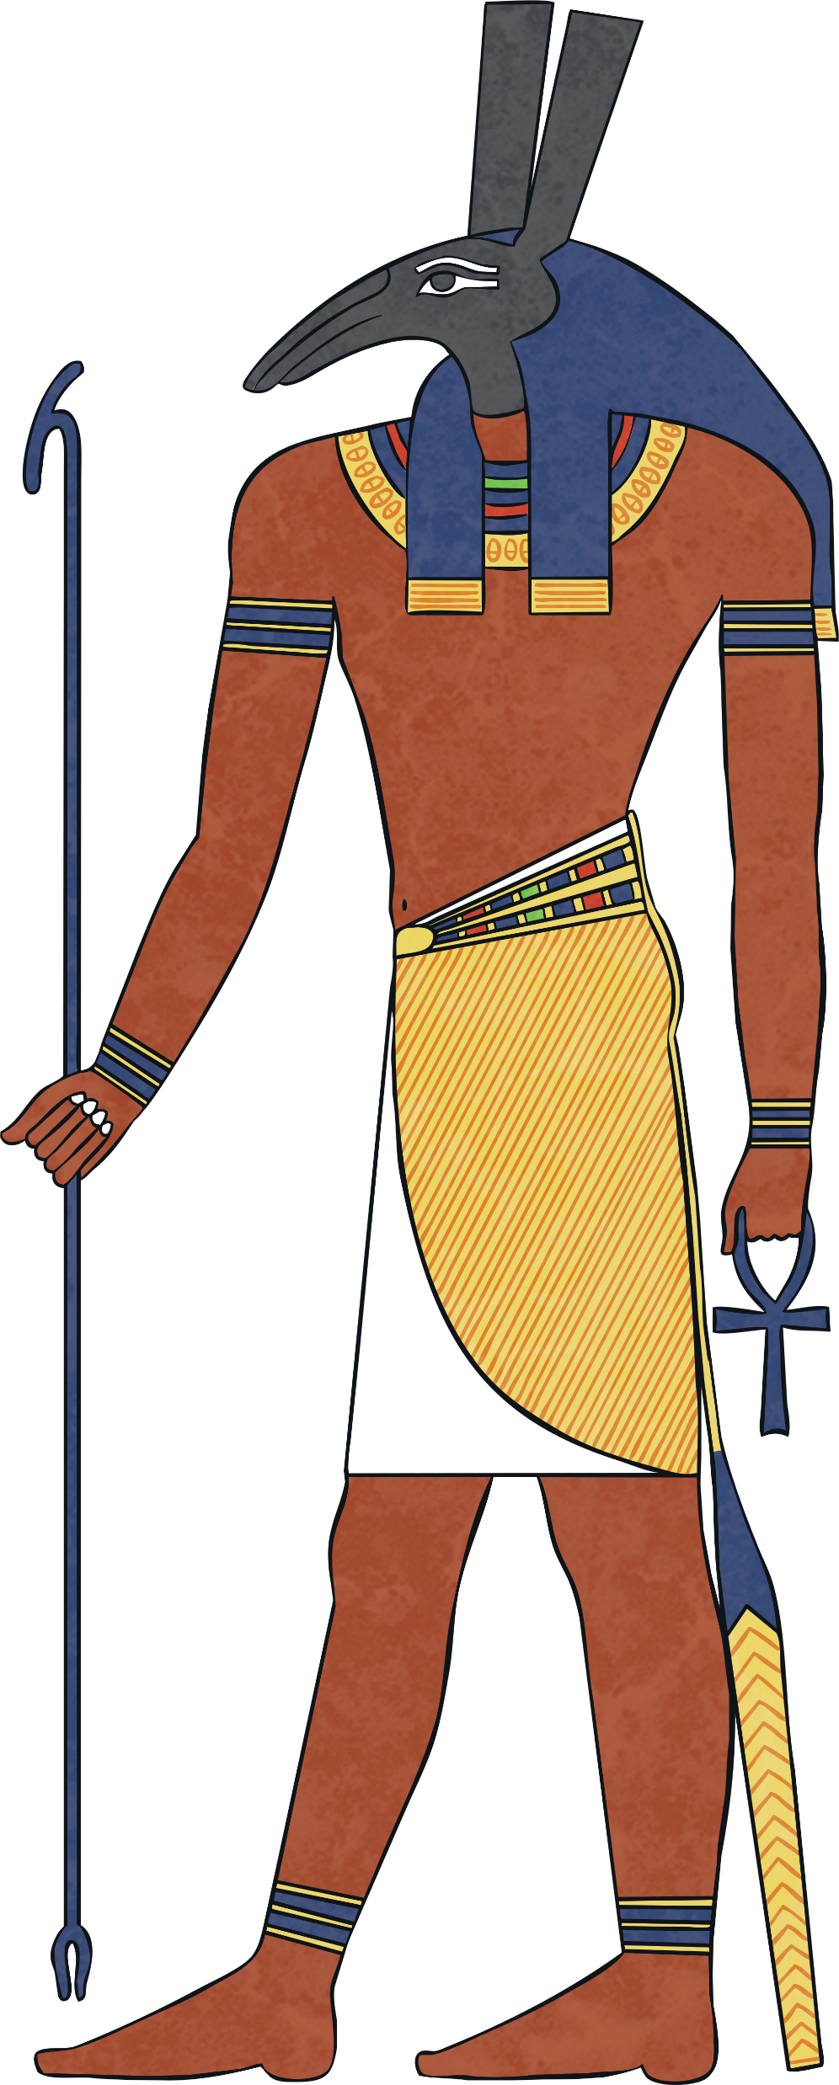
Papyrus Paper
.
https://www.wikihow.com/Make-Papyrus

Slide 6
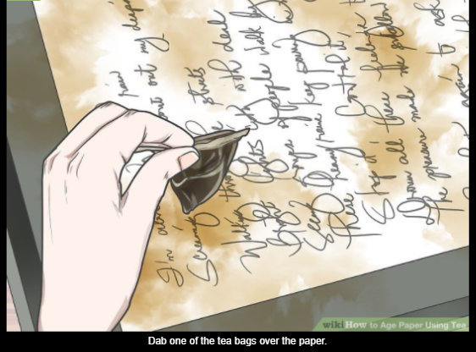
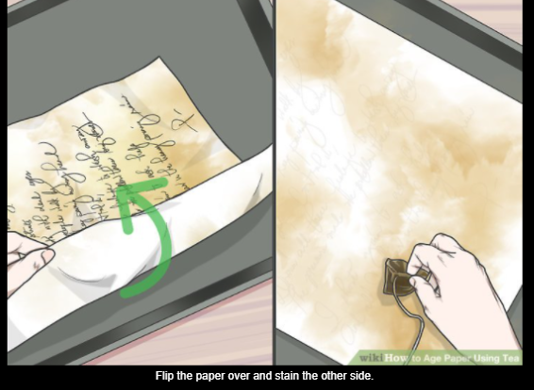
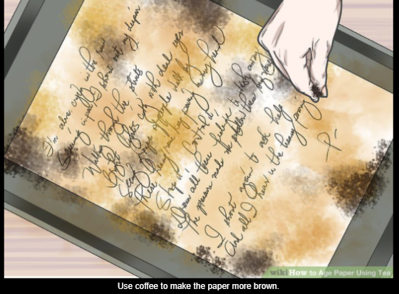
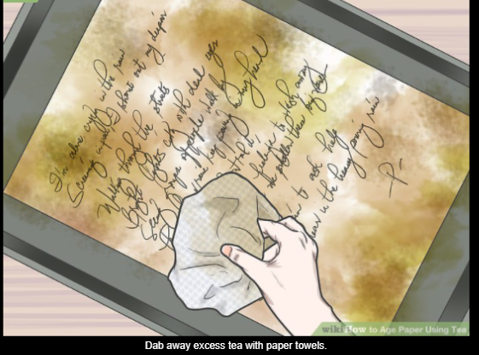
Papyrus Paper
An alternative way of making the effect of papyrus paper would be to tea stain paper.
PLEASE WORK WITH AN ADULT!!!!
Place tea bags, in a cup of warm water from the tap.
Allow time for the tea bags to brew you will notice the water turning brown.
When the water feels cool, use the tea bags and gently dab the paper.
Do not let the paper get to wet as it will just rip.
You can also sprinkle coffee on for better effect.
Allow the paper to dry ready for next weeks lesson.
.

