Slide 2

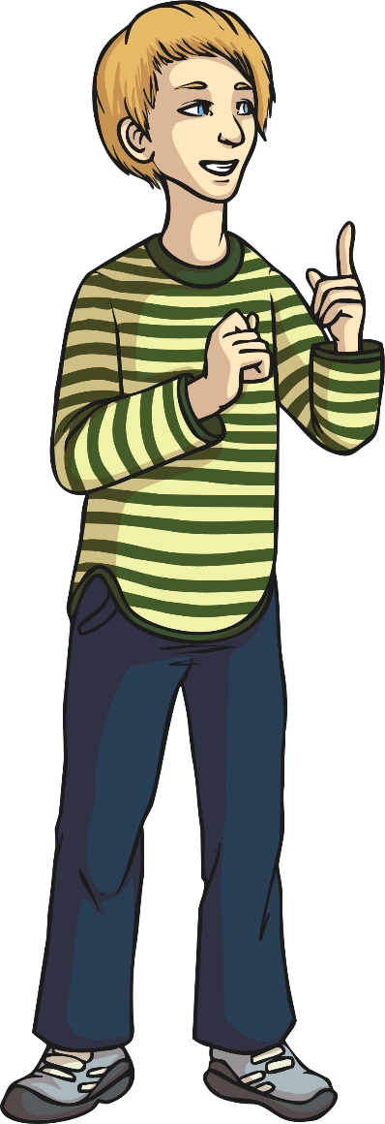
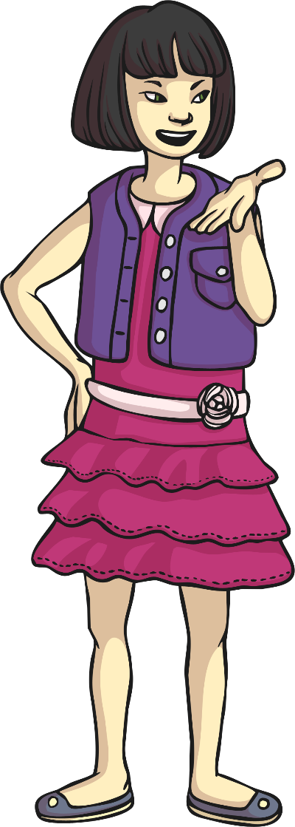
What is
a happy mind?
How can it make a difference to our lives?

Slide 3

What Is Positive Thinking?
Using the words below, work with a partner to compose a positive statement to share with the class.
great
enjoy
brilliant
smile
special
nice
good
amazing
better
best
fantastic
laugh
love

Slide 4

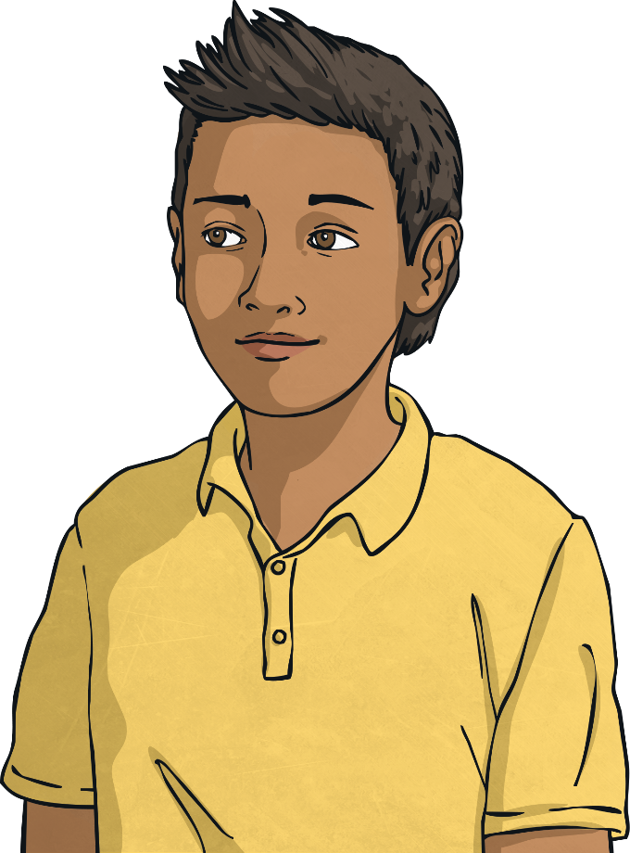
A Positive Attitude
Thinking positive thoughts and always seeing the best in a situation is called having a positive attitude to life. It can make you a happier person and plays an important part in having good mental health.

Slide 5
A Positive Attitude
Read the quotes below and discuss with your partner what they mean. See if you can choose the one you like the best.
“Every day may not be good, but there is good in every day.”
“Having a positive attitude is asking how something can be done, instead of saying it can’t be done.”
“We can complain because rose bushes have thorns or be happy because thorn bushes have roses.”
“A positive attitude will lead to positive outcomes.”
“A bad attitude is like a flat tyre; you can’t go anywhere until you change it.”
“Attitude is a little thing that can make a big difference.”

Slide 6

A Positive Attitude
Which quote was your favourite?
Can you explain why you chose it?
Why are quotes like these helpful?
Will you remember and use the quote you liked?
How can positive thinking or having a positive attitude help us to have happy minds?

Slide 7

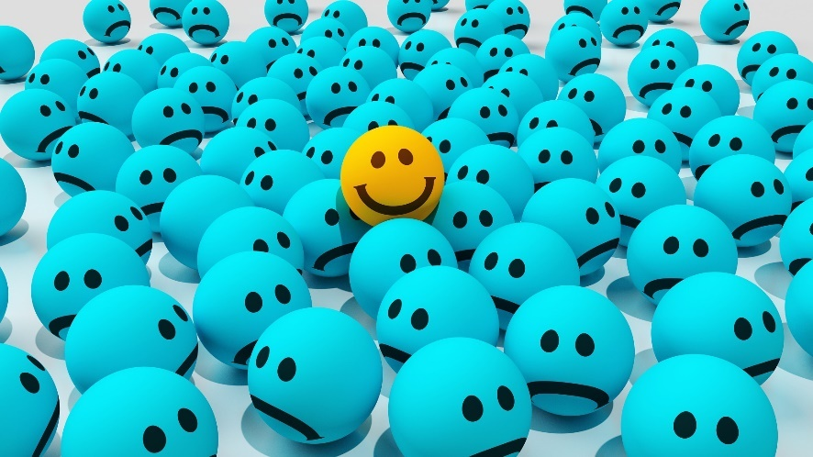
The Science of Happiness
Never before has there been more research into happiness and how it affects our whole lives.
Scientists have found that happy people are more successful – that means that they are more likely to achieve their goals.
In schools, research shows that happy children learn better and make more progress.
However, one study found that only 17% (that’s 17 out of 100) of the people in the world are living truly happy lives.

Slide 8

The Science of Happiness
Our brains are in charge of our feelings and emotions.
There are chemicals in our brains that actually make us feel happy.
There are four main chemicals. They have tricky names…
dopamine
oxytocin
serotonin
endorphins
The fantastic news is that there are things we can do to trigger our brains to release these ‘feel-good’ chemicals!

Slide 9
How to be Happy
Find ways to relax your mind.
Get plenty of sleep.
Smile and laugh.
Spend time with family and friends.
Exercise regularly.
Eat healthily.
Be fair and honest.
Listen to music.
Care for others.
Accept yourself and be proud of who you are.
Take up a hobby or join a club.
Work hard to achieve a goal.
Next

Slide 10
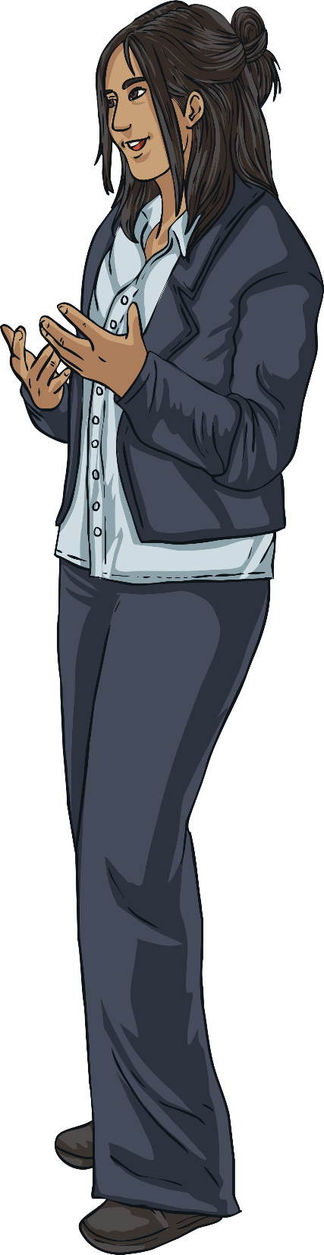
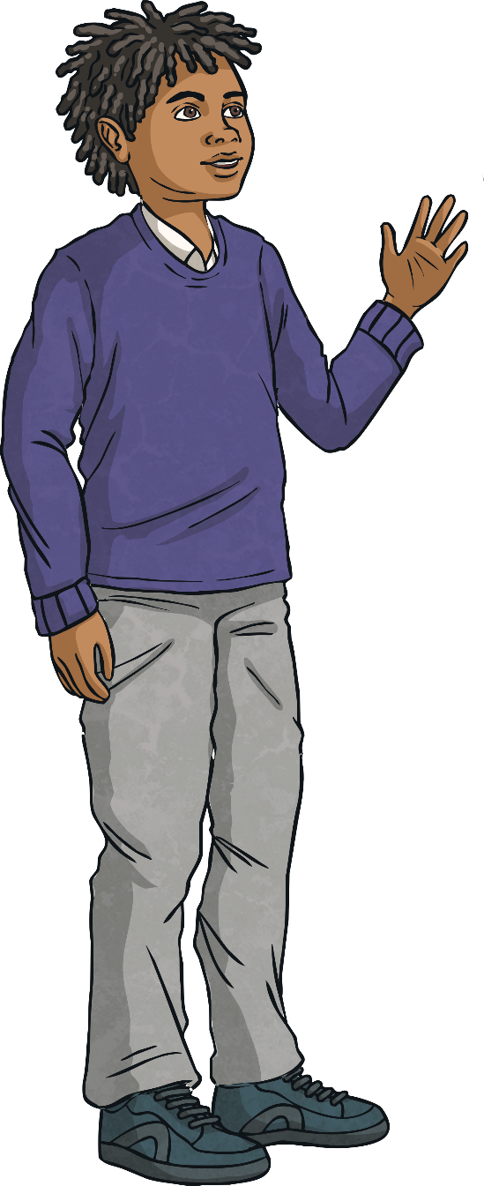
How to Be Happy
There are lots of ways we can help ourselves to feel happy but sometimes people struggle with mental health and this can be difficult.
There are lots of ways people can get support
if this happens and talking to a
trusted adult is a really important
thing to do.
Who are your trusted adults?
Consolidating
Reflecting

Slide 11



Happiness Is…
What does happiness mean to you? Different things make different people happy.
Whatever it is that makes you happy, it is good for your mental health to spend time thinking about it and doing it!

