Slide 1

Hello, salut, ہیلو, ciao
EAL group!
This is Sam from Primet.
I hope you had a lovely Christmas. We will be working from home for the next few weeks

Slide 2

Here's the good morning song to wake you up!
Click on the link below:
https://www.youtube.com/watch?v=CuI_p7a9VGs

Slide 3

Hello children
Follow the link and watch the video:
https://www.youtube.com/watch?v=TI-pfeaErY4

Slide 4

Hello! Your all doing so well!
Now try and have a go on the games below!
We have used this in class
Click on the link:
https://www.starfall.com/h/

Slide 5

Reading time!
Follow the link to read a great story:
https://www.getepic.com/book/16687222/super-cute-baby-cats?utm_source=t2t&utm_medium=link&utm_campaign=content&share=30531028816
Draw a picture of the story and label it

Slide 6
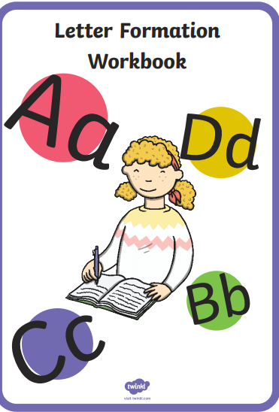

I have added a file which has this.
You can download it and copy the work onto paper

Slide 7


Please find a list of websites that you may find useful in helping you and your child learn about phonics.
http://www.phonicsplay.co.uk
Games to play with all phonics sounds
http://www.bbc.co.uk/bitesize/ks1/literacy/phonics/play/
Games and videos on each sound
http://www.ictgames.com/literacy
Phonics games for the children to play
http://www.starfall.com
Phonics games for the children to play
http://www.firstschoolyears.com
Phonics games for the children to play
https://learnenglishkids.britishcouncil.org/grammar-chants
Sparklebox - lots of resources

