Slide 1
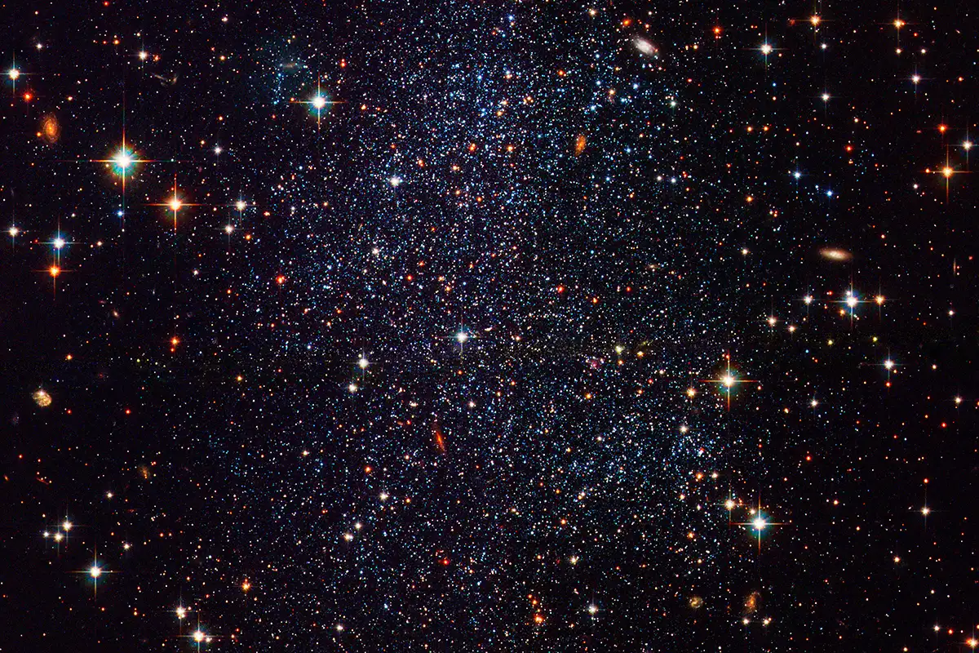
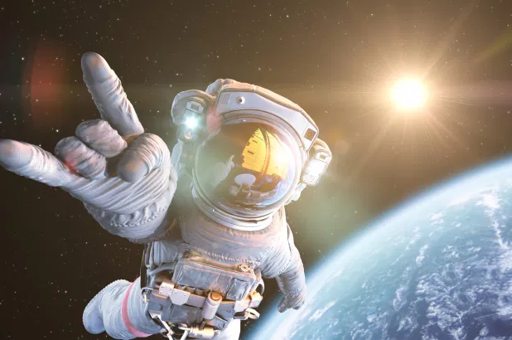

Explorers

Slide 2
Explorers
Year2, you are going on a mission to explore the moon. Your first task is to create a vehicle which would be suitable for us to drive when we land.

Slide 3
Explorers
Think about…..
What Could we make?
Why are we making this vehicle?
Who will use your vehicle?

Slide 5
How Does It Move?
Look at this toy car. When you push it, how does it move??

Slide 6
How Does It Move?
When you push the toy car, the wheels turn, which is how the car can move. Do you think all the wheels turn at the same time and at the same speed?

Slide 7
Wheels and Axles
The wheels on the toy car move at the same time and speed because each pair of wheels is attached to a pole called an axle. Real vehicles, such as cars and vans, also have axles.

Slide 8
Wheels and Axles
On toy cars, if a wheel isn’t directly attached to an axle, it will need to be secured in place so it doesn’t move from side to side.
If you are making your own toy car, wheels can be secured with a washer on either side. You could even use small pieces of modelling clay either side of the wheel if you don’t have any washers.
washers
washers

Slide 9
Wheels, Axles and Chassis
An axle needs to be attached to the chassis (said ‘shah-see’). A chassis is the frame upon which the rest of the vehicle is built.
In this picture, the chassis is an upside down shoebox lid. Holes have been made on each side of the box and the axles have been threaded through.

Slide 10
Wheels
If you were creating your own toy vehicle, what could you use for your wheels?
Here are some ideas:
wooden wheels
wheels from plastic brick toys
cotton reels

Slide 11
Axles
If you were creating your own toy vehicle, what could you use for your axles?
Here are some ideas:
wooden dowel
straw
cotton bud

Slide 12
Chassis
If you were creating your own toy vehicle, how could you attach the axles to the chassis?

Slide 13
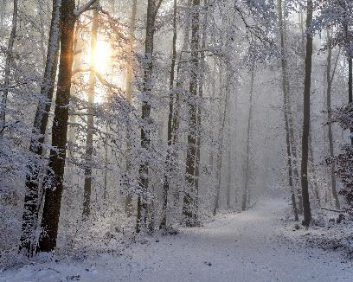


Purpose of a Vehicle
The materials you use and the design of your vehicle will depend on what the vehicle needs to do and where it will be travelling.
Will it be transporting people or something else? Will it need to travel at high speeds? What kind of ground will it travel on?

Slide 14
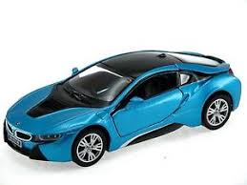
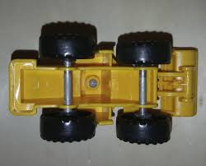
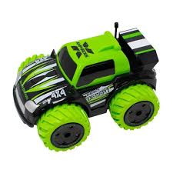
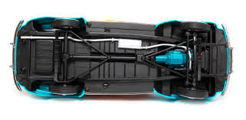
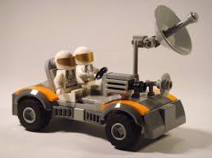
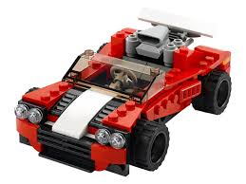
Explorers
We are going to investigate existing vehicles?

Slide 15
Explorers
Using the images or a toy vehicle, lets discuss together…..
What sort of wheels does it have?
How are they fastened to the chassis?
How does the wheel turn?
Is the axle fixed or free turning?
Is the wheel fixed or loose on the axle?
What would this vehicle be able to carry?
What sort of terrain(surface) could it travel on?
How strong do you think it might be?

Slide 16
Activity
Explorers
Choose a different vehicle. (Image or toy)
Draw the vehicle and label the different parts in you book.
Answer the questions below.
What sort of wheels does it have?
How are they fastened to the chassis?
How does the wheel turn?
Is the axle fixed or free turning?
Is the wheel fixed or loose on the axle?
What would this vehicle be able to carry?
What sort of terrain(surface) could it travel on?
How strong do you think it might be?

Slide 17
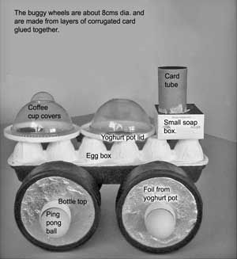
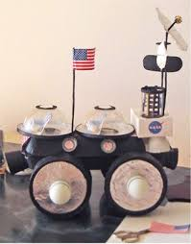
Explorers
Please start to save any items that might be useful to make your Moon Buggy…

