Slide 1
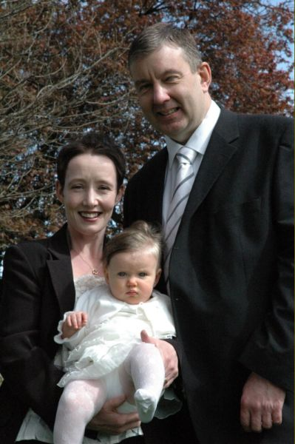
To compare infant and adult baptism
The parents bring the baby to the church for the baptism.

Slide 2
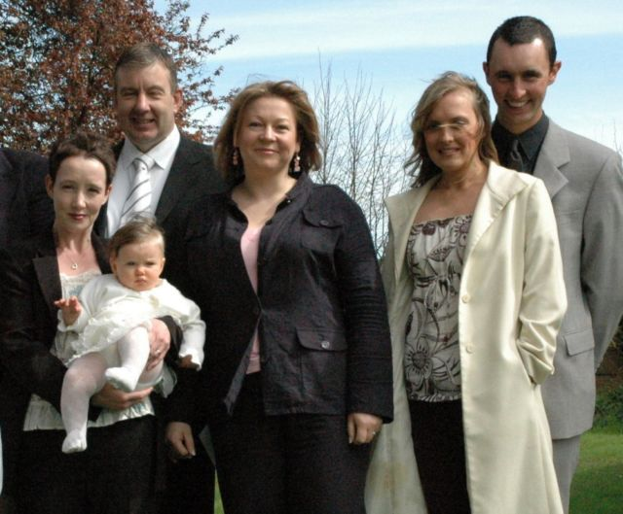
Godparents
Mum and Dad have chosen special people to be Godparents to the baby.

Slide 3
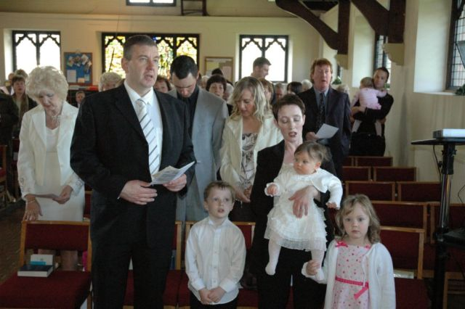
Church
Everyone goes to the church to see the baby get baptised. It is very special.

Slide 4
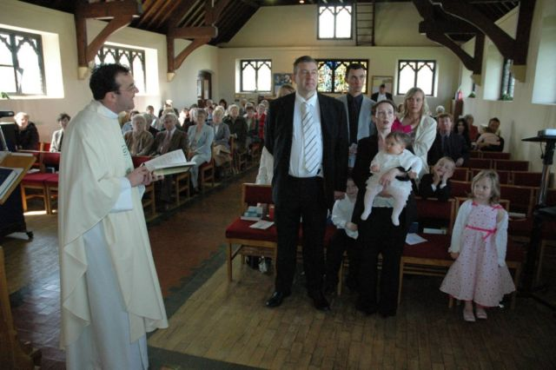
Jesus
The Parents and the Godparents say that they believe in Jesus.

Slide 5
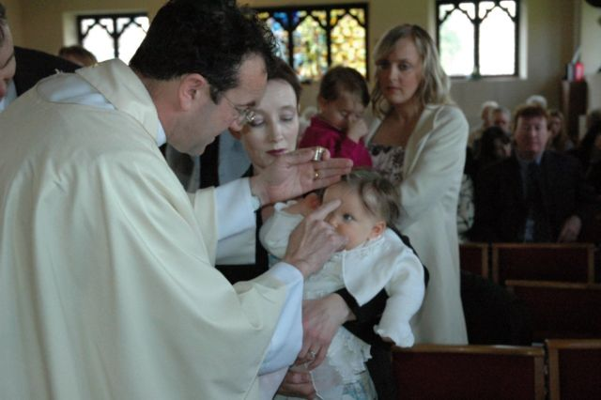
Cross
The Vicar draws a cross on the baby’s head with some water.

Slide 6
Promise
Everyone makes a promise to help the baby as they are growing up.

Slide 7
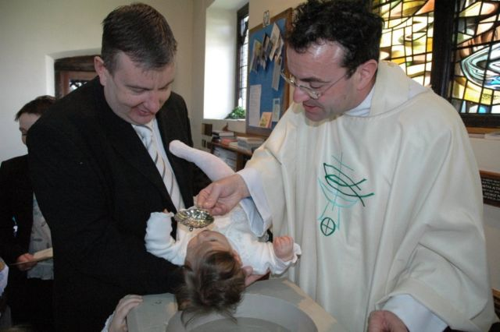
Vicar
The Vicar says, 'I baptise you in the name of the Father, and of the Son, and of the Holy Spirit'

Slide 8
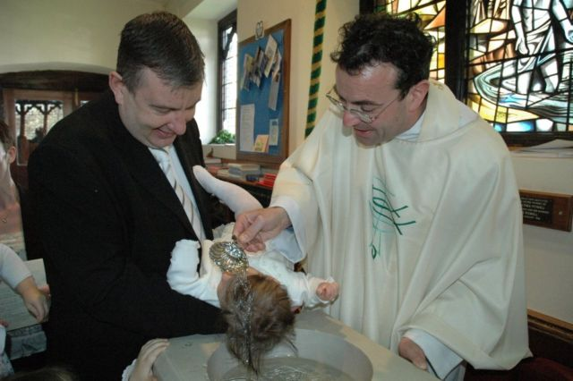
Water
The vicar pours water on the baby’s head.

Slide 9
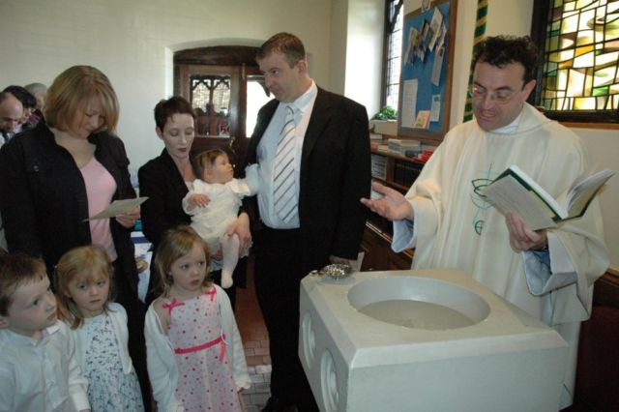
Prayer
The Vicar prays for the baby and for the family.

Slide 10
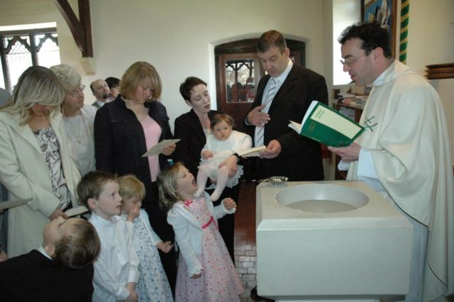
Pray
The parents and godparents are asked to pray for the baby, and to teach her about Jesus.

Slide 11
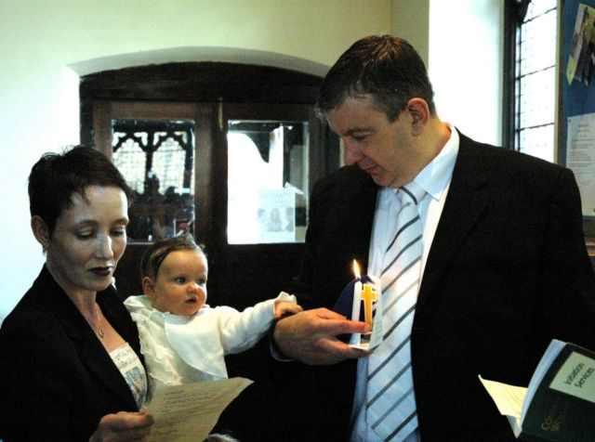
Candle
The Vicar lights a candle and gives it to the parents.

Slide 12
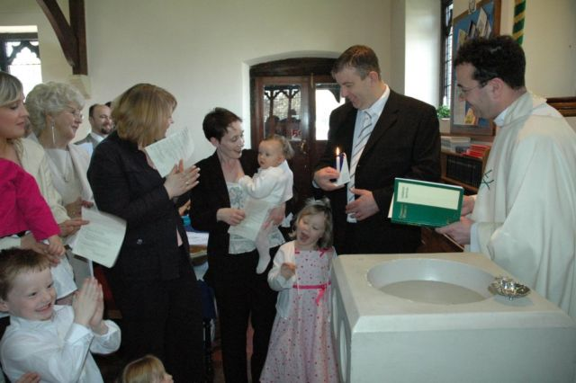
Christian
The baby is welcomed into the Christian family.

Slide 13
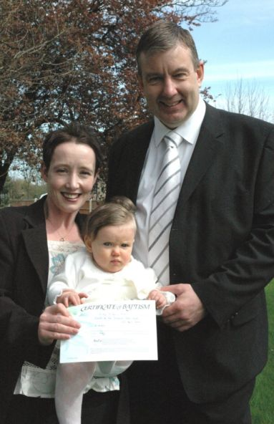
Certificate
The Parents and the baby are given a certificate of baptism to show that the baby has been baptised in a church.

