Slide 1
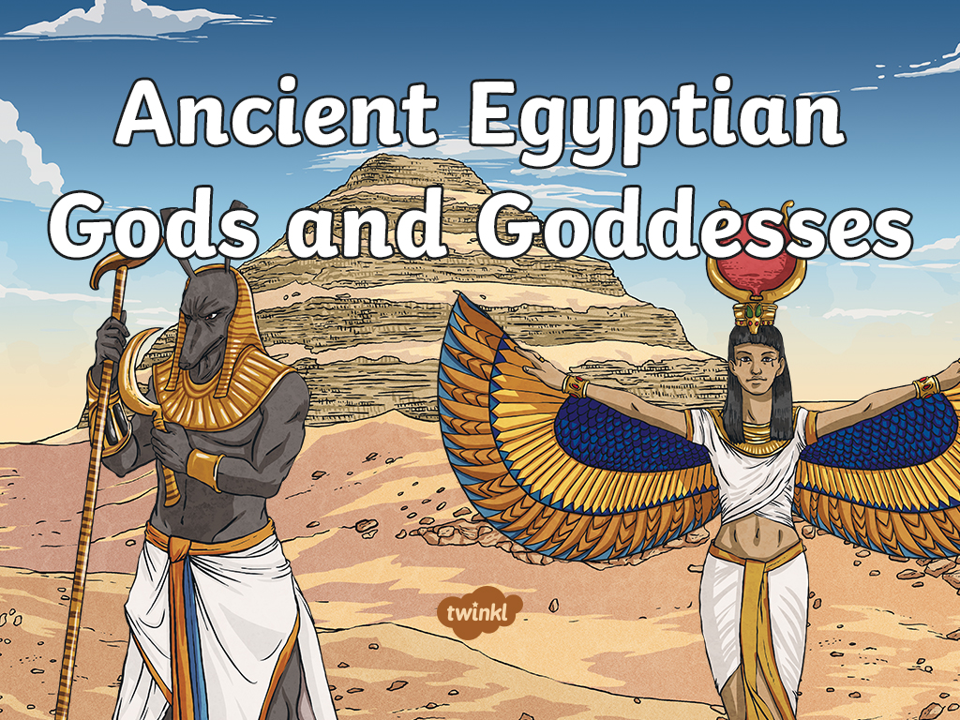

Slide 2
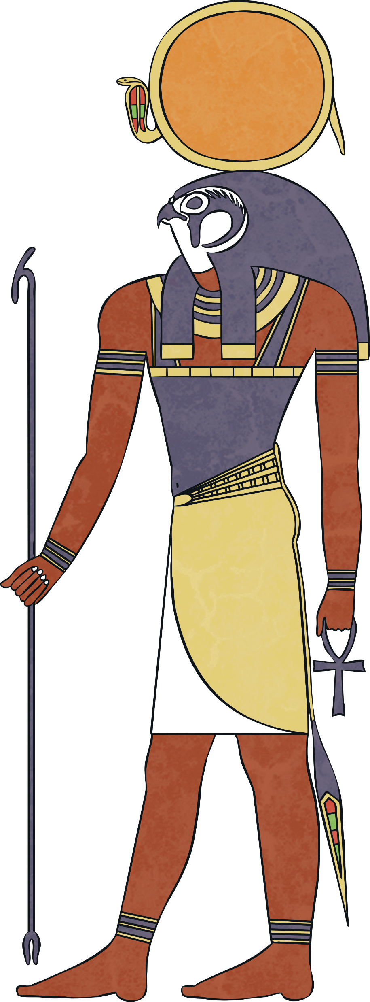
NAME: Ra
GOD OF: the sun
Ra was the most important god to all the Egyptians.
It was believed that he was swallowed by Nut the sky goddess every night and born again in the morning.
The Egyptians also believed that Ra travelled through the underworld at night, where he appeared as a man with the head of a ram!

Slide 3
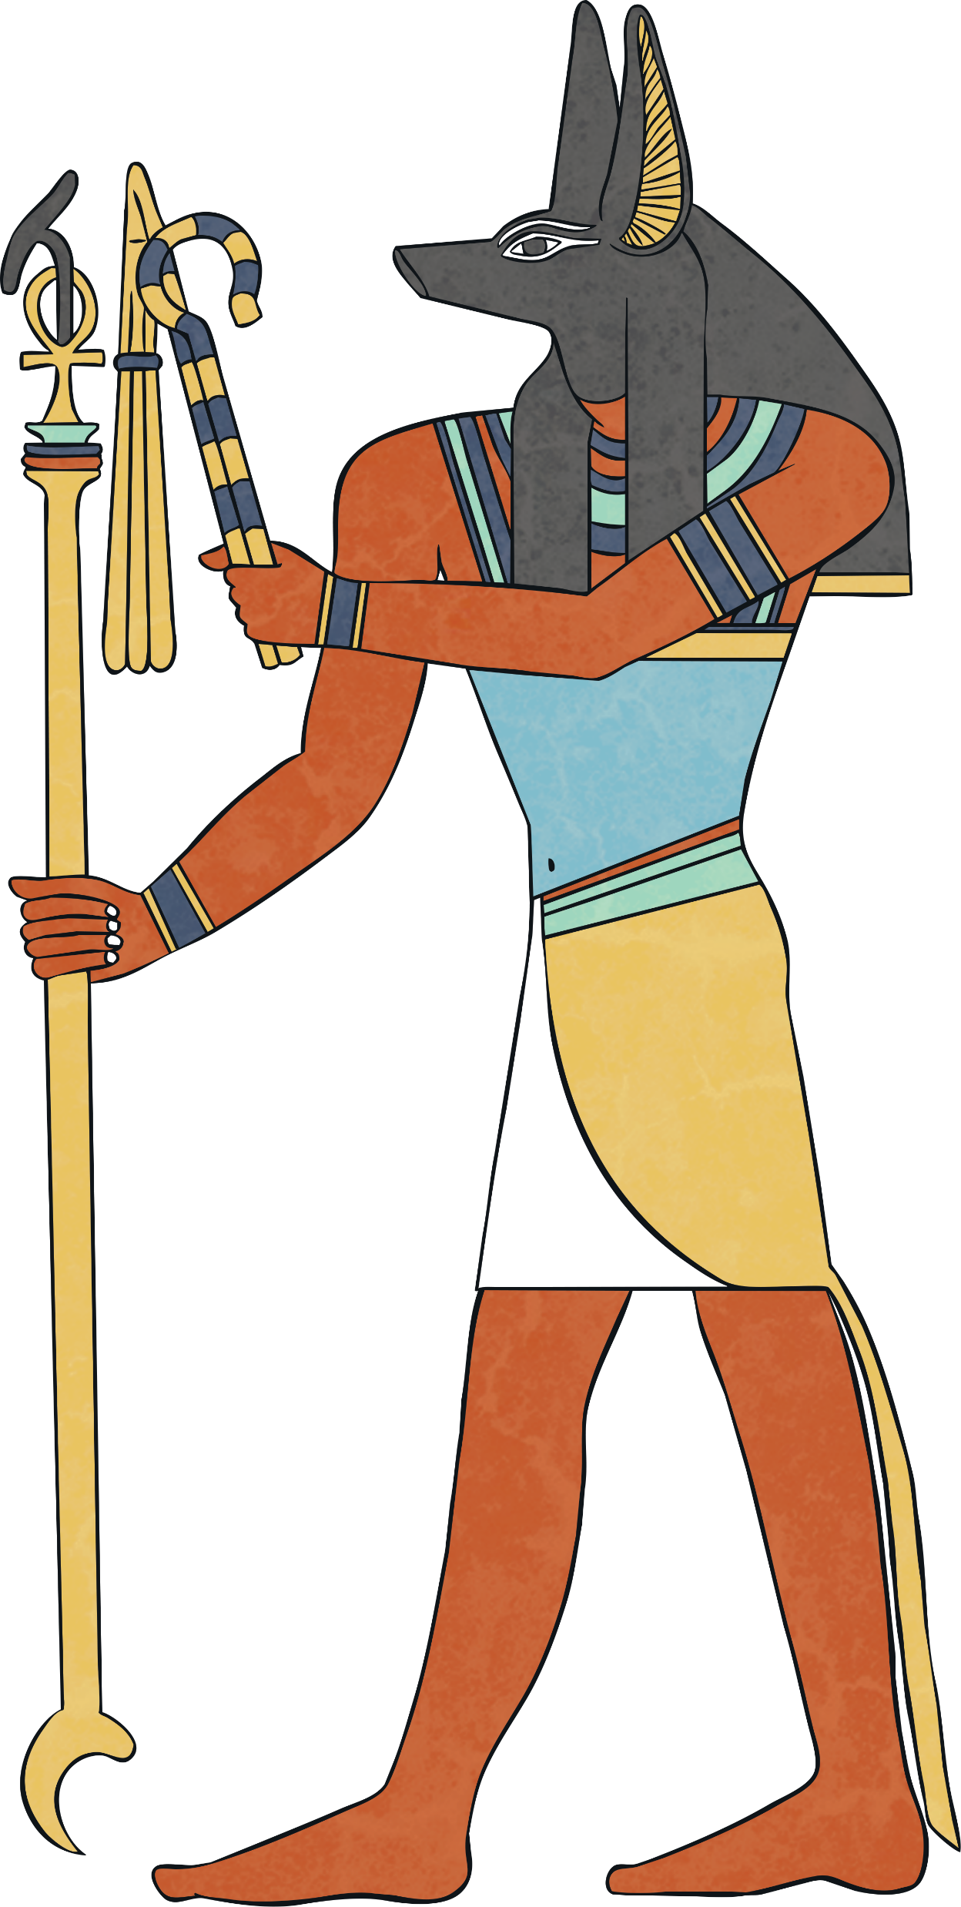
NAME: Anubis
GOD OF: the dead and the process of embalming
It was thought that jackals watched over the dead as they were seen in cemeteries a lot.
Anubis helped to embalm Osiris when he was killed by Seth.
Egyptian priests would wear a mask of Anubis during mummification ceremonies.

Slide 4
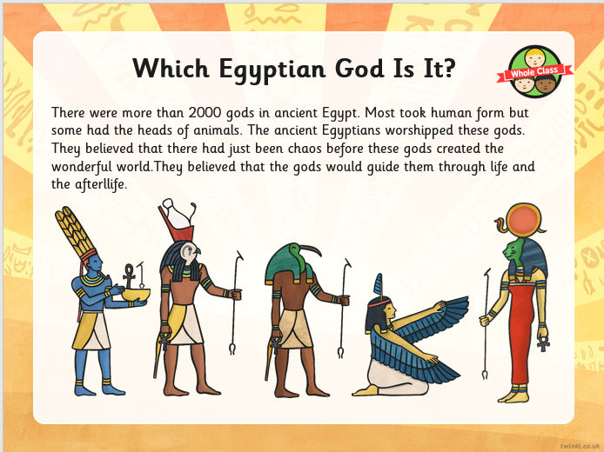

Slide 5
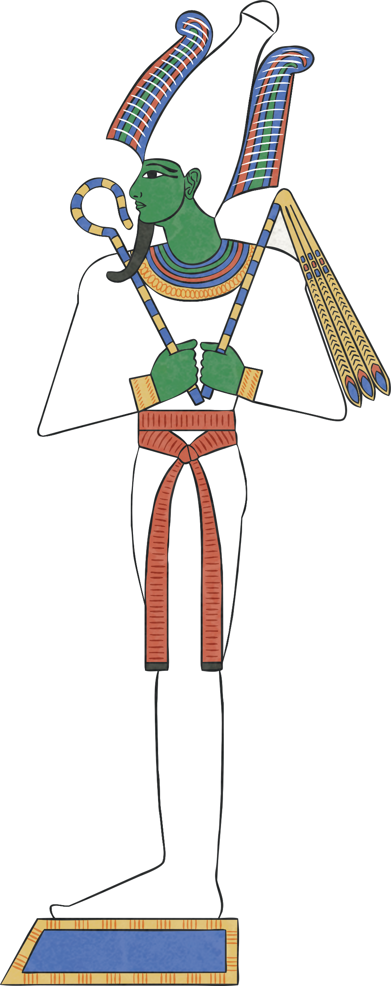
NAME: Osiris
GOD OF: the dead and the underworld.
Osiris was also a god of resurrection and fertility.
The Egyptians believed that he gave them the gift of their most important crop, barley.
Osiris was the husband of Isis and the father of Horus.

Slide 6
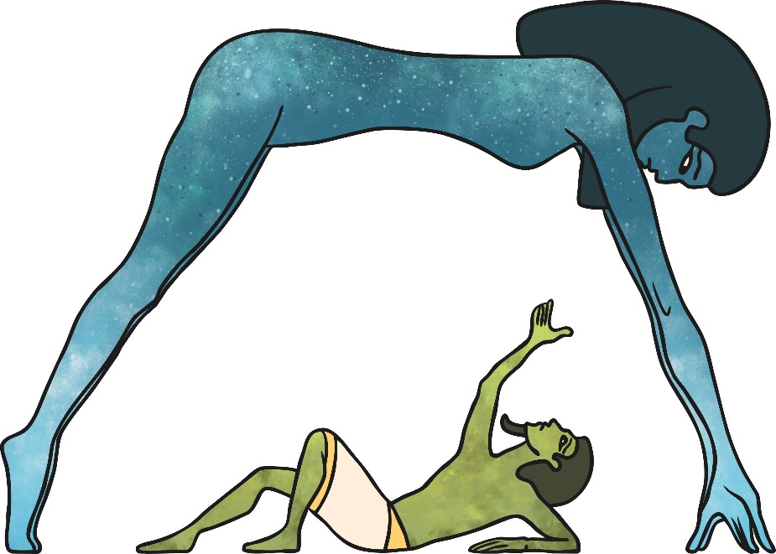
NAME: Nut and Geb
GOD/GODDESS OF: Nut – the sky, Geb – the earth
Nut’s body is stretched across the sky and covered in stars. She and Geb are the parents of Isis and Osiris.
Nut is the sister/wife of Geb and it is believed that Nut swallowed Ra, the sun god at the end of every day and gave birth to him again in the morning.
It was believed that earthquakes are caused by Geb’s laughing.

Slide 7
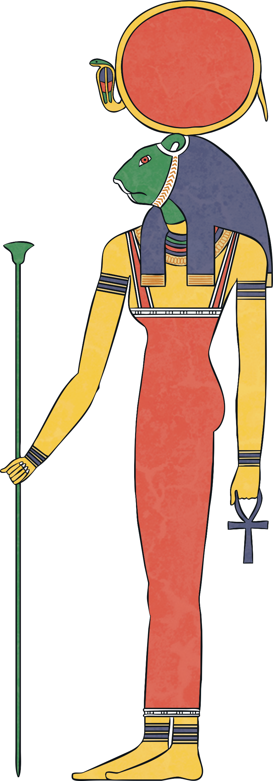
NAME: Sekhmet
GODDESS OF: war
Sekhmet means ‘the powerful one’!
She is sometimes called the daughter of the sun god Ra.
She is celebrated at the end of battles.

Slide 8
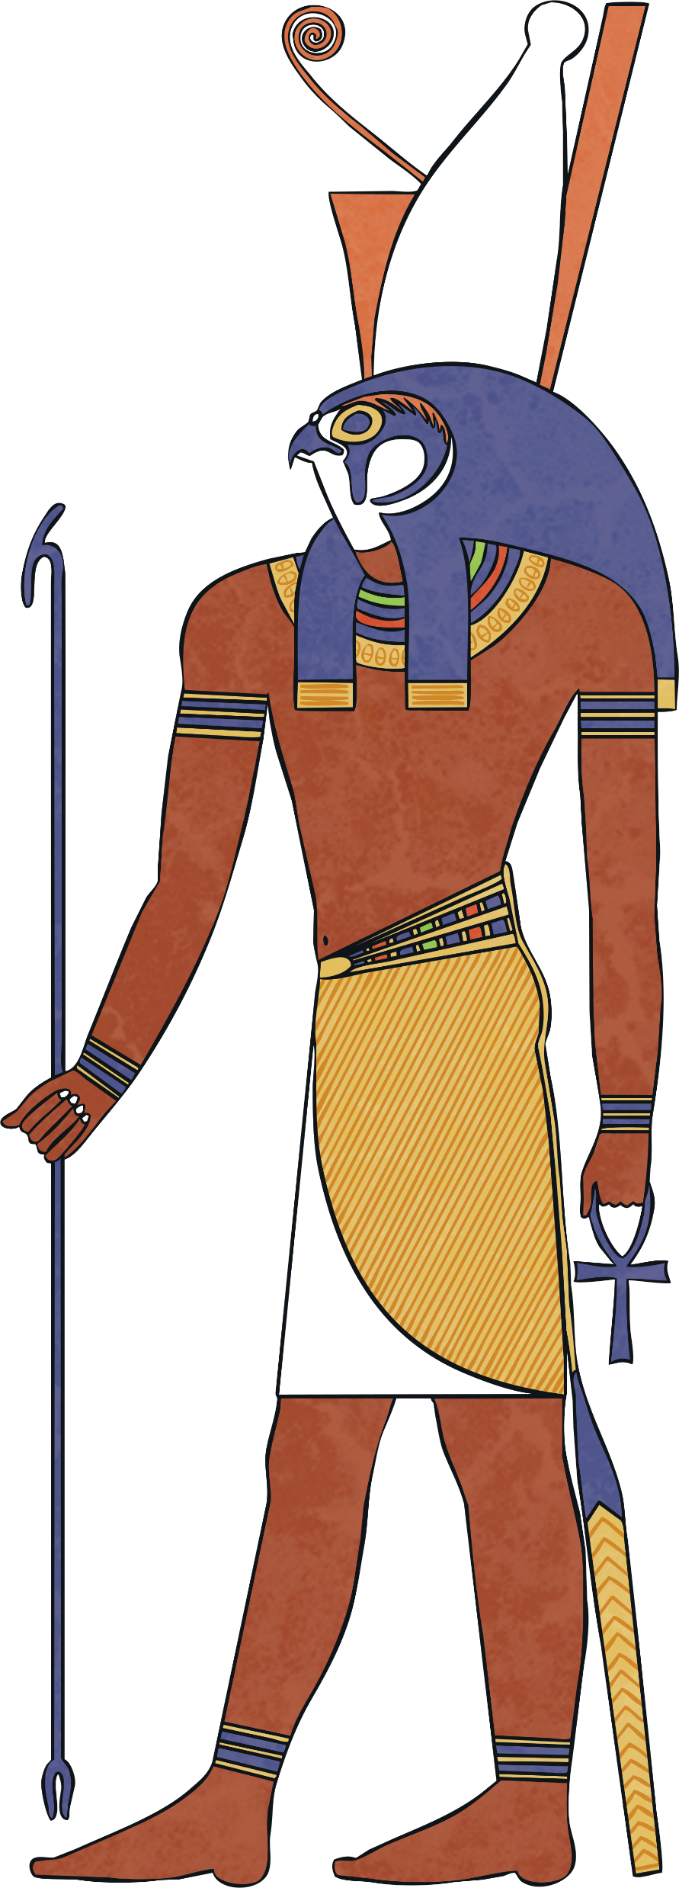
NAME: Horus
GOD OF: the sky
Protector and ruler of Egypt. All living pharaohs were considered a ‘living Horus’.
It was believed that Horus was the son of Isis and Osiris.
Horus became a ruler of the living after losing an eye in a battle and having it restored. The eye then became a symbol of protection.

Slide 9
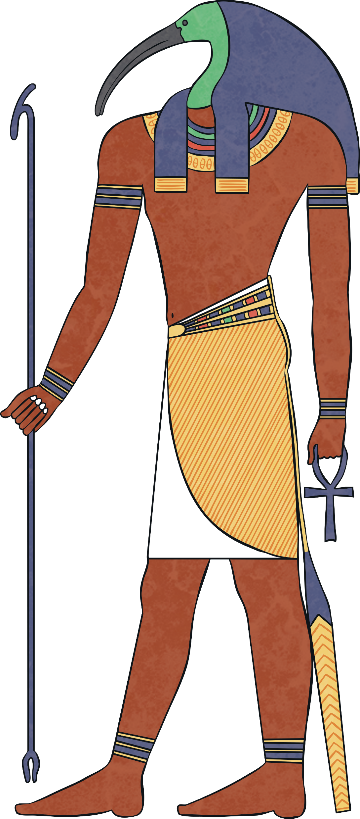
NAME: Thoth
GOD OF: writing and knowledge
Thoth could also appear as a baboon.
It was believed that Thoth gave the Egyptians the gift of hieroglyphs.

Slide 10
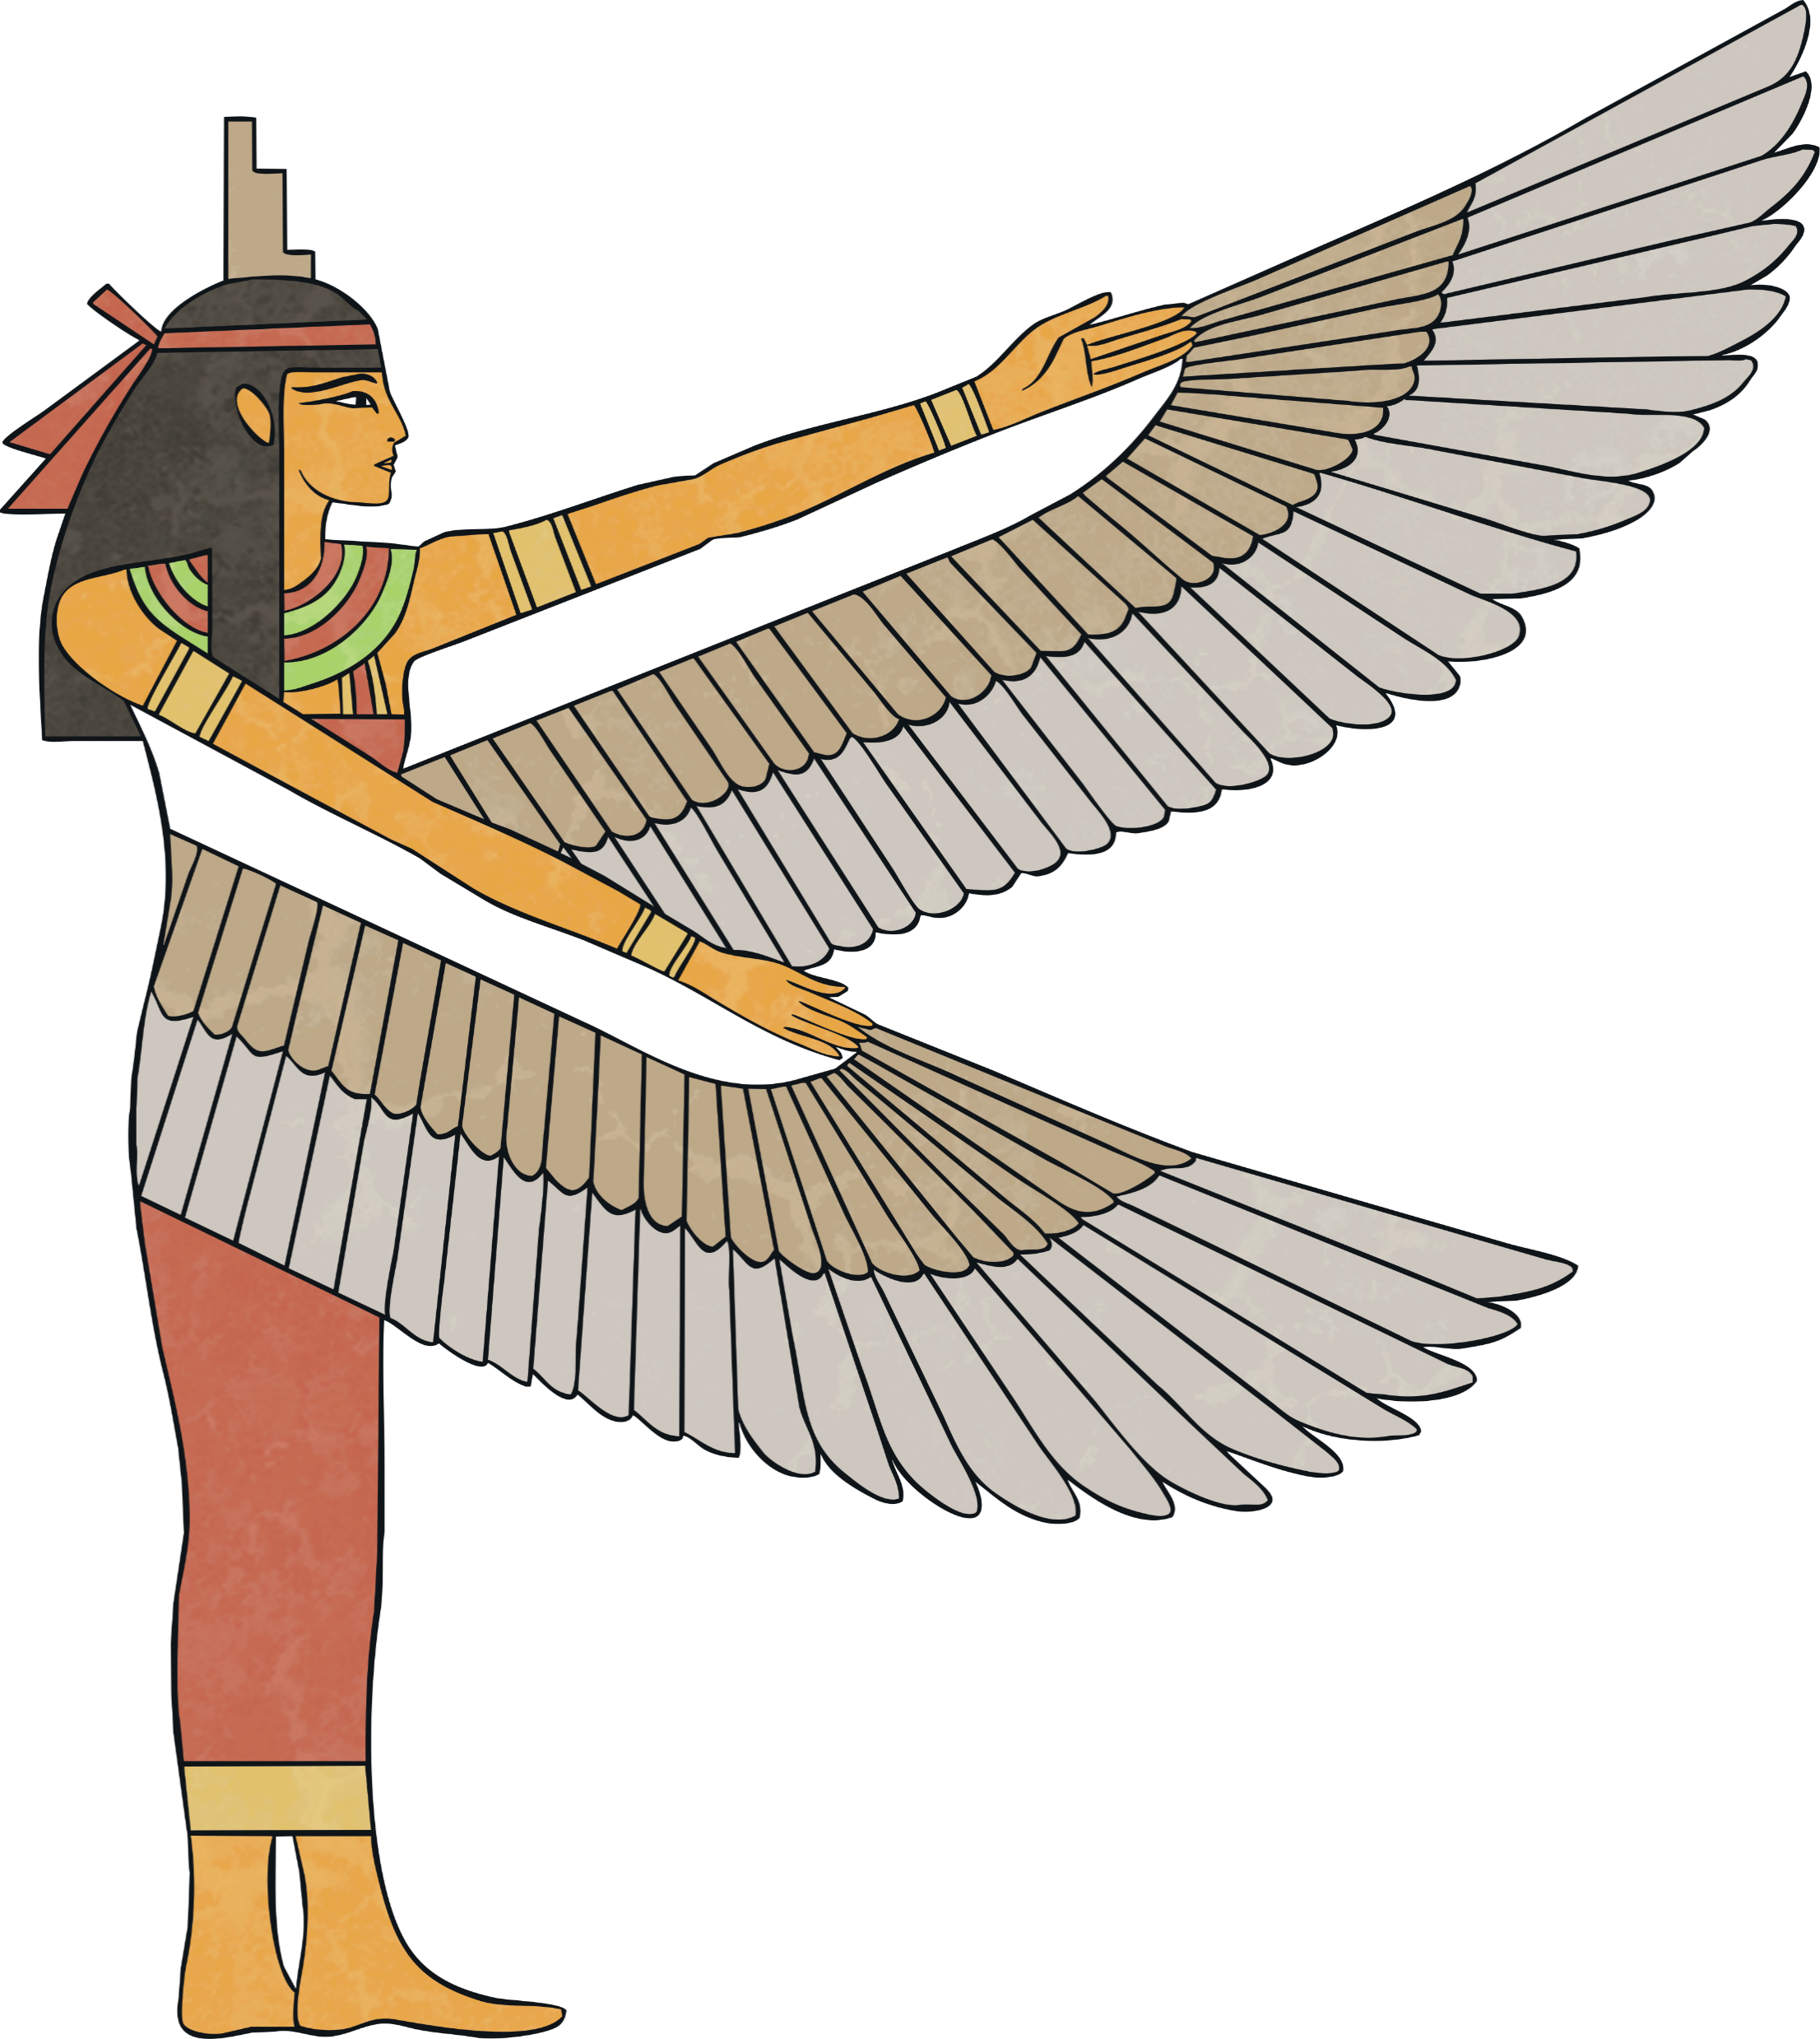
NAME: Isis
GODDESS OF: protecting the needy.
Isis is the wife of Osiris, King of Egypt. Isis was the daughter of the earth god Geb and the sky goddess Nut. She is also the sister of Osiris, Seth and Nephthys.
She is also the mother of Horus and has him sitting on her lap.
Isis was a good queen. She taught the women of Egypt how to bake and weave

Slide 11
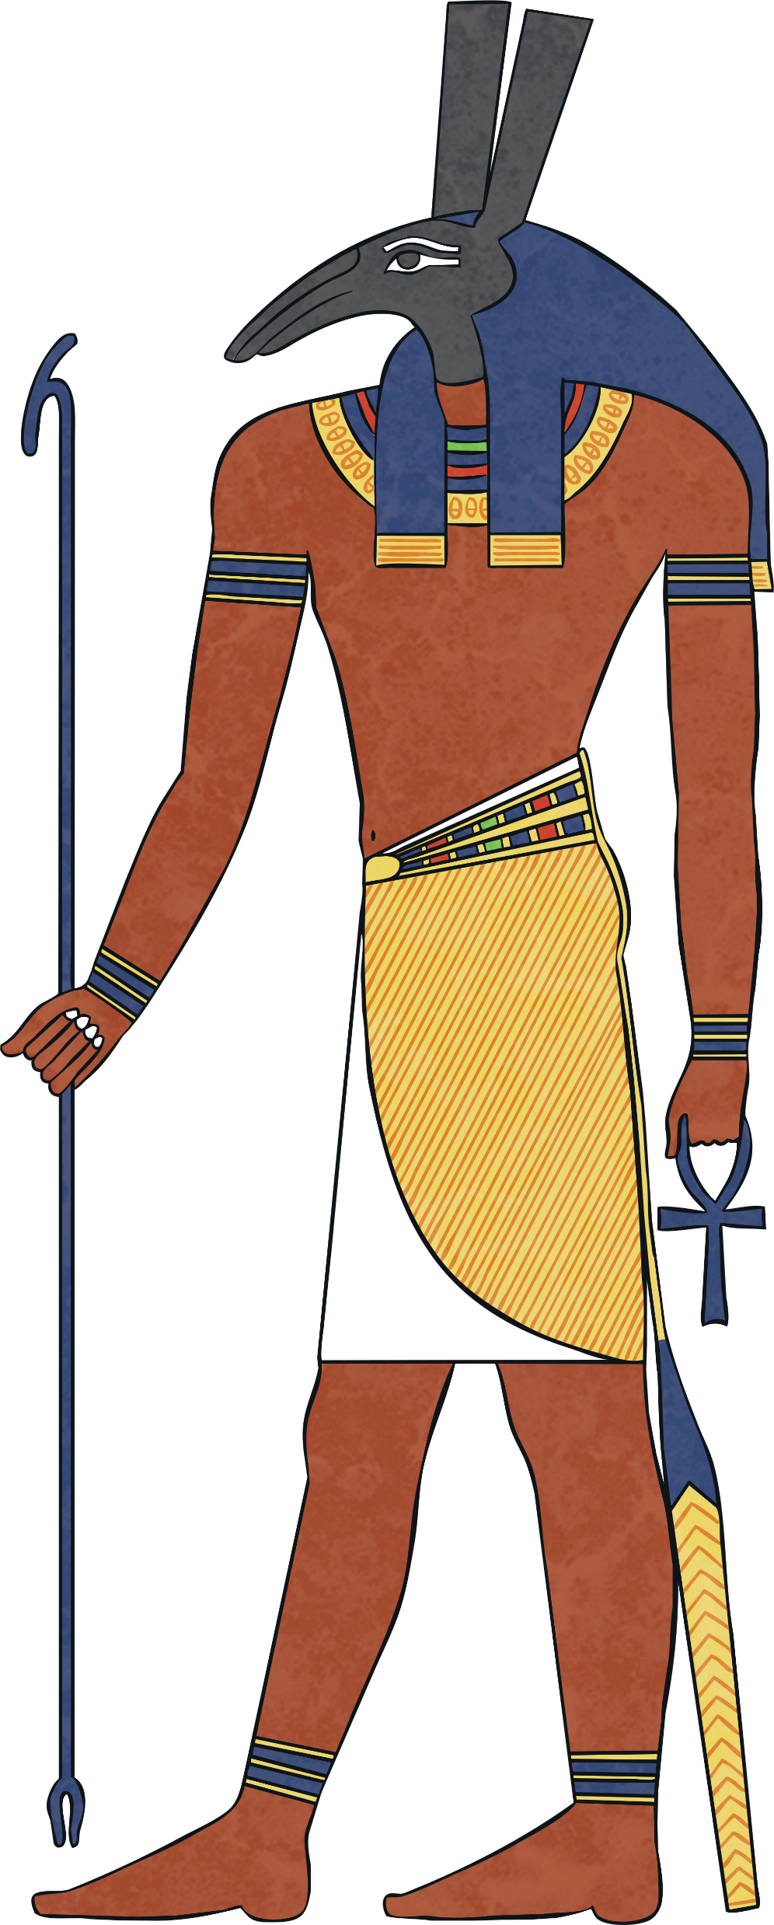
NAME: Set
GOD OF: chaos, the desert
and storms.
Set is the son of Geb and Nut. He is the father of the jackal-headed
god Anubis.
Set represented everything that threatened peace in ancient Egypt, such as war, disease and destruction.
Set is seen as a strong and dangerous god but not completely evil. He is a friend to the dead, helping them rise to heaven on his ladder.

Slide 12
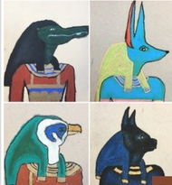
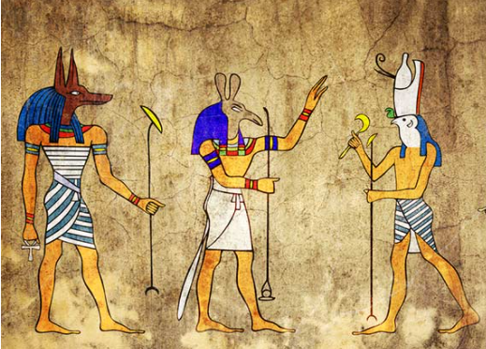
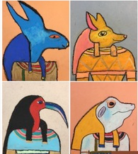

https://www.youtube.com/watch?v=j11eVnJg02Q
https://www.youtube.com/watch?v=NDYJYJhl0tk

