Slide 2
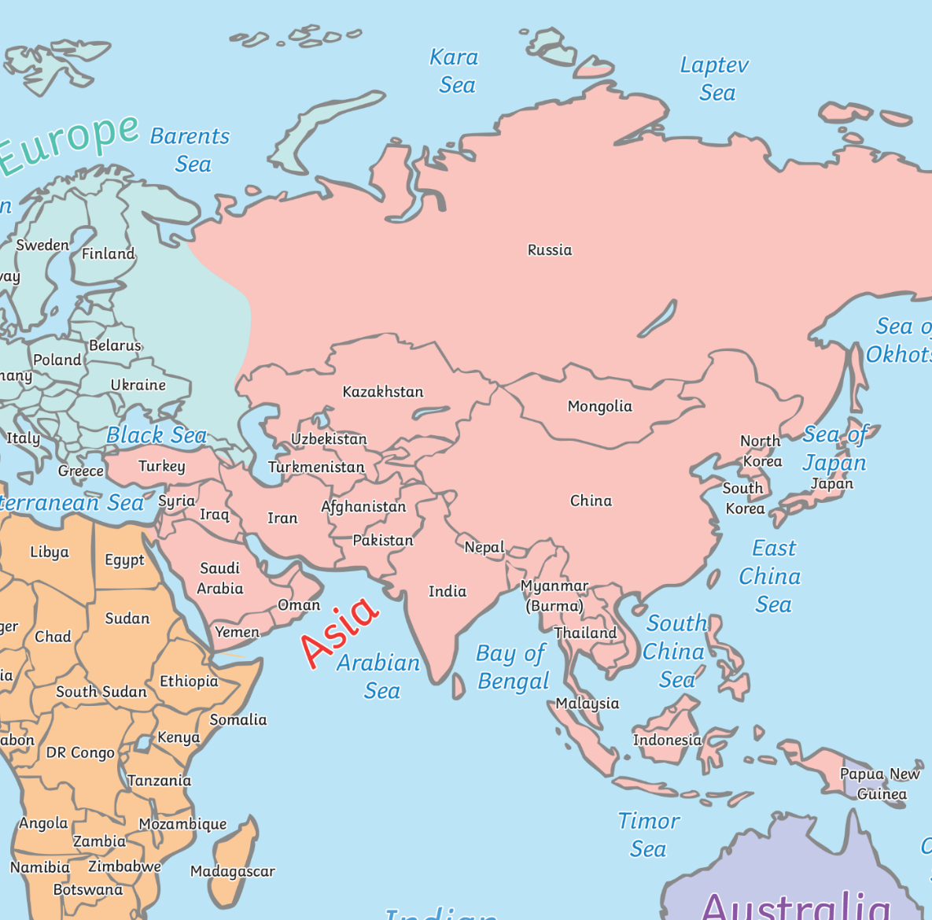
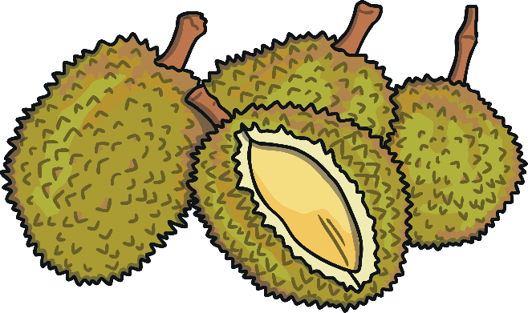
Where Is Your Fruit From?
Amazing Fact
The durian fruit grows in countries such as Malaysia, Thailand and Indonesia in Southeast Asia.

Slide 3
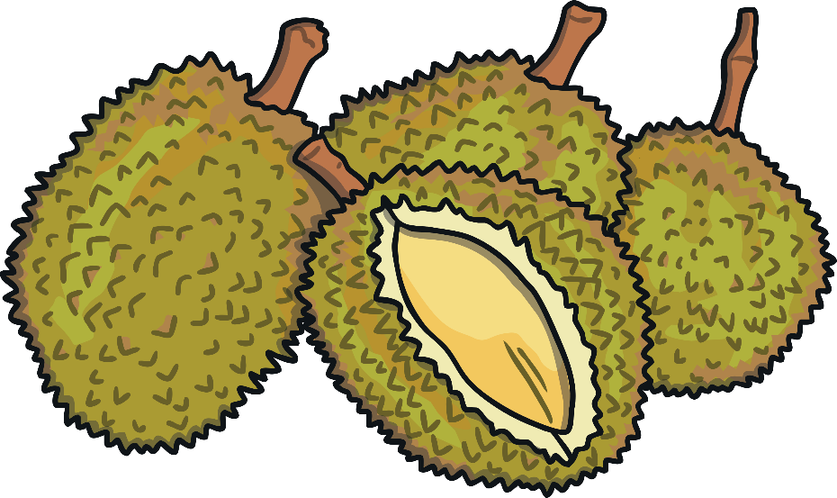


Where Is Your Fruit From?
It is sometimes called the ‘King of Fruits’. It is known for its large size, its thorny skin but most of all, its strong smell.
It has such a potent smell that it is banned from hotels, airports and other public places.

Slide 4
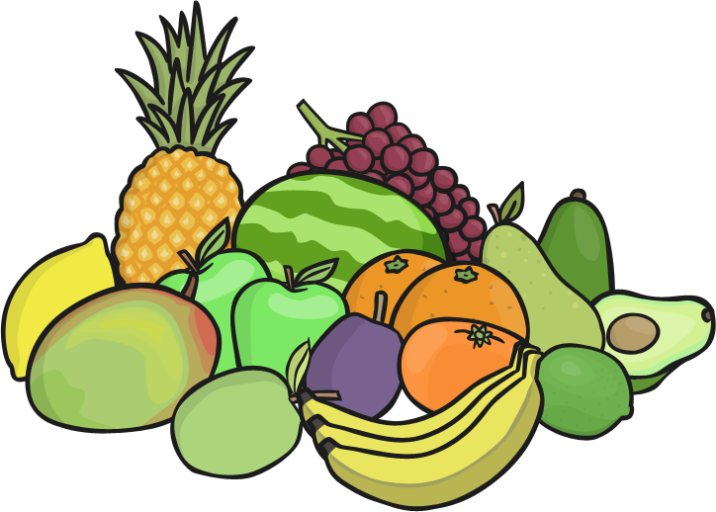
Where Is Your Fruit From?
You could try to find out:
if you can find durian for sale in this country;
which other fruits are native to Southeast Asia;
which other foods are banned and why.

Slide 5
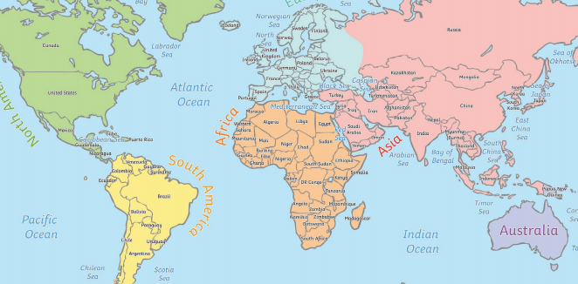
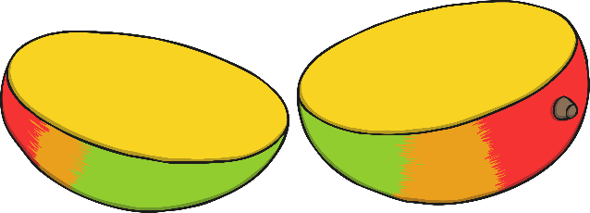
Where Is Your Fruit From?
Amazing Fact
The mango grows in many tropical places all around the world, such as India, Africa, Central America, South America and China.
The mango tree can grow to between 35-40 metres tall. The mango fruit is juicy and has a large stone.

Slide 6


Where Is Your Fruit From?
There are over 500 types of mangoes growing around the world.
It can take between 4 and 5 months for the fruit to ripen after it has flowered.

Slide 7
Where Is Your Fruit From?
You could try to find out:
which other countries grow mangoes;
where the world’s biggest mango was grown.

Slide 8
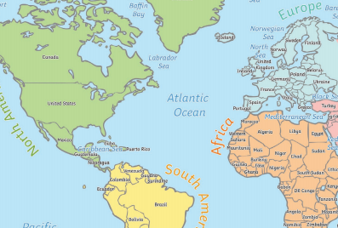
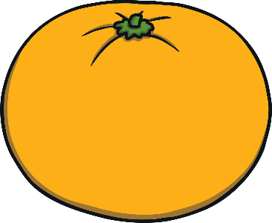
Where Is Your Fruit From?
Amazing Fact
The tangerine was the name of the fruit that first came from Tangier in Morocco.
Tangerines grow in many places around the world including Central America and Europe.

Slide 9


Where Is Your Fruit From?
Tangerines are part of the citrus family. Other fruits in this group are oranges, satsumas and mandarins.
They are smaller and sweeter than oranges with thin peel that is easy to take off.

Slide 10
Where Is Your Fruit From?
You could try to find out:
which other fruits are part of the citrus family.

Slide 11


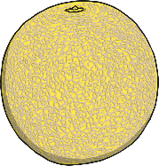


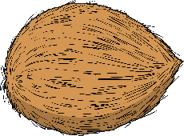

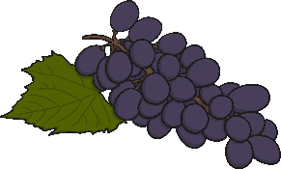

Where Is Your Fruit From?
Research where the following fruits are grown. Then find the countries on the map and match the fruits with the correct country. Using a ruler, draw a line to connect the fruit to the country it is grown in.
bananas
pineapples
melons
oranges
coconut
kiwi
grapefruit
grapes

Slide 12
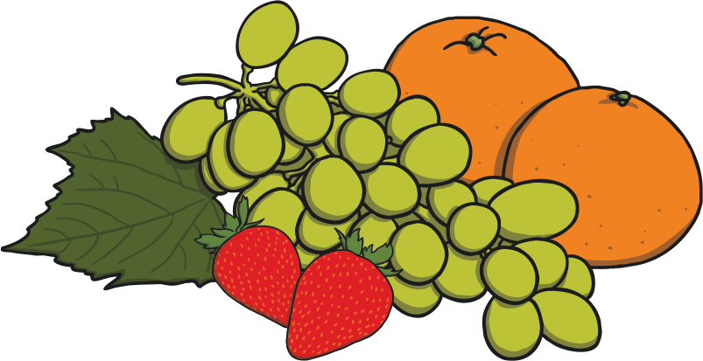
Where Is Your Fruit From?
Bananas – South East Asia/Vietnam
Pineapples – Hawaii
Melons – Thailand
Oranges – Florida, USA
Coconuts – Malaysia
Kiwis – New Zealand
Grapefruits – Barbados
Grapes - Spain

