Slide 1












Primet Primary School
Class Dojo

Slide 2


Class winner of the week..
Reception – Ali & Hafsa
Year 1 – Freddie
Year 2 – Dylan
Year 3 – Abia, Eliza, Esha’al & Louis
Year 4 – Aliza
Year 5 – Zoya
Year 6 – Patrick

Slide 3
Year group winner..
Well done Year 4 !!!!!!!!!!!!!!

Slide 4
House team of the week!
Well done Brilliant Badgers!!!!!!!!

Slide 5
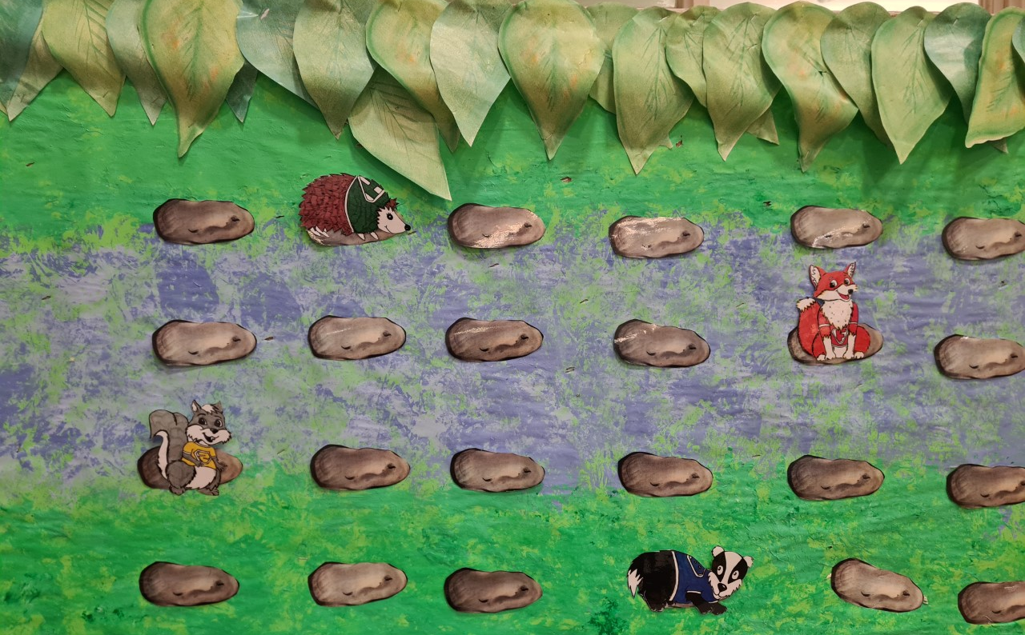
House points display board
There is only 2 more weeks left to get dojos for your house! It looks like it could go either way between badgers and foxes….

