Slide 1












Primet Primary School
Class Dojo

Slide 2


Class winner of the week..
Reception – Hafsa
Year 1 – Luiza
Year 2 – Emaan
Year 3 – Khloe
Year 4 – Elise
Year 5 – All children
Year 6 – Fatima

Slide 3
Well done Year 3 !!!!!!!!!!!!!!

Slide 4
House team of the week!
Well done Fantastic Foxes!!!!!

Slide 5



It means that Foxes – yes, you Fantastic Foxes are our winners this term!
Stay tuned to find out about your prize…
Do you know what this means?!?!

Slide 6
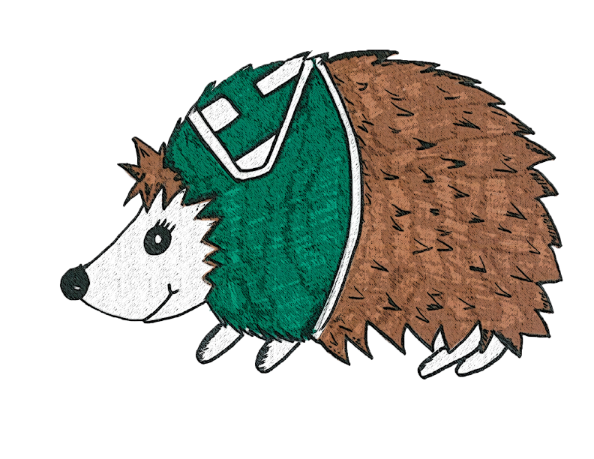


OVERALL
A total of 21,932 dojos have been given out this term! Well done to everyone at Primet Primary School!

