Slide 1


Slide 2


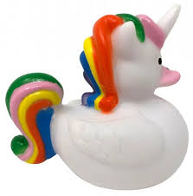
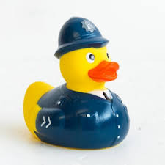
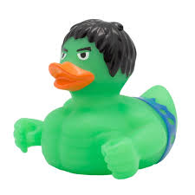
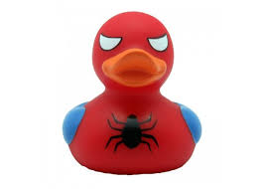



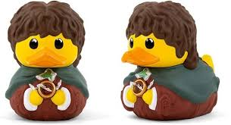
When you have completed your design, please take a picture and email to missokeefe@primet.lancs.sch.uk. Any ducks we receive will be displayed around school for Children in Need.
I have included an outline of a duck in your home pack.

Slide 3
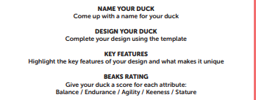

Slide 4


