Slide 1

ROBOTS

Slide 2


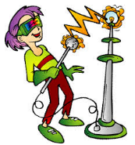

Slide 3

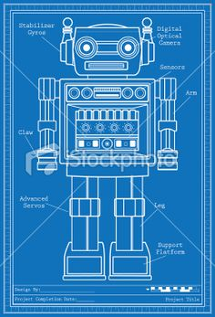

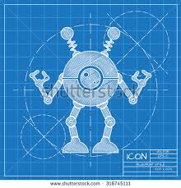
Before inventors start making their inventions they have to first draw and design their model. They will hardly ever use their first drawing and will change their ideas a number of times on how they want their model to look and what materials they want to use to create their sculpture.

Slide 4

What shapes can you see?

Slide 5

2d Shapes
A shape that only has two dimensions (such as width and height) and no thickness. Squares, Circles, Triangles, etc.are two dimensional objects.

Slide 6
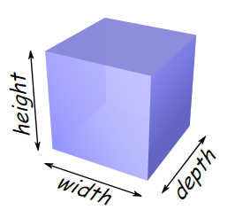
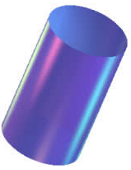


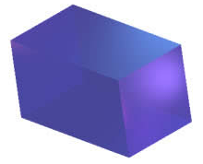
3D Shapes
It is called three-dimensional,
or 3D, because there are
three dimensions: width, depth and height.

Slide 7
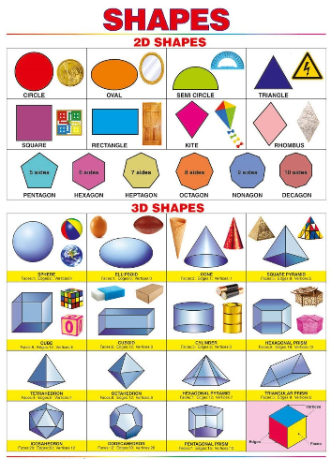
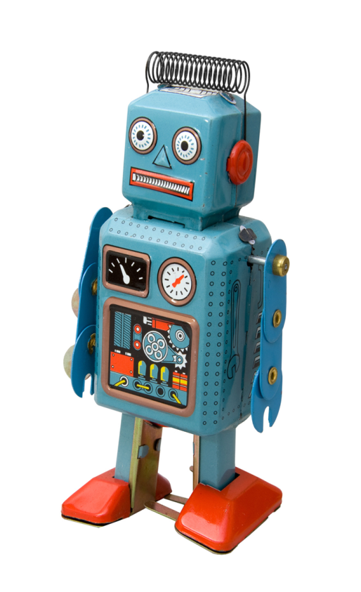

Slide 8

What 3d Shapes can you see?

Slide 9
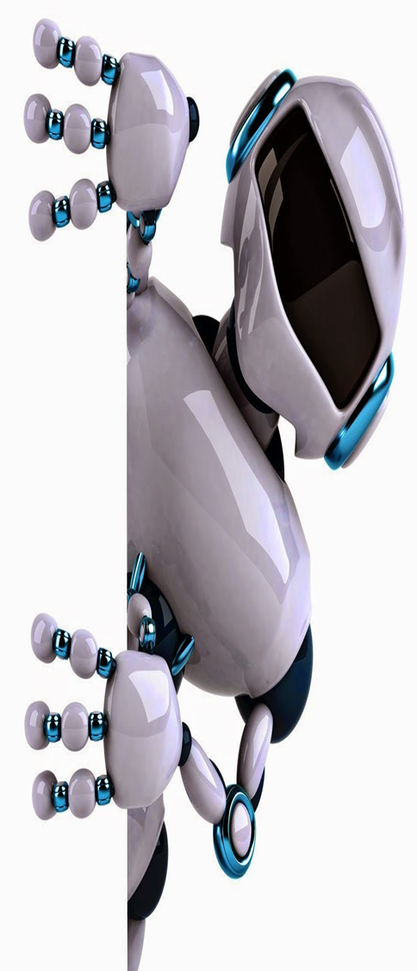
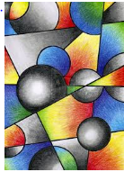

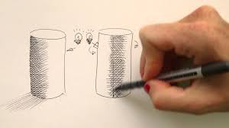
Shapes are all around us. What 2d shapes can you find around your house. Draw around the2d shapes you have found.
Use pastels/pencil crayons pencils etc around the outline and smudge to shade and create shadows.
Watch and learn how to draw 3d shapes and also add depth and shadow.
https://www.youtube.com/watch?v=DCyJ1LMTzxk

Slide 10
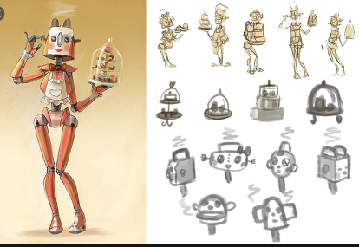
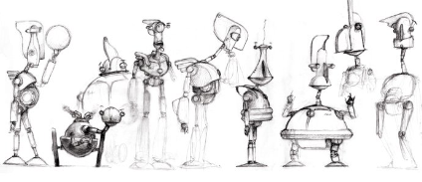
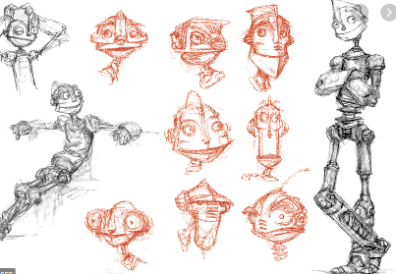

Designing
Inventors will try different designs before completing their final design.
They will think about the size, shape and features they would like their robot to have and draw many illustrations.
Have a go at sketching ideas for your own robot!!!
https://www.youtube.com/watch?v=UHX69T9bqCc
Simple design
https://www.youtube.com/watch?v=P4OzY7ryMJc

Slide 11
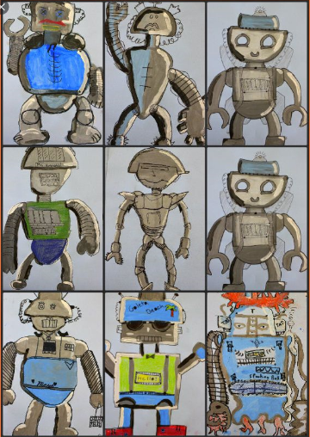

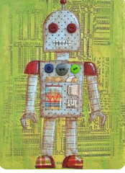

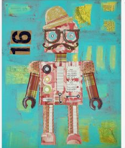
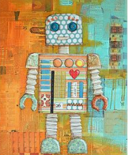
Draw a final design of your robot.

Slide 12

Please send in photos of your robots, including the sketches leading to your final design.missokeefe@primet.lancs.sch.uk.
Next week this topic will link in with 3d sculpture and collage.
Please save any boxes, bottles, lids, magazines etc.

