Slide 1


Heroes

Slide 2
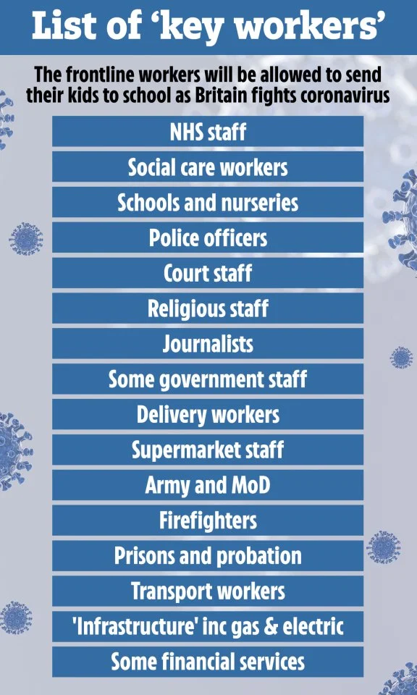
Keyworkers have been classed as heroes , keeping the country going through this pandemic. In a way to thank them for all their hard work, I would like you to design a superhero costume or picture for a keyworker of your choice.
You might have somebody in your family who is a key worker you might wish to draw . Please send your pictures in to missokeefe@primet.lancs.sch.uk.
If you would like to give a keyworker a special mention with your art work, send in the details with your picture and I will display your work on the school website.
I have left a few ideas on the following slides.

Slide 3
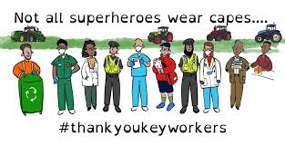
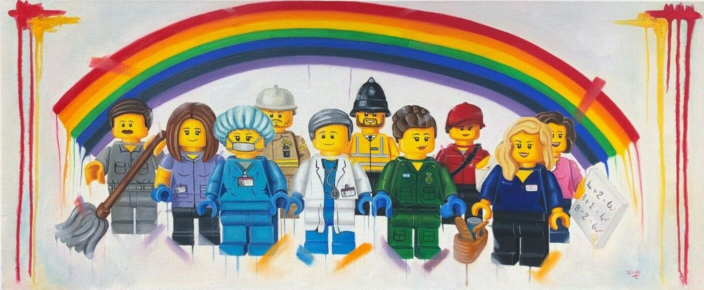
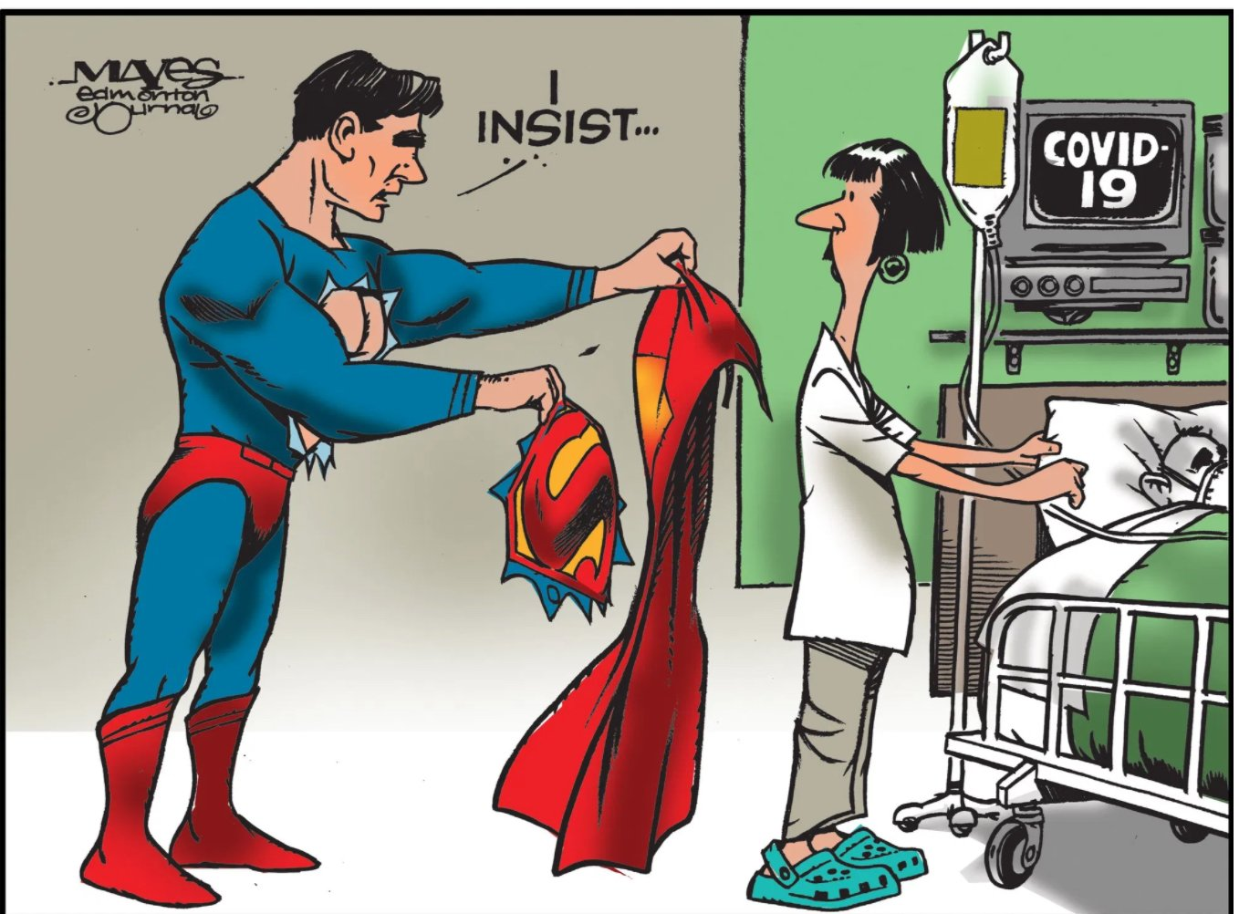
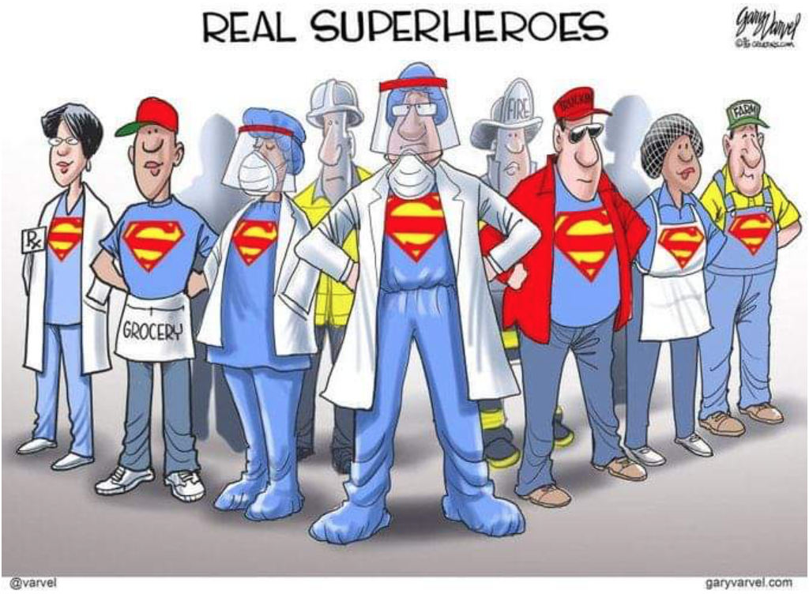

Slide 4
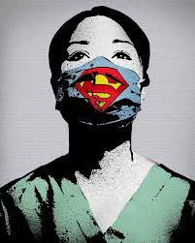
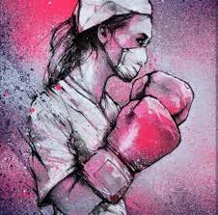
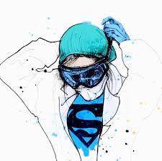

Slide 5
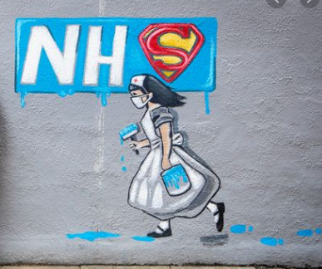
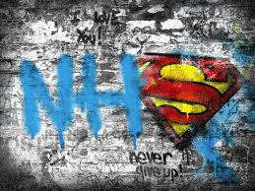
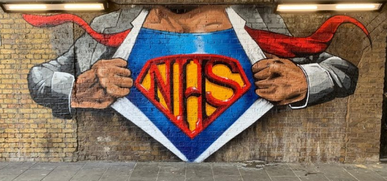

Slide 6
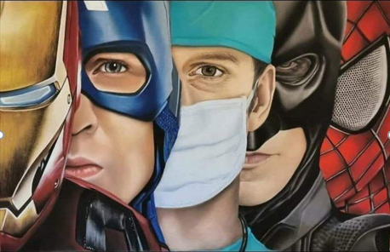
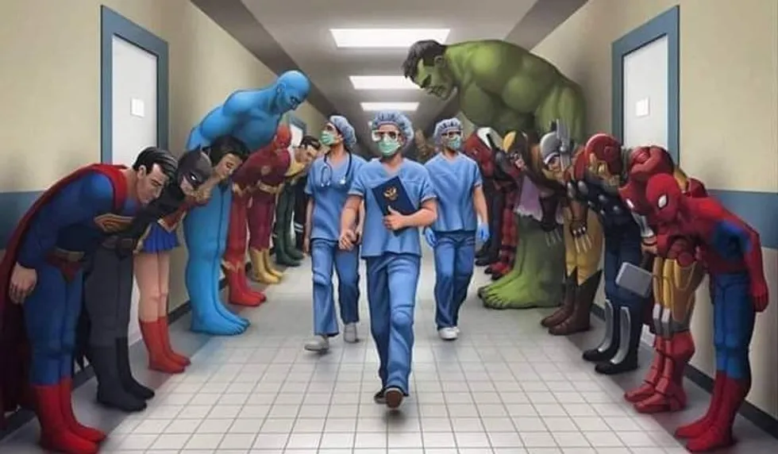


Slide 7
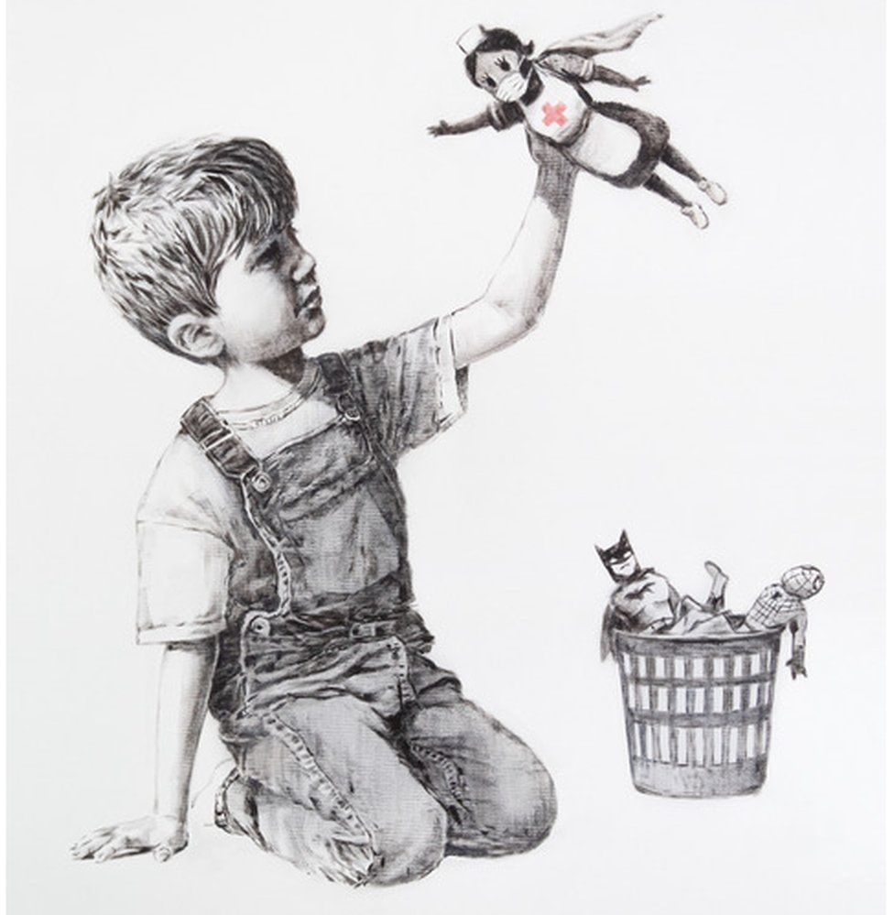
Banksey
https://www.bbc.co.uk/news/entertainment-arts-52556544

