Slide 1

VE Day
Activities

Slide 2
VE Day
Friday 8th May the country will be celebrating VE Day.
I have based this weeks activities around WW2.
Activity 1-Make union Jack flags and bunting to decorate your houses and gardens.
Activity 2-Draw your own spitfire. You could also draw a spitfire with your own design on.
Activity 3- Draw a WW2 soldier. This could be black and white drawing or use pencil crayons or paint.
Activity 4= Solider silhouette.

Slide 3
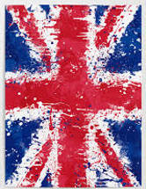
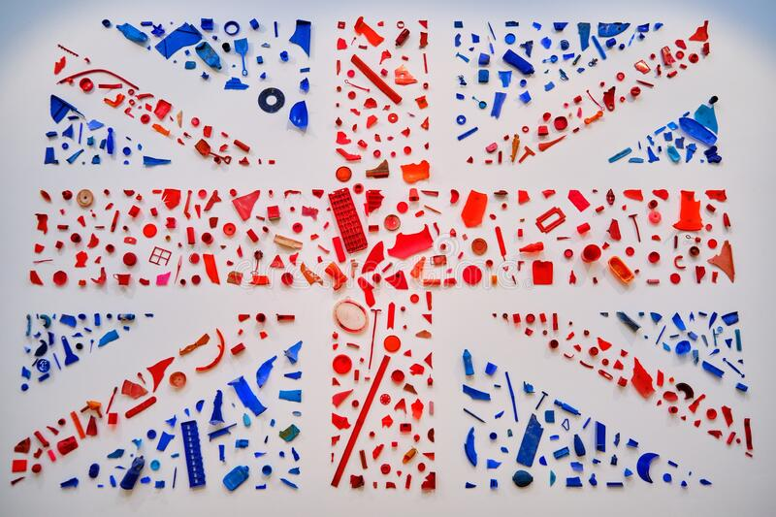


Get messy with paint.
Make Union Jack bunting to decorate your house.
Use different objects to print with paint.
Lego, cereal, pasta, pen lids… etc
Union Jack
https://www.youtube.com/watch?v=9dUTzBcbboM

Slide 4
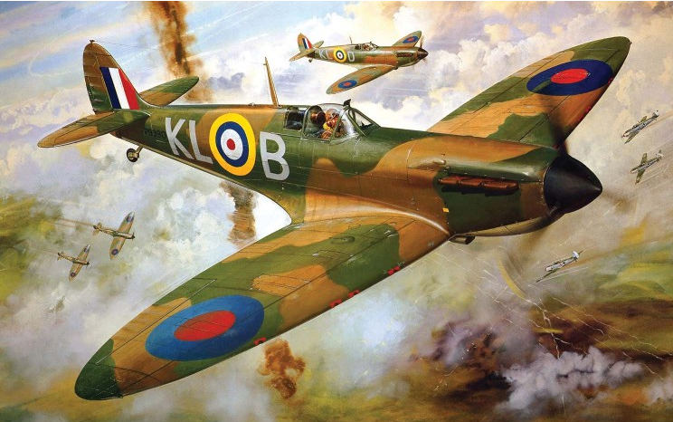
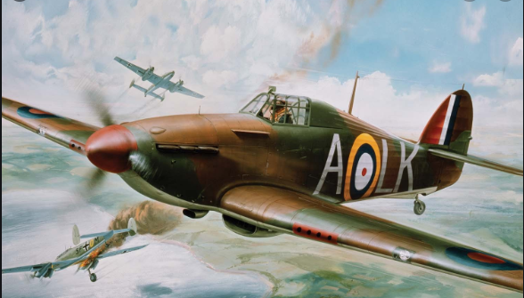
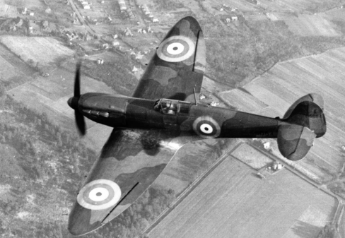
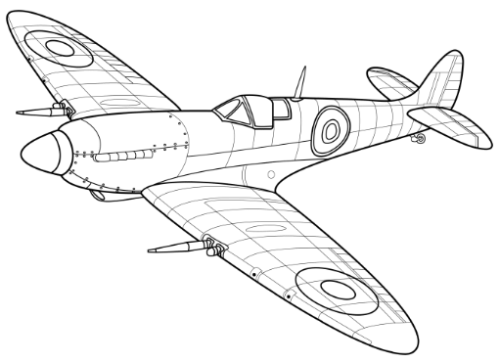
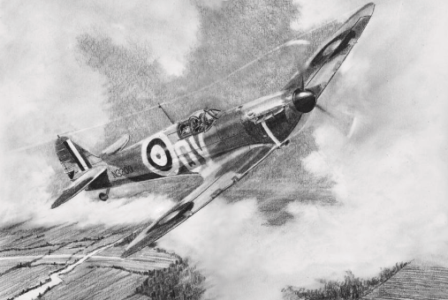
Spitfire
https://www.youtube.com/watch?v=-MFsvjGpASQ

Slide 5
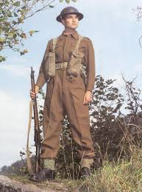
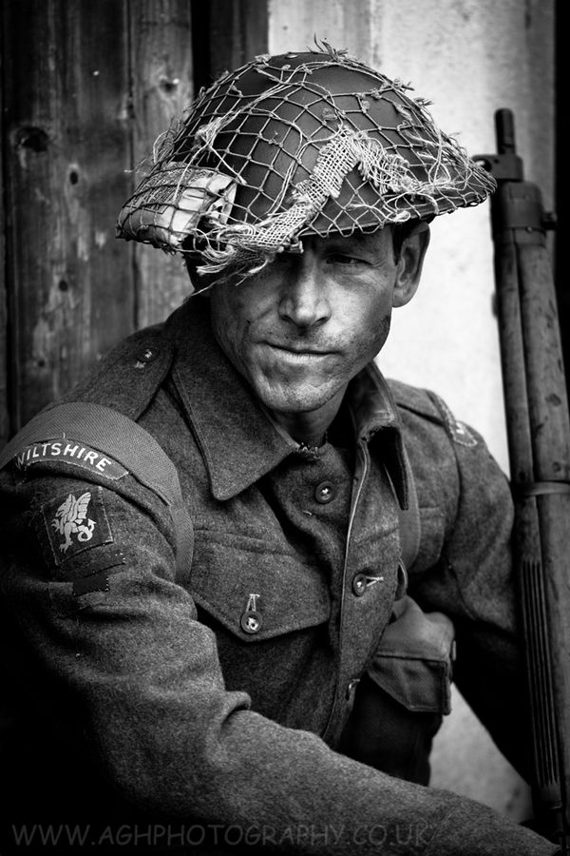
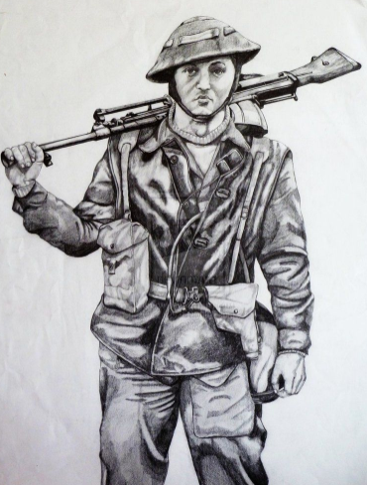
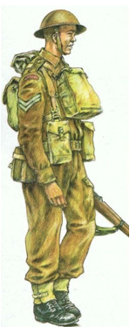
Soldier
https://www.youtube.com/watch?v=1srT2lngzl4

Slide 6
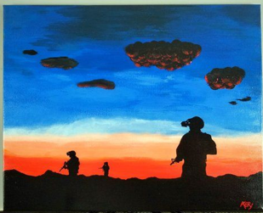
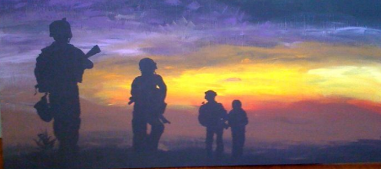
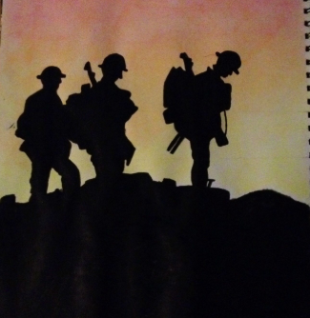
Create a sunset background using paints, crayons, collage, pencil crayons etc.
Draw the outline of your soldiers and colour/paint them black to create a silhouette of the soldiers.
You could also draw your soldiers on a separate piece of paper and place them on your background.

