Slide 1
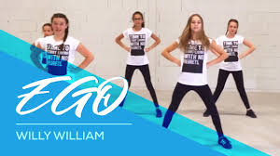
ZUMBA!
ONLINE ZUMBA
https://www.youtube.com/watch?v=v4RvOm40t6E
The dance teachers for the children are from UK’S Zumba Dance Party Academy and hold degrees from various top of the range performing arts universities.
The classes are a combination of fitness, dance and choreography training sessions all mixed into one!

