Slide 1




Fly
your
Flag

Slide 2


Fly Your Flag Day aims to bring together our local and national community to stand together in solidarity. Celebrate all of the amazing people, families, friends, neighbours, key workers and acts of kindness in this challenging time.
Please support and get involved by decorating a flag and showcasing it in your home, window or garden on
Monday 4th May 2020!

Slide 3
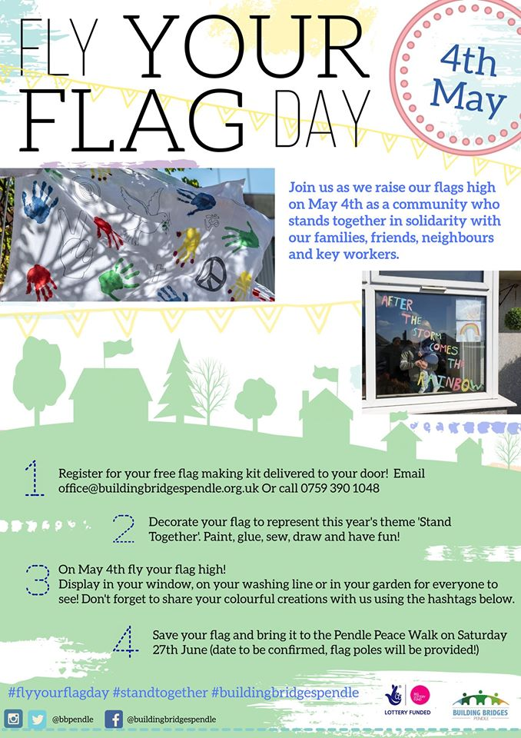

Slide 4

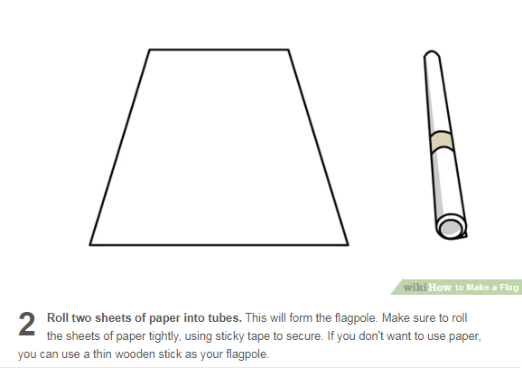
Make a paper flag

Slide 5
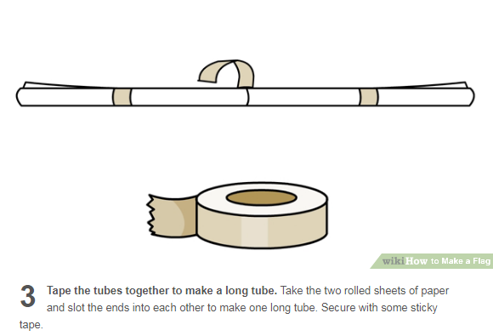
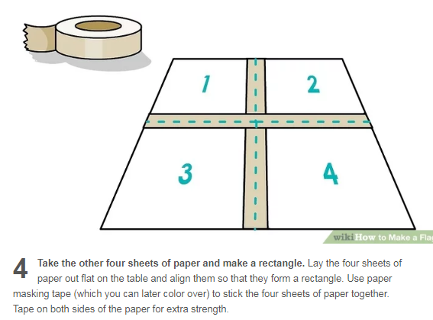

Slide 6
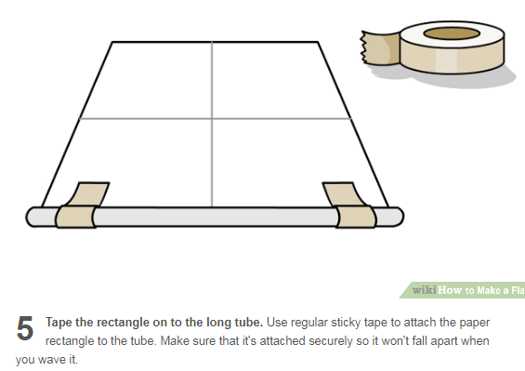
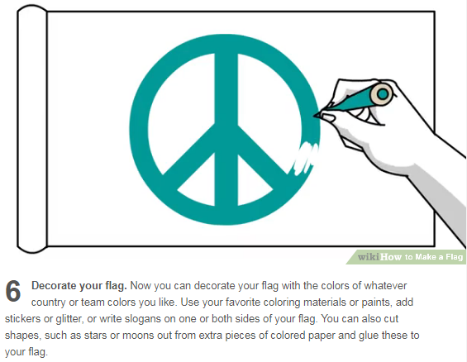

Slide 7
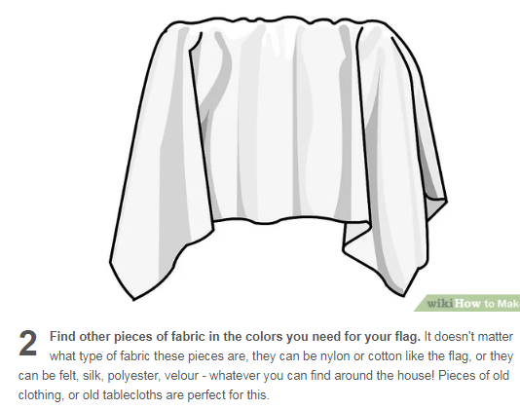
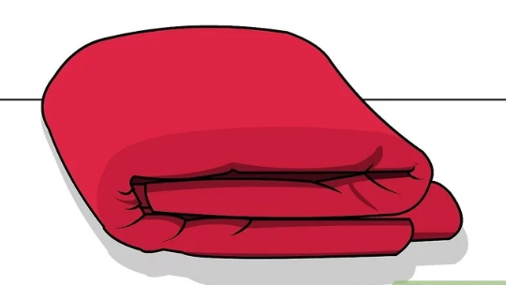
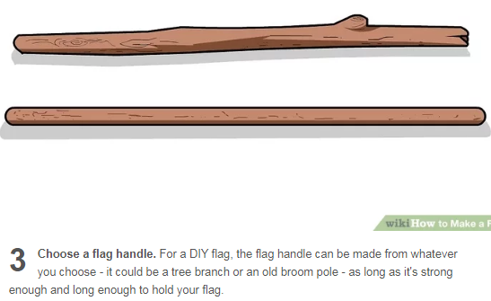
Make a cloth flag

Slide 8
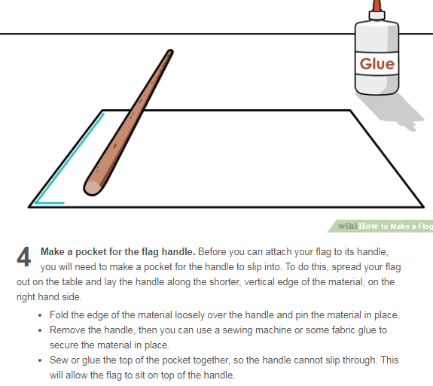
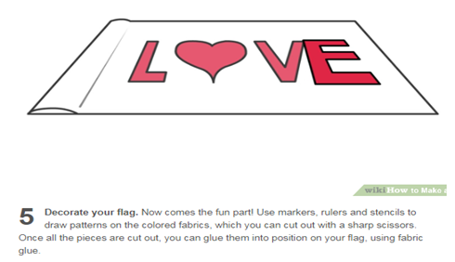

Slide 9
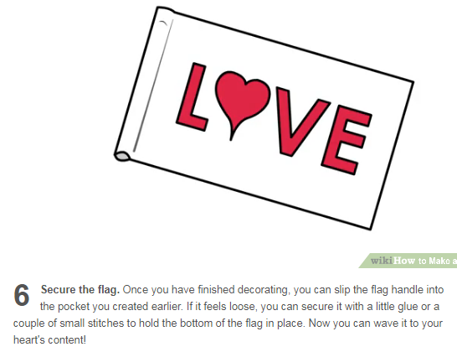

Slide 10
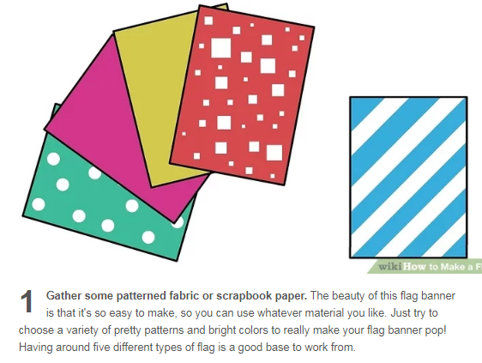
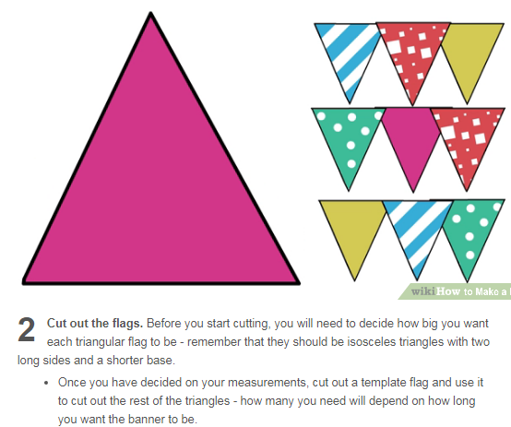
Make bunting

Slide 11
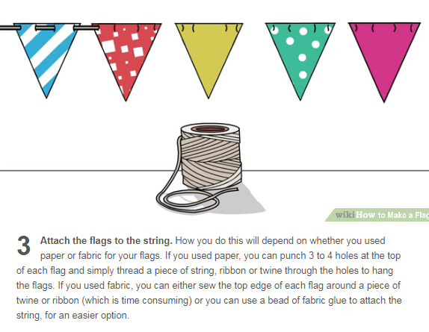
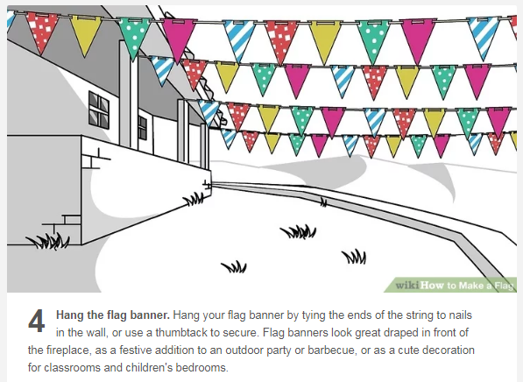

Slide 12
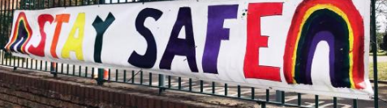



Slide 13
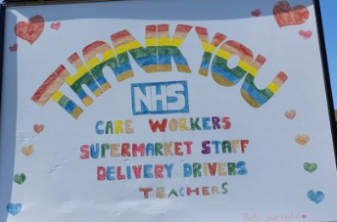



Slide 14



Symbols for peace and love

Slide 15
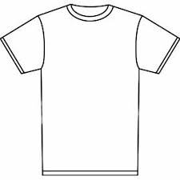

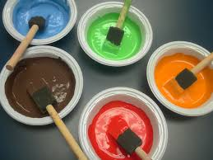
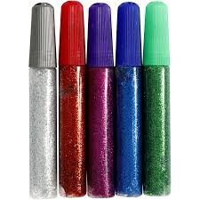

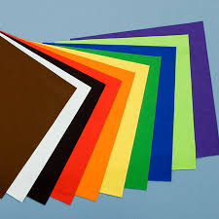
Materials.
The flags can be made from paper, card, material (old sheets, pillow cases, t-shirts etc).
Poster paints and felts will work best on any sort of fabric.

Slide 16
Please email photos to:
missokeefe@primet.lancs.sch.uk

