Slide 1
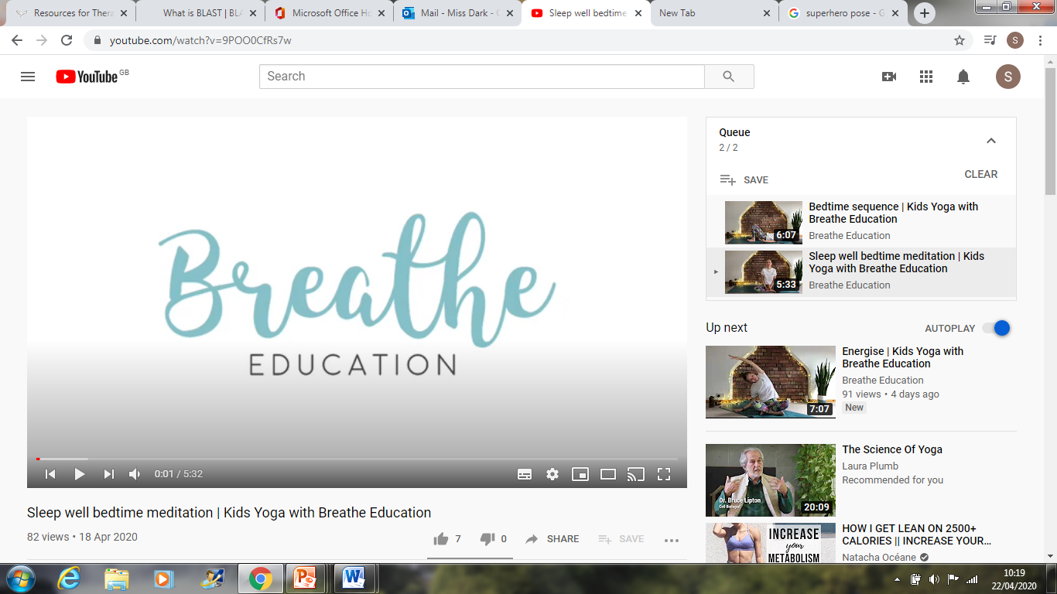
Yoga
I’m Sarah from Breathe Education and I work with schools across Lancashire delivering yoga and mindfulness to children and teachers.
I wanted to share with you some free short videos which I think will be helpful for your families to practice at home during this time. It can certainly be an anxious time for both children and their parents and I feel that now more than ever, yoga and mindfulness practices are important to look after our own well-being.
Breathe Education is an excellent you tube channel follow this link to join in:
https://www.youtube.com/channel/UCvzkeC7NJirFn1vqGSut-Qw
Thank you Sarah from Primet Primary

