Slide 1



Primets superhero comic!!

Slide 2


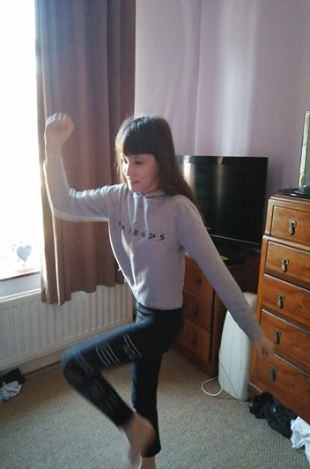
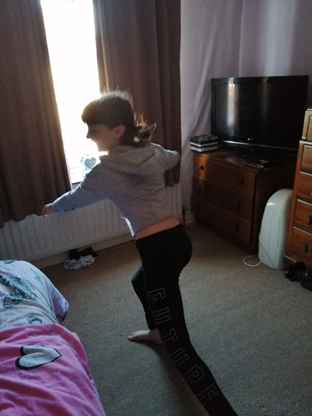
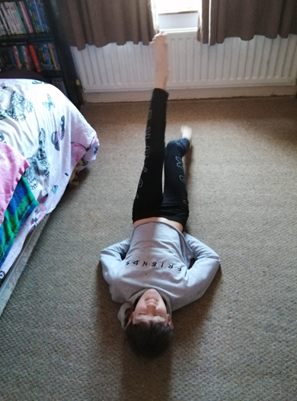
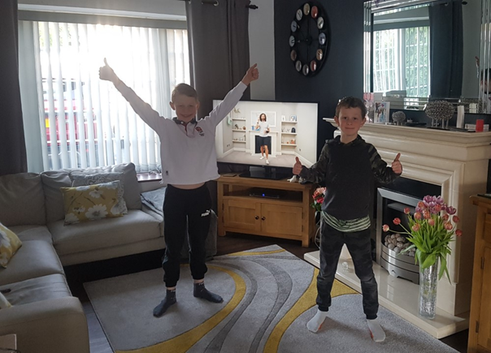
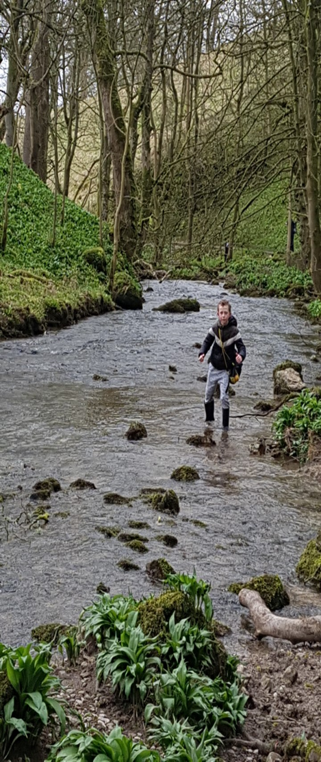
Elouise is pumping iron with Joe Wicks!
Go Orion & Josh to infinity!!!!!
Indiana Josh!

Slide 3



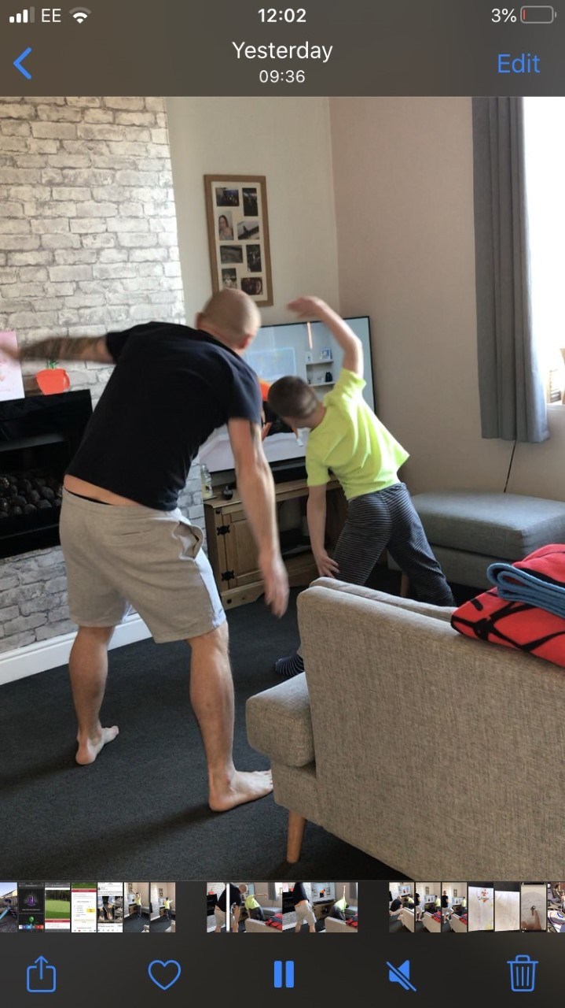
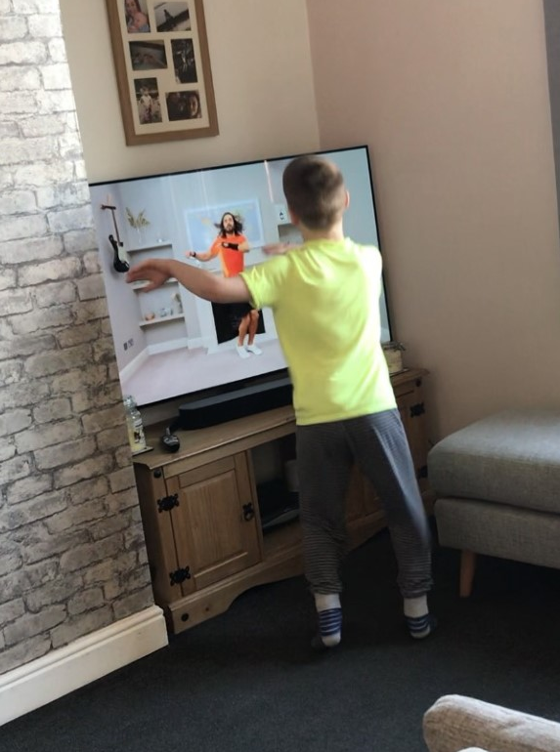
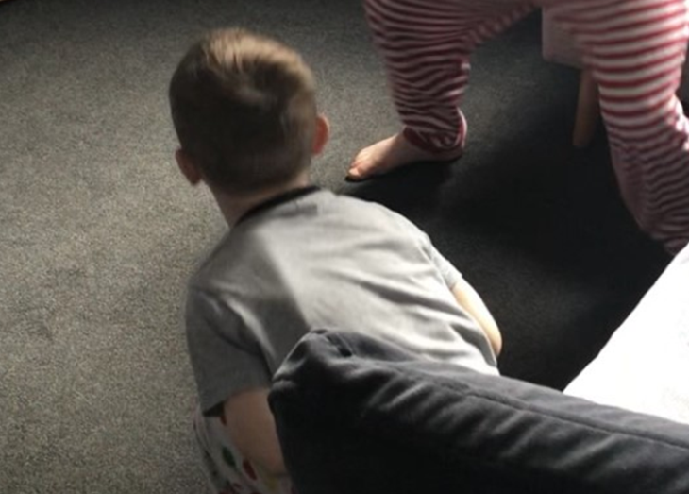
MISSION: TO COMPLETE SUPERSAMS TASKS!
This is a job for Captain Cole & Superhero brother Codey !
Great Job Superheros!

Slide 4

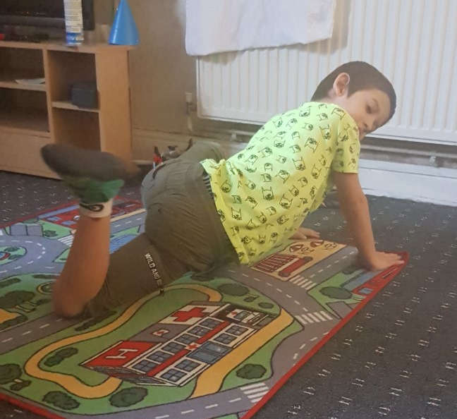
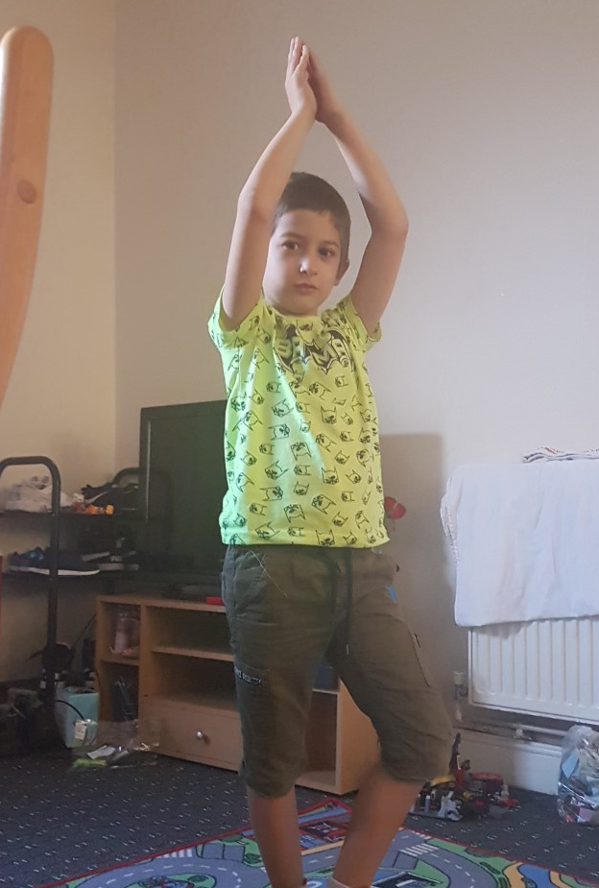
TO INFINITY MARIUS!
Marius is ready to explore space with his yoga poses!

Slide 5


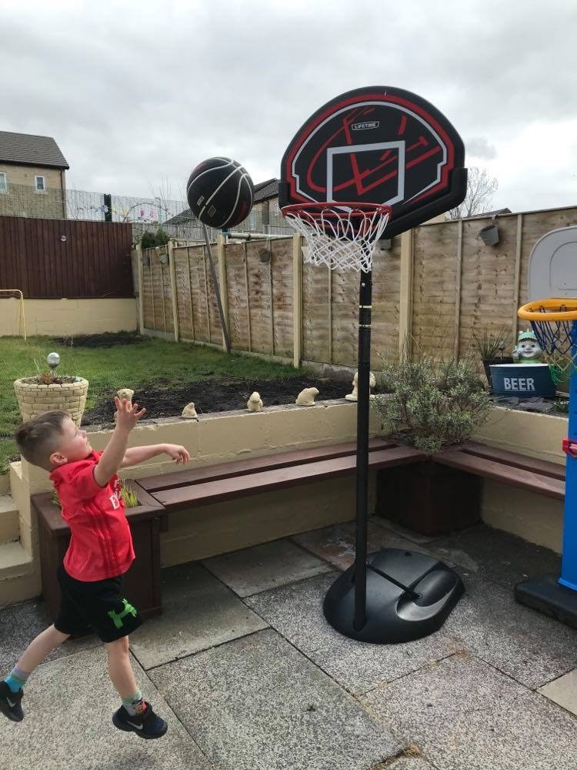
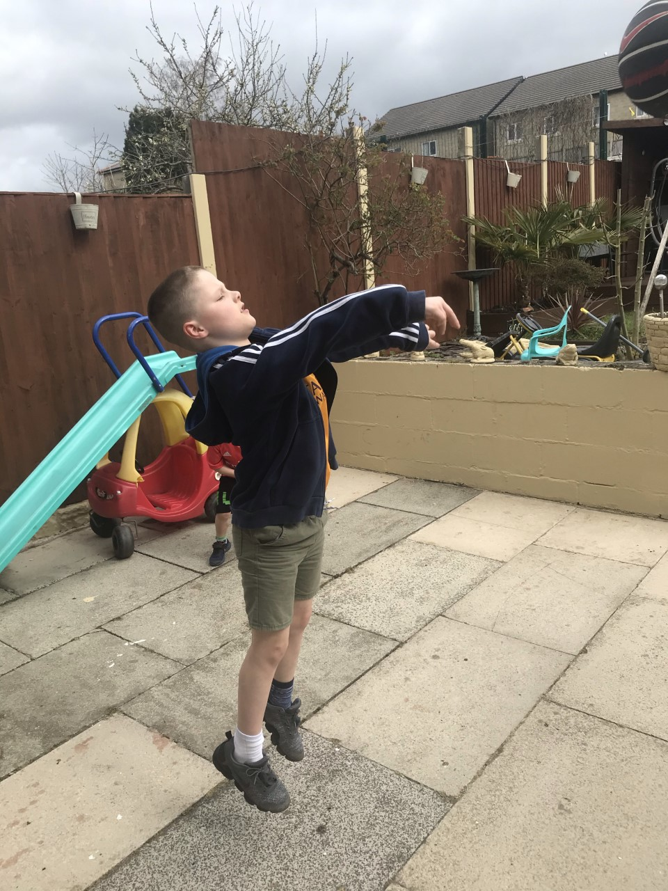
Captain Cole & Superhero Codey shoot for the galaxies!!!!

