Slide 1
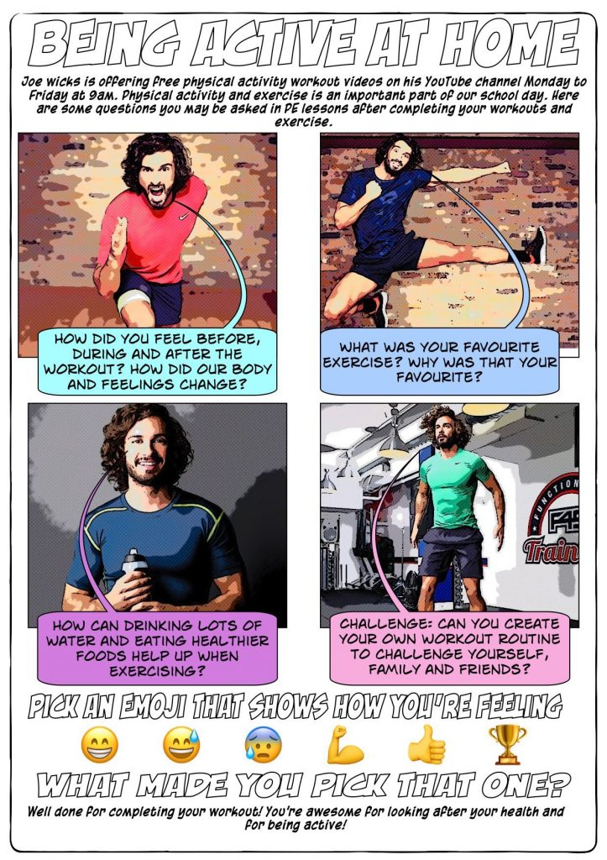
DAILY P.E WORKOUTS!
Hello Primet!
I would like you to challenge yourself and complete Joe Wicks P.E Workout every day!
Follow this link: https://www.youtube.com/user/thebodycoach1

Slide 2


Slide 3
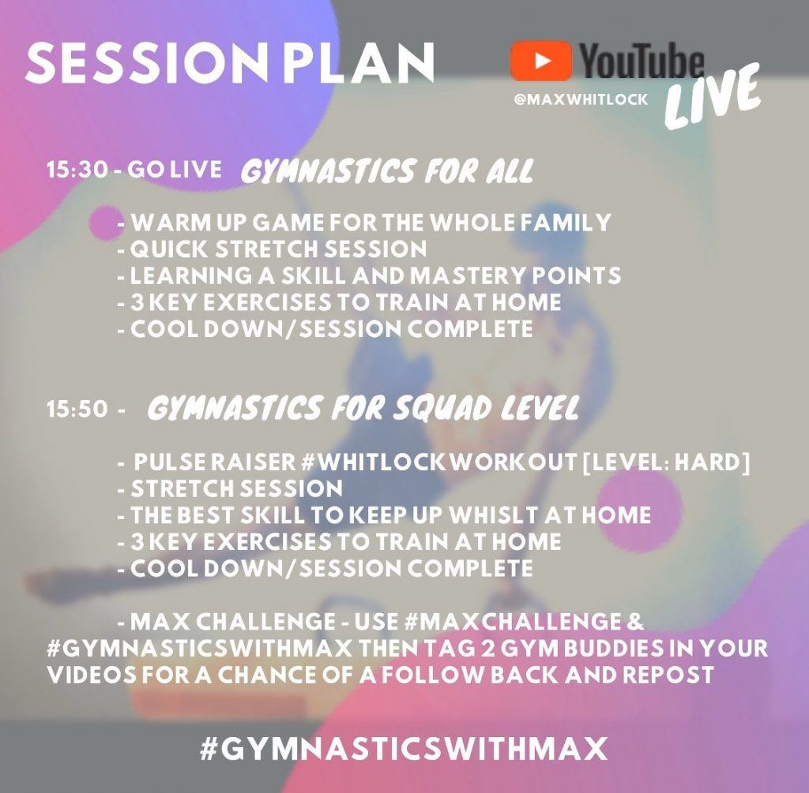

Slide 4


Slide 5
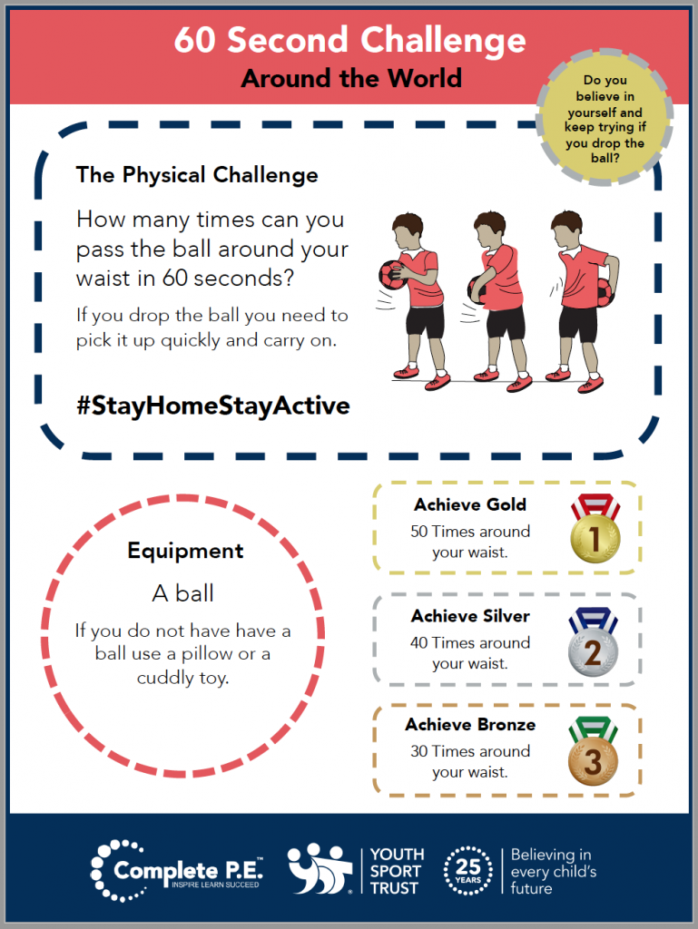
DAILY P.E WORKOUTS!

Slide 6
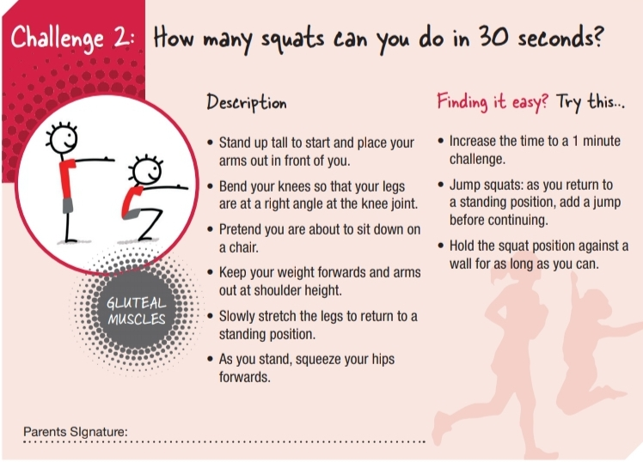

Slide 7
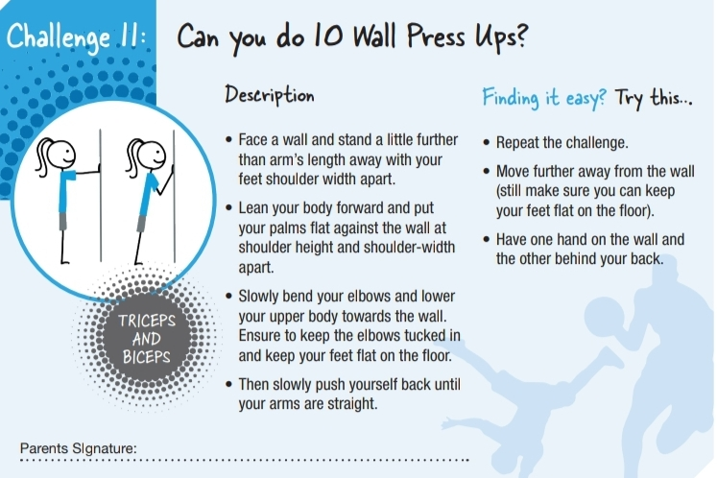

Slide 8

Dance class with Otis Mabuse:
https://www.youtube.com/watch?v=0w3vSt4sEuc

Slide 9
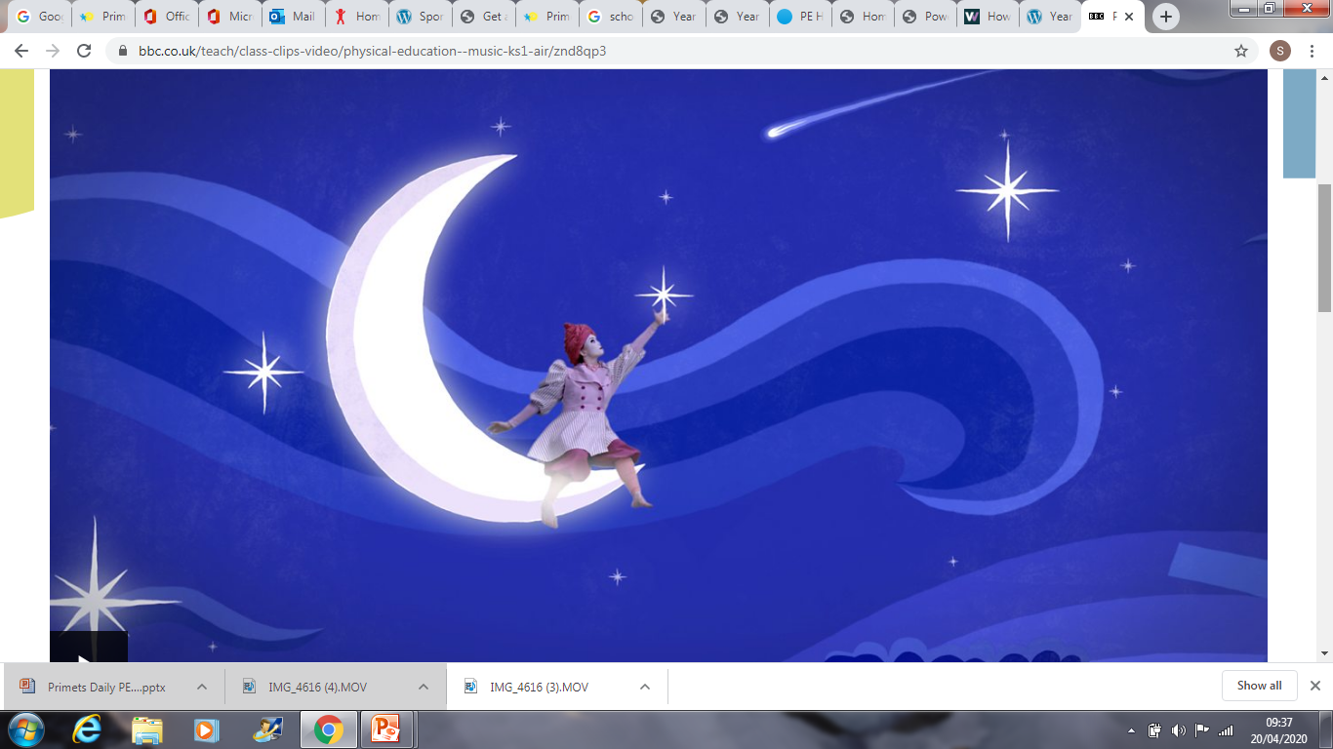
Hello guys!
Try BBC Supermovers Dance- follow the dancers moves
Air Dance
https://www.bbc.co.uk/teach/class-clips-video/physical-education--music-ks1-air/znd8qp3
Earth Dance
https://www.bbc.co.uk/teach/class-clips-video/physical-education--music-ks1-earth/zjvygwx
Fire Dance
https://www.bbc.co.uk/teach/class-clips-video/physical-education--music-ks1-fire/z6crkmn
Water
https://www.bbc.co.uk/teach/class-clips-video/physical-education--music-ks1-water/zbm2t39

Slide 10
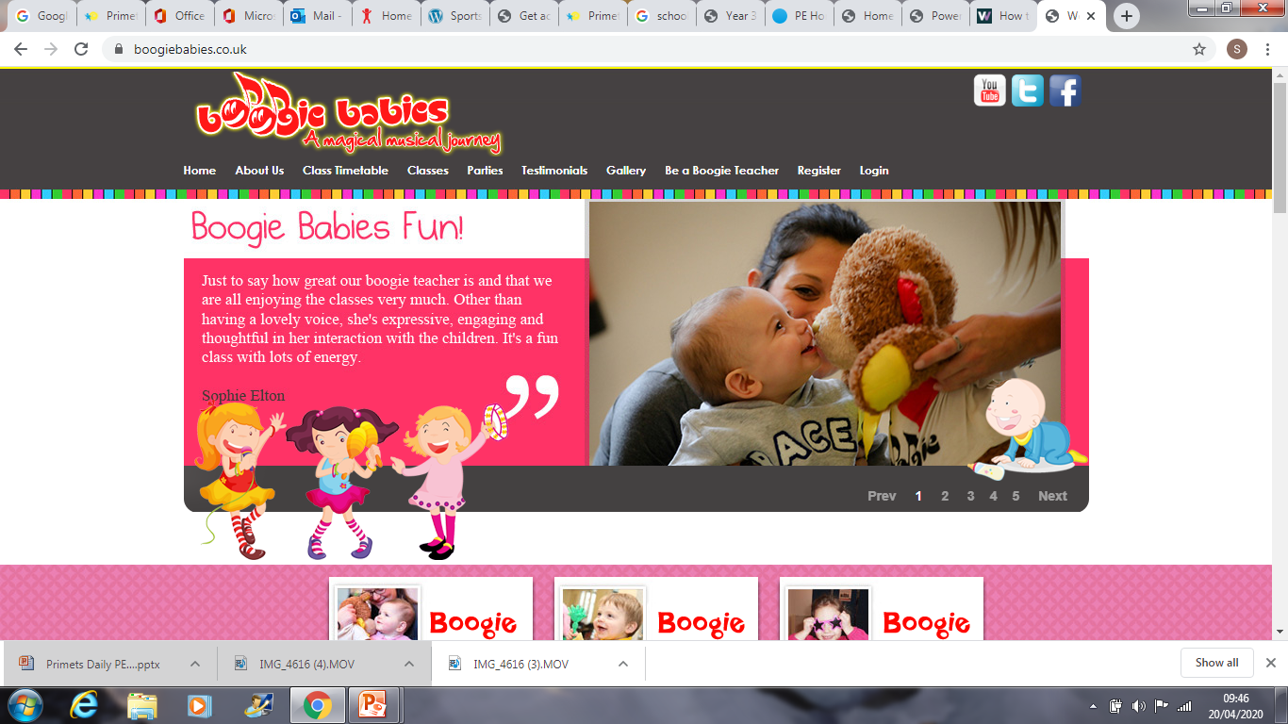
Hey
If you have any baby brothers or sisters you could have a boogie with them follow this link for lots of dance, music and fun!
https://www.boogiebabies.co.uk/
If you would like to send me any photos for the comic
My email is: missdark@primet.lancs.sch.uk

Slide 11

Andys Wild Workouts!
Andy travels the world to amazing places and learns to move like the animals he meets on his wild adventure. Can you adventure with Andy and
learn some animal moves of your own?
Follow the link:
https://www.bbc.co.uk/iplayer/episode/p06tmn51/andys-wild-workouts-series-1-1-under-the-sea

