Slide 1


Hey children!
I hope you have been exercising over the Easter period!
Lancashire School Games have an amazing timetable for you to follow.
Once you have reached the challenges section send me your scores and we will give out certificates for the highest scores!
If your in key stage 1 follow this link:
https://lancashireschoolgames.co.uk/year-1-2-spar-lancashire-school-games-activity-timetable/
If your in key stage 2 follow this link:
https://lancashireschoolgames.co.uk/year-3-6-spar-lancashire-school-games-activity-timetable/
My email is: missdark@primet.lancs.sch.uk

Slide 2
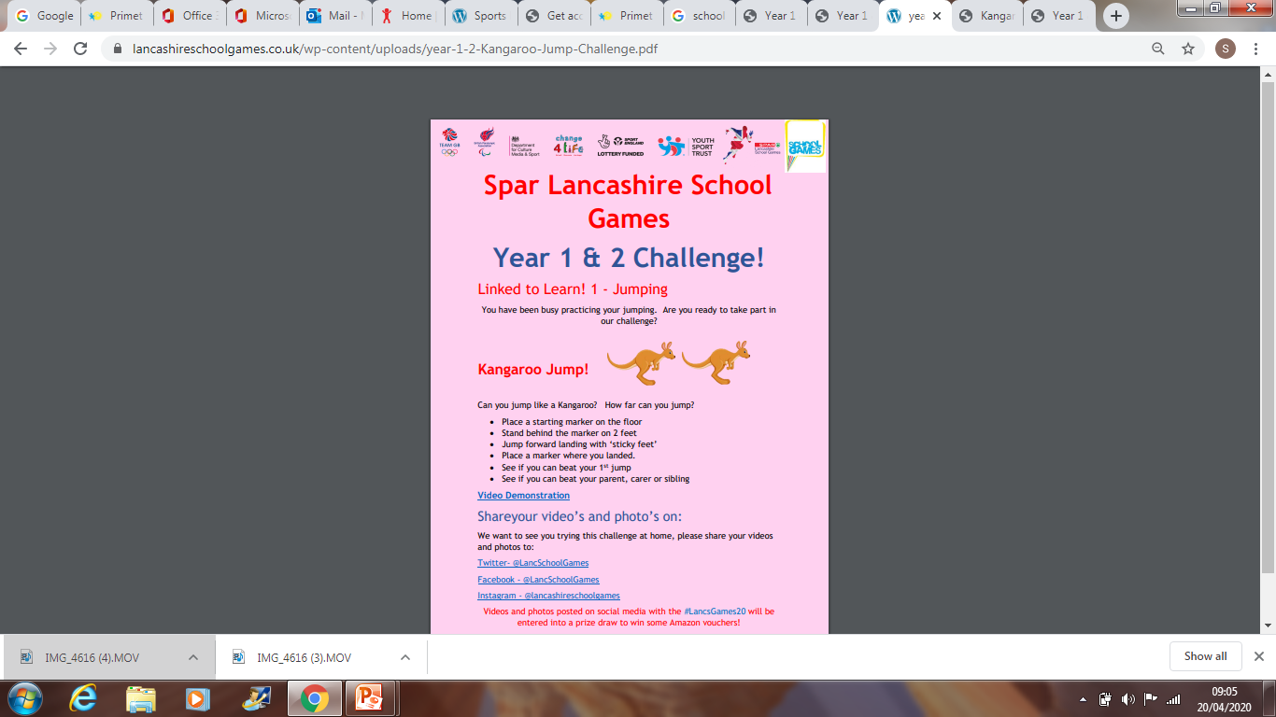
Hello send me your results to : missdark@primet.lancs.sch.uk
I will upload your photos to the comic!
Good Luck key stage 1!

Slide 3
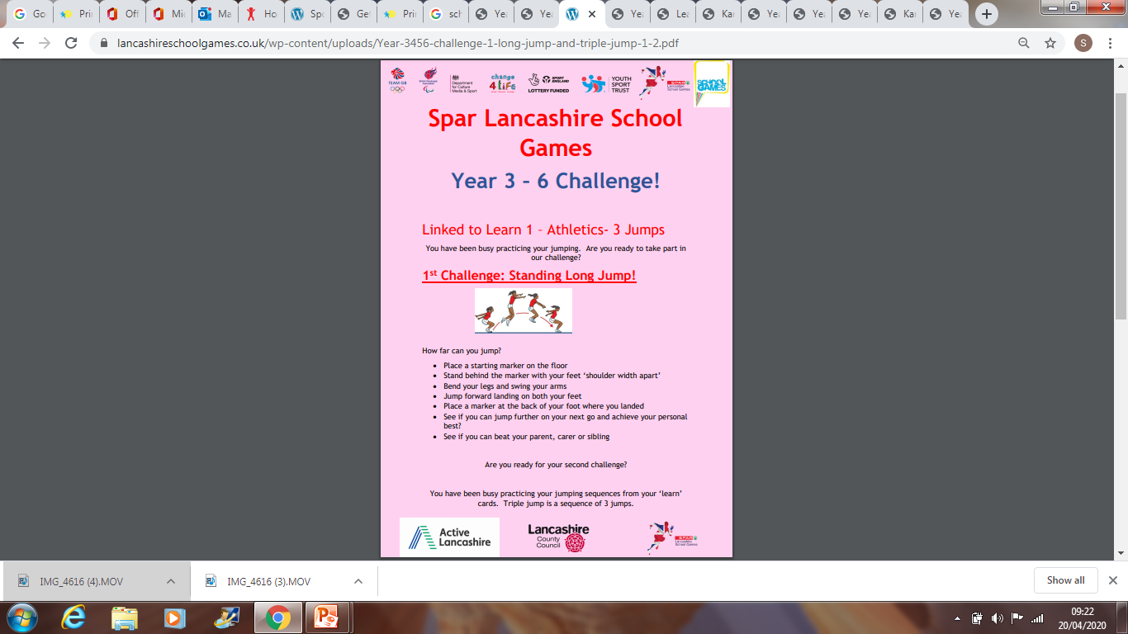
Hello send me your results to : missdark@primet.lancs.sch.uk
I will upload your photos to the comic!
Good Luck key stage 2!

